Slide 1
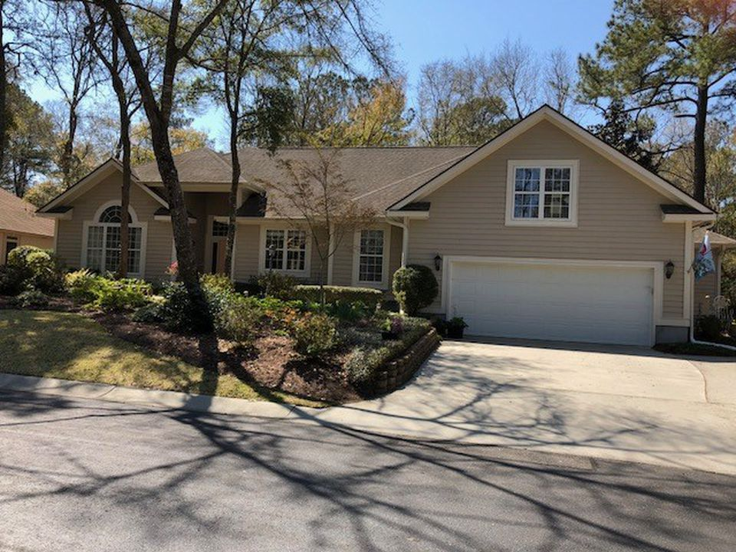
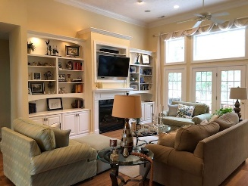
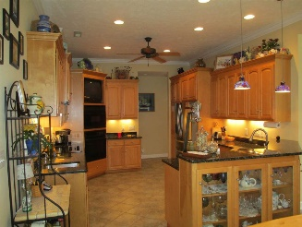
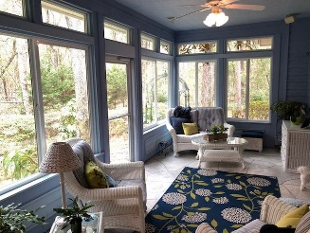
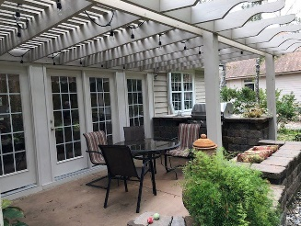
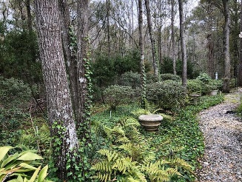
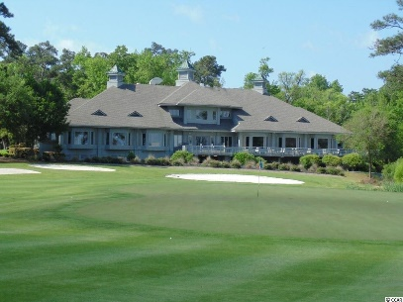
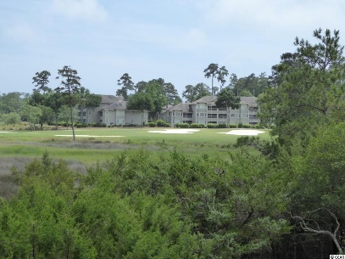
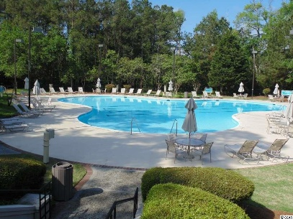
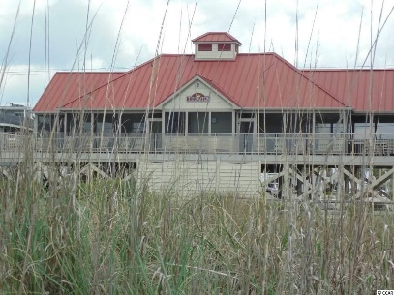
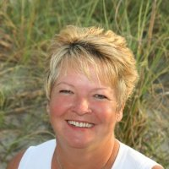

Agent/Broker Open House
Monday 4/9 from 3-4
1214 Pine Valley Rd
North Myrtle Beach, SC 29582
MLS# 1806431 ~ $439,000
Tidewater Golf Plantation, Pristine home move in ready. This is a must see home, 3/4 bedroom with 2 and 1/2 baths. Beautiful landscape and nestled in among trees. Featuring beautiful custom maple cabinets in the large eat in kitchen, wet bar and granite counter tops. Great room, custom built-ins, marble fireplace, with lighting on the top of cabinets, featuring 14 ft. ceilings. Formal dining room/or office. Open floor plan with hardwood floors through-out. Tray ceilings in Master bedroom, which opens in to the Carolina room. Double walk in closets, custom cabinets in master bath with double sink. Split floor plan with bonus room and lots of storage. All bathrooms have custom cabinets. Plenty of storage, central vac. and Rinnal hot water system. Tidewater offers golf, pools, tennis courts, fitness center, restaurant and pro-shop. Tidewater has an ocean front cabana for exclusive use of homeowners. Tidewater is a gated community with 24 hour security.
Donna Fortney 703-624-3517
dofortney@aol.com
Robert Jacoby 843-455-7075
NEW WAY PROPERTIES MYRTLE BEACH

