Slide 1

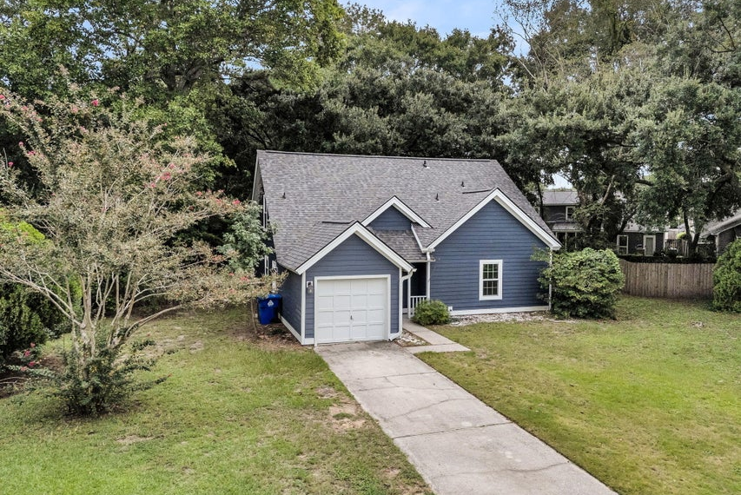
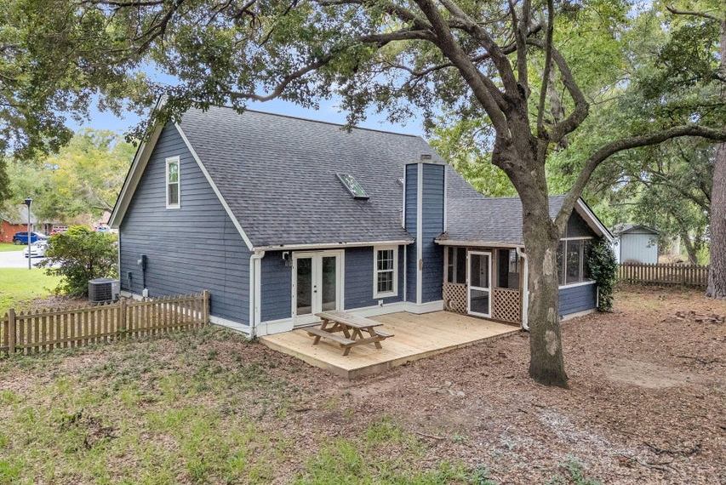
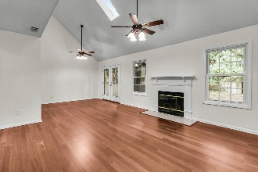
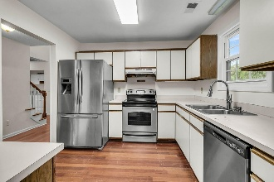
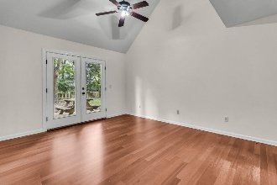
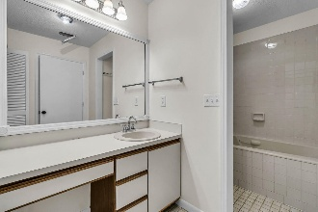
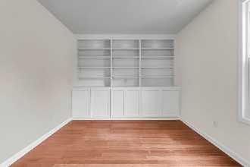

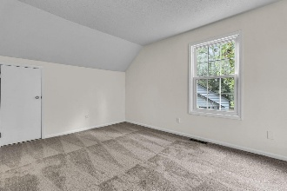
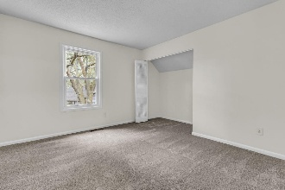
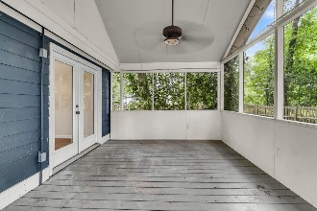
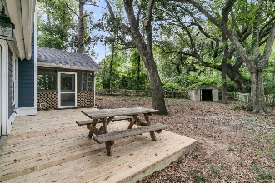
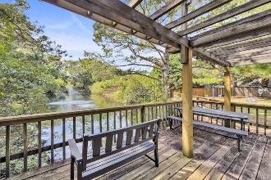
Updated Mt. Pleasant Home
New Roof, Deck & More!
Debbie Cromer
ABR, RSPS, REALTOR, CRS
(843) 437-6342
debbie@debbiecromer.com
www.debbiecromer.com
1214 Canvasback Court
Mallard Lakes | Mount Pleasant, SC 29464 | MLS# 25025045 | $700,000
$30k reduction on this bright & contemporary 4BR/3BA Mt. Pleasant home is ready for your personal touches, w/ major updates already done—new roof, new deck, new carpet, refinished floors, freshly painted interior (2025), HVAC (2023), water heater (2016), skylights (2015), & new cement plank siding, windows & doors (2018). Inside, you'll love the vaulted ceilings w/ skylights, balcony overlook, & cherry hardwoods that bring warmth & light throughout. This home is ready for you to put your personal touches on the kitchen and baths. The kitchen features stainless steel appliances including a new dishwasher, & the floor plan is ideal w/ a primary suite on the main level, a secondary bedroom w/ nearby full bath, plus two more bedrooms & a hall bath upstairs.
Storage is plentiful w/ a spacious walk-in attic, while outside you'll find a one-car garage, room to store a boat, a screened porch leading to the deck for easy entertaining. Tucked on a quiet cul-de-sac backing to woods, this home feels like a retreat yet is just a short bike ride to Sullivan's Island, shops, & restaurants - offering the perfect blend of comfort, convenience & coastal lifestyle. Best of all, flood insurance is not required.
TAKE A VIRTUAL TOUR | PROPERTY WEBSITE
Century 21 Properties Plus | 1090 Park West Blvd; Ste 103 | Mount Pleasant, SC 29466

