Slide 1
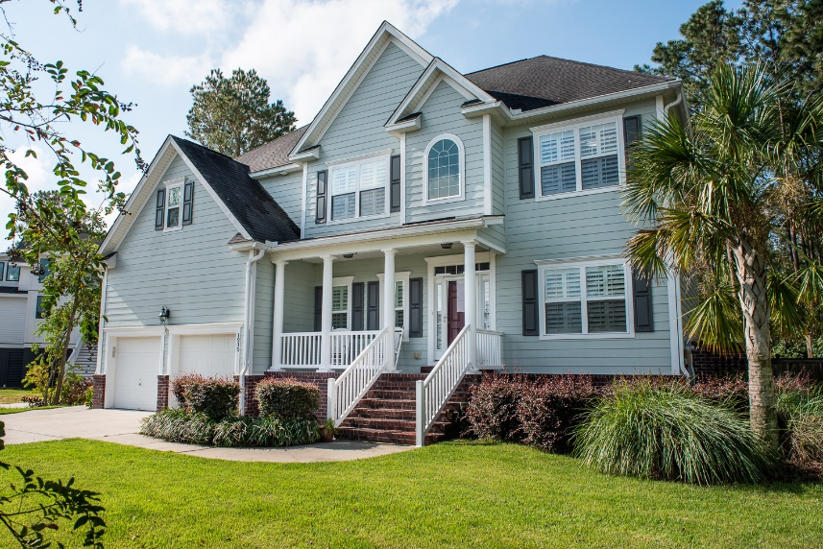
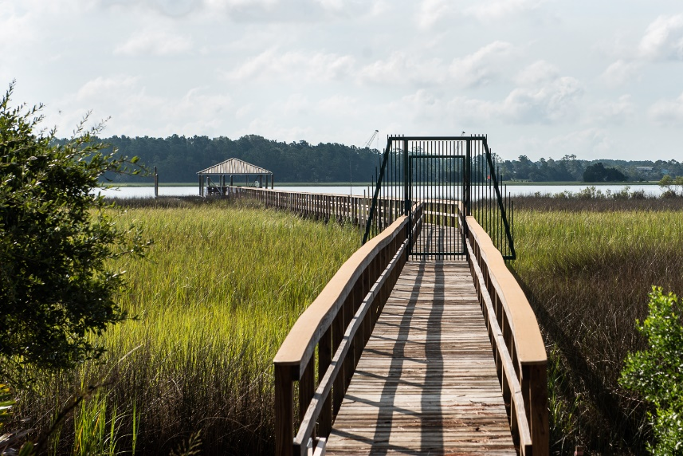
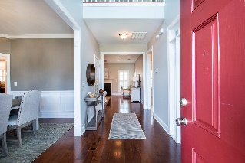
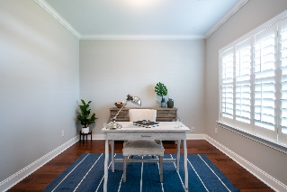
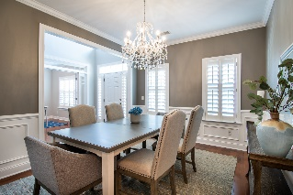
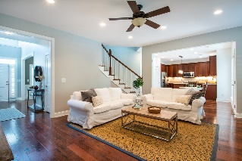
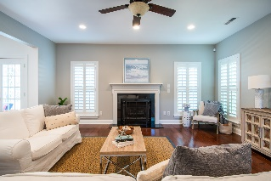
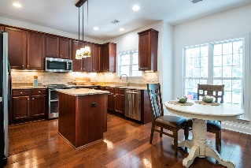
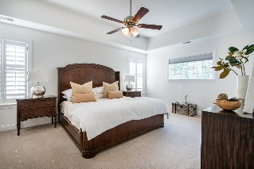
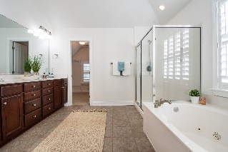
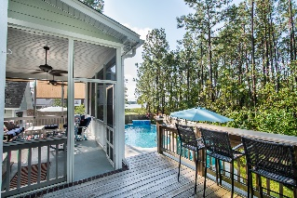
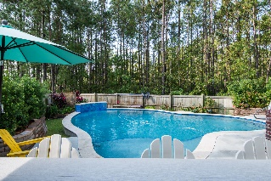


1215 Rivers Reach Drive River Reach Pointe | Charleston, SC 29492 | MLS# 19025812 | $610,000
Incredible Wando River Views + Saltwater Pool
Open House - Sunday, Sept. 29 2:30-430
Community Dock
Community Dock with Boat Slips, Quiet and peaceful cul-de-sac!! The home is an entertainers dream house for sure! Beautiful salt water pool with all the bells and whistles (heated/cooled) , including a screened porch, pool house and deck to enjoy with family and friends. Interior features wood floors, tile, fresh paint and carpet in the bedrooms. Plantation shutters throughout the home. Downstairs has a guest bedroom and full bathroom, plus a formal office, dining room, and open living area to the kitchen with granite, stainless steel, island, and custom cabinets and access to the large two car garage with storage. The upstairs has a nice sized master with tray ceiling with master bath with separate shower, water closet and dual sinks, garden jacuzzi tub and large master walk in closet. Additionally, four other bedrooms and one is particularly large could be media room, play room or another bedroom. Also, another full bathroom is upstairs. Oversized laundry room. Very peaceful neighborhood on the Wando River. There is a community dock with two community boat slips available for use. The neighborhood is also zoned for the Award Winning Phillip Simmons schools. New neighborhood grocery stores Publix, Lowe's Grocery and just five minutes Detyen's Boat Landing for easy access to the river. Truly a leisure lifestyle to enjoy!
A $2000 Lender Credit is available and will be applied towards the buyer's closing costs and pre-paids if the buyer chooses to use the seller's preferred lender. This credit is in addition to any negotiated seller concessions.
Charla McDonald
Cell - (843) 343-1456
cmcdonald@carolinaone.com
charlamcdonaldproperties.com
Carolina One Real Estate
628 Long Point Rd.
Mt Pleasant, SC 29464-3032

