Slide 1
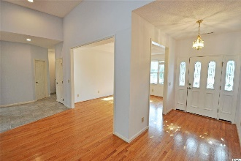
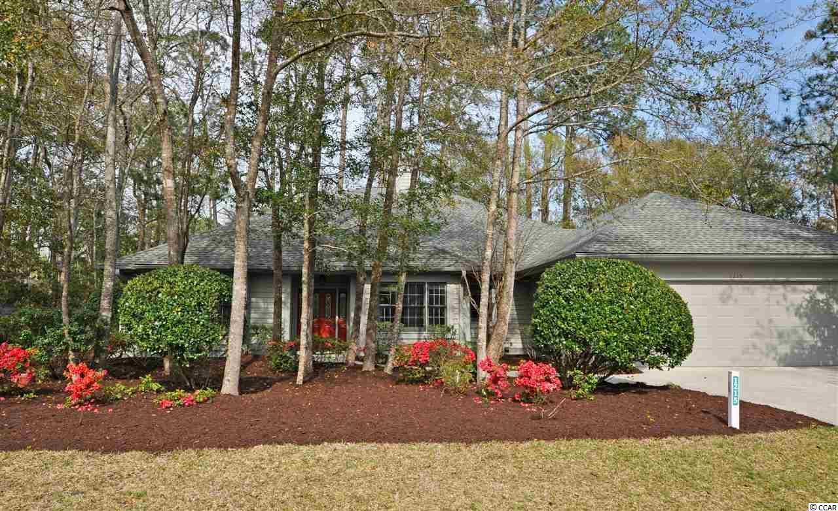
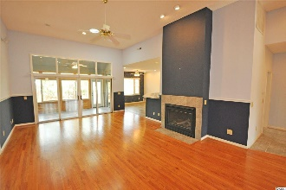
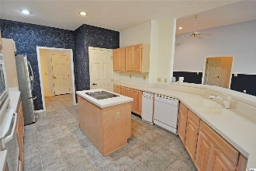
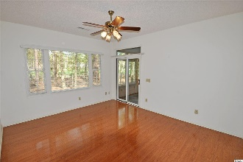
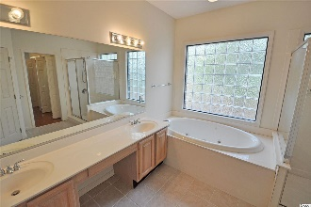
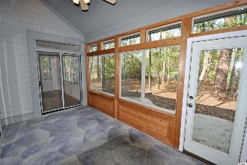
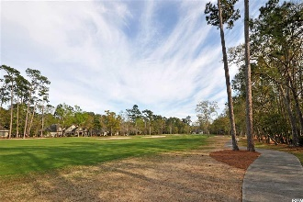
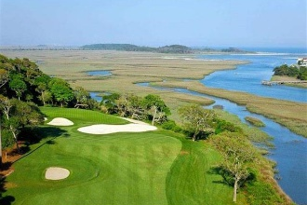
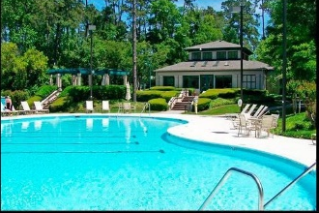
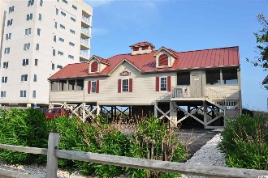


The Best Of Easy Beach & Golf Living
1215 Spinnaker Dr
North Myrtle Beach, SC 29582 | MLS# 2007167 | $415,000
The best of easy beach-golf living, this BIG, custom-built treasure is a rare find! Moreover, with the proven value of Tidewater, this golf-course home is appealing for a permanent residence, vacation home or excellent investment property. Homes in the Plantation have low HOAs and city taxes with amazing amenities and may be rented on both a short- and a long-term basis. Tidewater Plantation Resort boasts a world-class golf course, is minutes from the beach, shopping, medical services, schools, entertainment, dining & access to major highways. Amenities include owners' oceanfront beach cabana with open/screened porches, bathrooms, showers & kitchen on the wide white-sand Cherry Grove Beach, just named the 11th best in the nation. Residents have a private beach access entrance and plentiful beach parking. In Tidewater, residents enjoy the use of several pools/hot tubs. Other amenities are driving range, golf shop, clubhouse with bar/dining & event facilities, clay and hard-surface tennis courts, pickle ball court, fitness center, bocce/horseshoe courts & amenity center. Tidewater is manned, gated & has a gated, monitored storage yard for boats, jet skis, etc. The resort reflects the luxury & comfort of a fine upscale beach/golf lifestyle. And, in Tidewater, BIG value often comes in likewise surprising Big packages, such as this unforgettable nearly 3,000 heated-square-foot 4- bedroom, 2 1/2-bath traditional ranch with a memorably spacious flex-floor-plan, workshop, 3-season room overlooking the golf course and private split-bedroom guest wing with jack-n-jill en suite. Yet it lives like a cozy cottage with tons of cabinet space, planned storage and lots and lots of closets, including two entry, two linen, two masters and more. A nice front driveway leads to an over-sized two-car garage with an outside and interior double entrances, either directly into the home via the utility-room hallway to the kitchen or to the workshop/craft-room, also leading to that hallway and to the kitchen and guest bath. The front of the home overlooks a lovely, mature landscape of pretty flowering plants and indigenous foliage that surrounds the house as well. A welcoming entry foyer with decorative doorway looks out contiguously inside to the golf course via the seasonal Carolina room-rear-porch with a beautiful flag-stone floor. Formal dining is to the right and the towering great room straight ahead, adjoining the kitchen further to the right & the master/en suite and fourth bedrooms to the left. The fourth bedroom was used as an office. This living area is the heart of the home, has high ceilings & a wonderful gas fireplace. The formal dining space has a tray ceiling and is easily accessed from the kitchen and is nearby the guest bath for entertaining. The kitchen is family-sized with island, breakfast bar and breakfast nook with a great view of and access to outside living areas and to the golf course. The two guest rooms and bath are off of the kitchen to the right and are separated from the kitchen by a pocket door as a very private wing. The kitchen opens as well to the hallway to the guest bath, dining room and to the large functional utility room with BIG closet & cabinet-storage, workshop, and garage. Terrific traffic patterns throughout! This unique custom-build reflects preplanning by a thoughtful original owner who chose to construct a quality dream home for the generations in popular North Myrtle Beach, a Top-10 Beach Town in the U.S., named the safest city in South Carolina, and in Tidewater Plantation Resort. Tidewater is on a tree-lined road to oceanfront Anne Tilghman Boyce Coastal Reserve, a nature conservancy, including Waties Island. Tidewater itself is on an elevated peninsula of live oaks and southern pines between the ICW and the Cherry Grove Inlet to the Atlantic Ocean. The plantation also preserves the singular look of its own historic origins. See this best of the best easy-living beach-golf home on a third-acre lot today!
Deborah Collins
843-424-9013
dctidewater@yahoo.com
Connie Ross-Karl
702-306-2643
conniesross@aol.com
NEW WAY PROPERTIES MYRTLE BEACH

