Slide 1
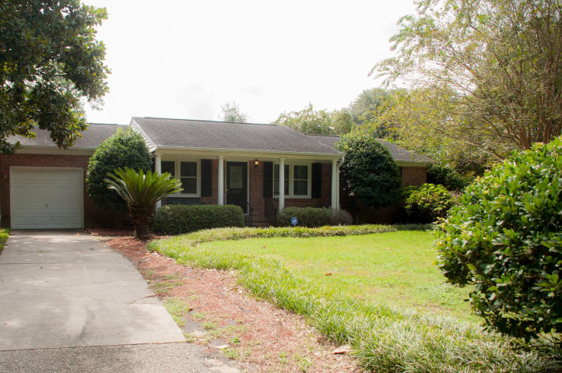

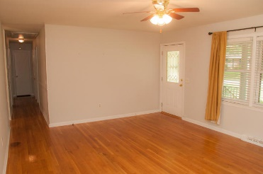
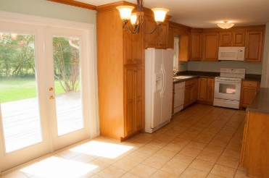
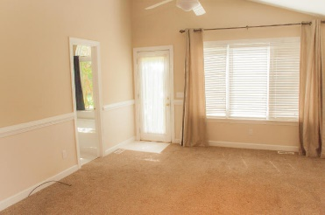
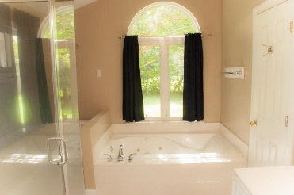
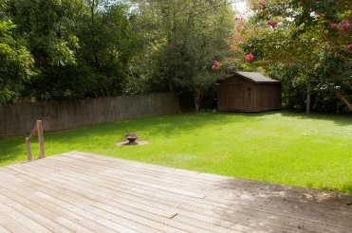
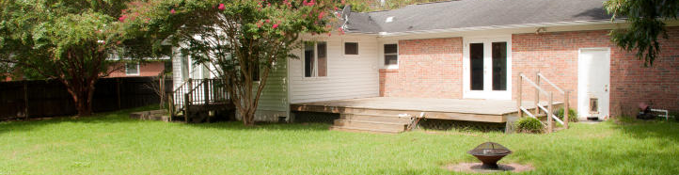


Beautiful James Island Ranch in Battery Point!
1215 W Darwin Street
Charleston, SC 29412 ~ MLS# 15022548 ~ $335,000
1,582 SF ~ 3 Bedrooms :: 2 Baths
This beautiful James Island brick ranch in Battery Point is waiting for you! This charming single family home has gleaming hardwood floors. The master bedroom has been renovated to become a master suite with its' own access to the back yard! The master suite has a huge walk-in closet and renovated bathroom with a garden tub! There are ceiling fans in all rooms! There is a one car garage and additional off-street parking. The back yard is a wide-open green space, perfect for entertaining. The wooden storage building is a great space for extra storage. There is a wooden privacy fence and a huge back porch making this back yard a truly nice place to escape and relax from the hustle and bustle of the day!
Jon Moore
Mobile - (843) 732-3365
jonathanwyattmoore@gmail.com
Charleston Real Estate Partners. LLC
792 Folly Rd. C1
Charleston, SC 29412
www.charlestonrealestategroup.com

