Slide 1
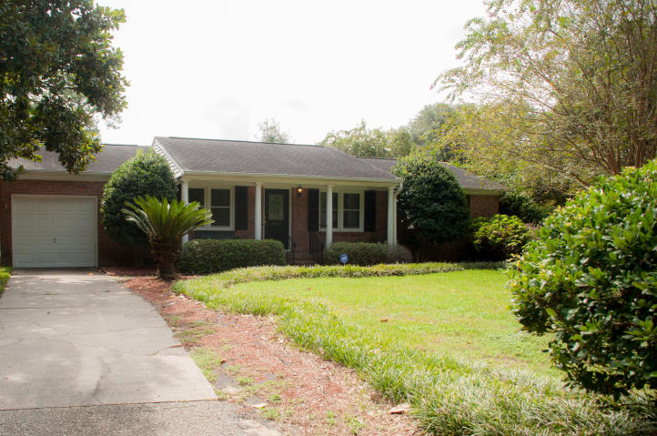

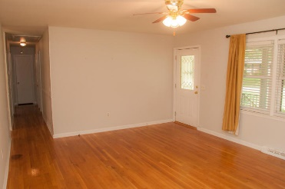
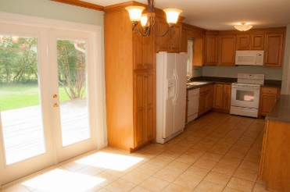
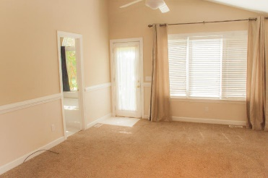
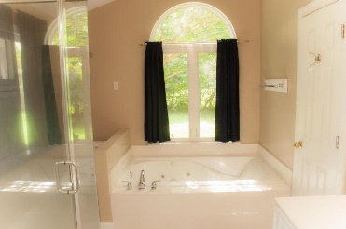
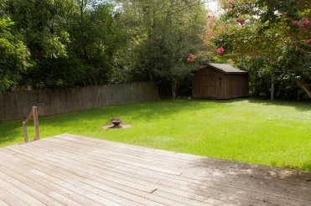
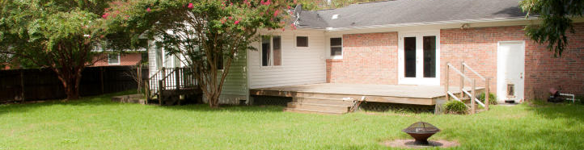


MOTIVATED SELLER in Battery Point!! Bring your client!! Harbor View Elementary School District - Community boat ramp.
1215 W Darwin Street
Charleston, SC 29412 :: MLS# 15022548 :: $319,500
1,675sf :: 3 Bedrooms :: 2 Baths
This beautiful James Island brick ranch in Battery Point is waiting for you! This charming single family home is 5 houses from the community boat ramp!! It has gleaming hardwood floors. The master bedroom has been renovated to become a master suite with its' own access to the back yard! The master suite has a huge walk-in closet and an over-sized renovated bathroom with a garden tub! There is a one car garage and additional off-street parking that would be a perfect place to park a boat! The back yard is a wide-open green space, perfect for entertaining. The wooden storage building is in great condition - a great space for extra storage. There is a wooden privacy fence and a huge back porch making this back yard a truly nice place to escape and relax after a day of work!
Jon Moore
Mobile - (843) 732-3365
jonathanwyattmoore@gmail.com
Charleston Real Estate Partners. LLC
792 Folly Rd. C1
Charleston, SC 29412
www.charlestonrealestategroup.com

