Slide 1
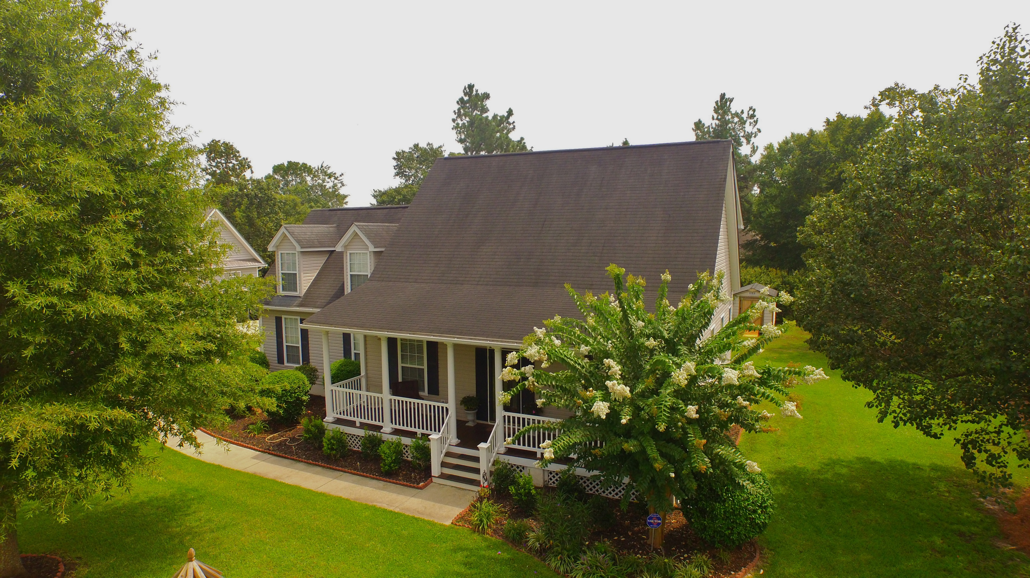
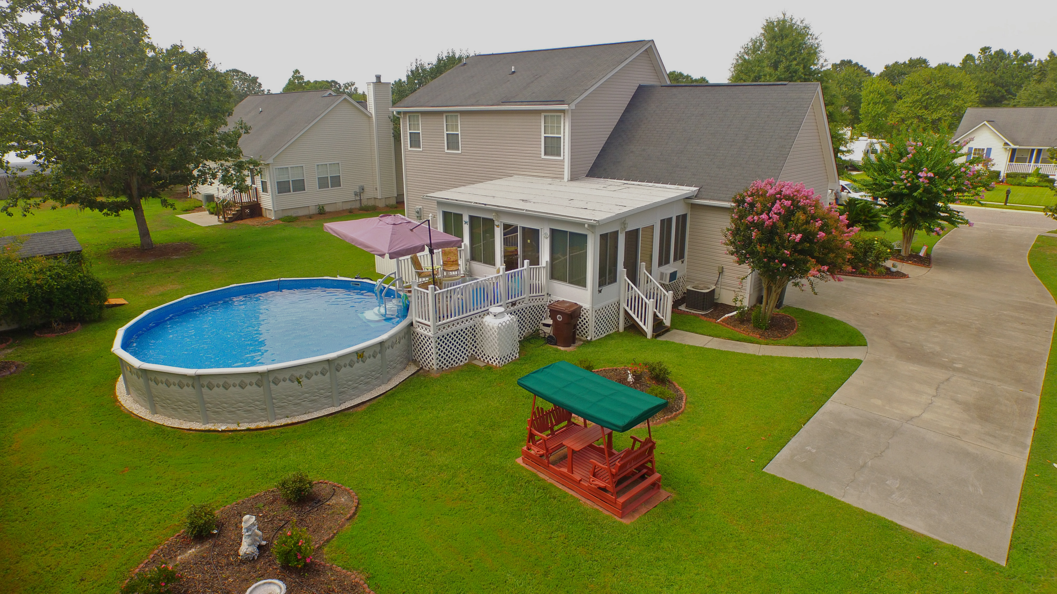
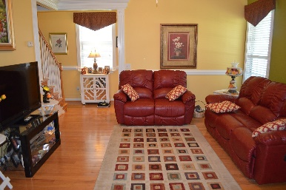
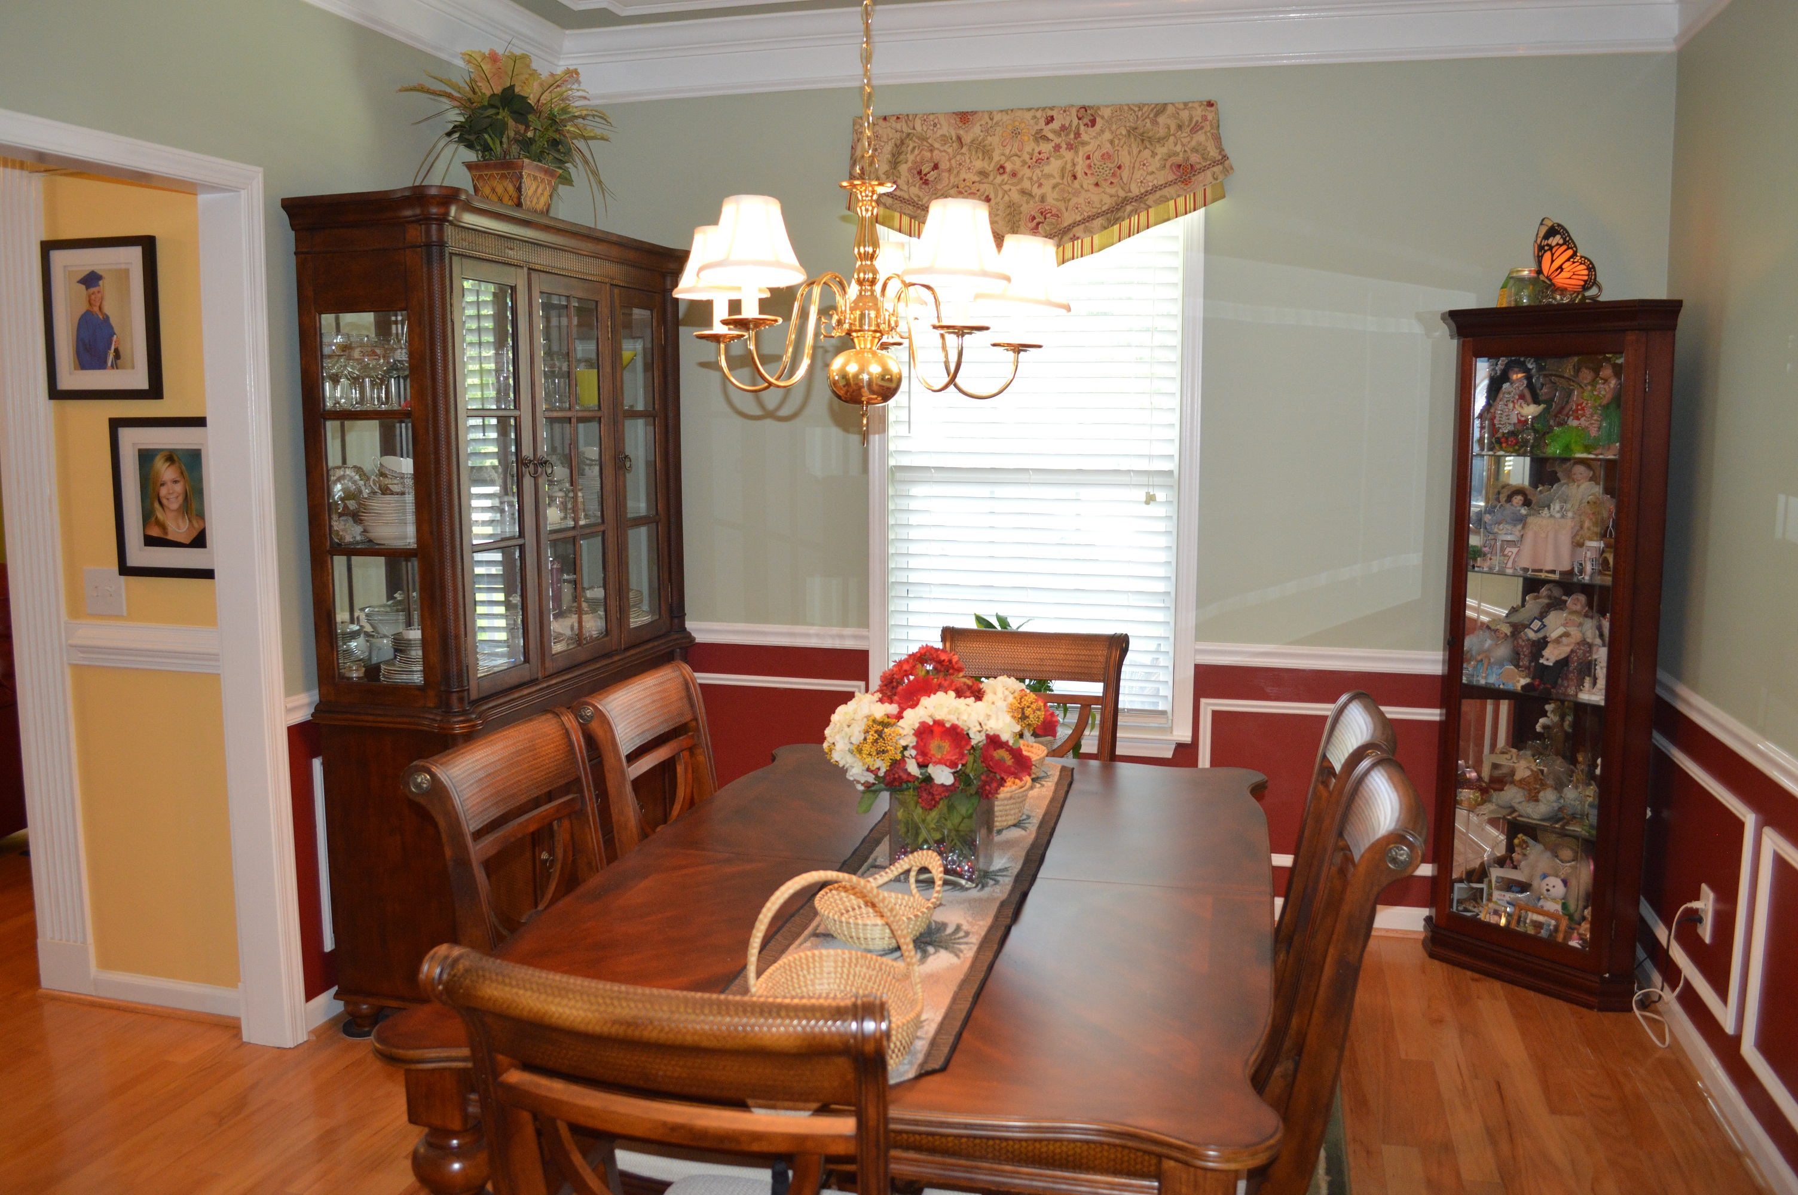
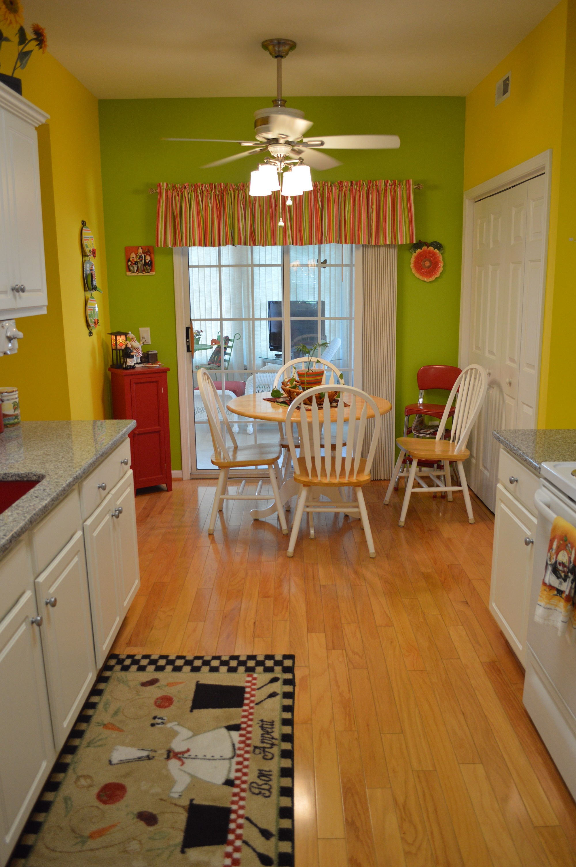
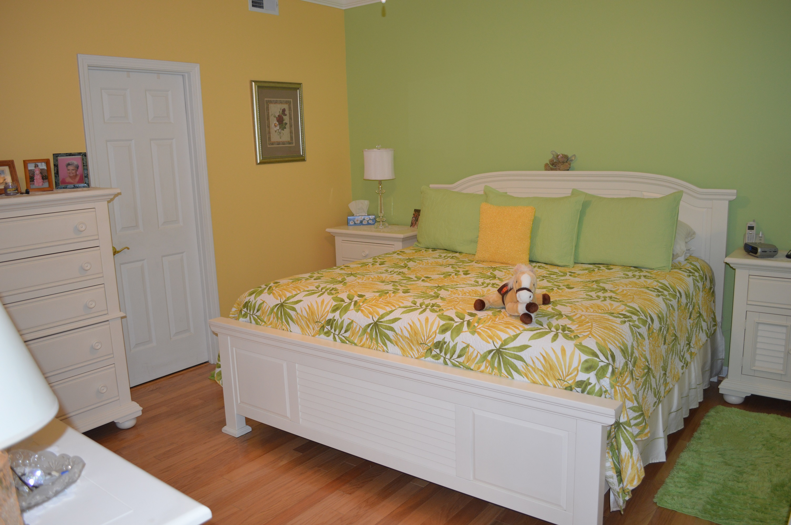
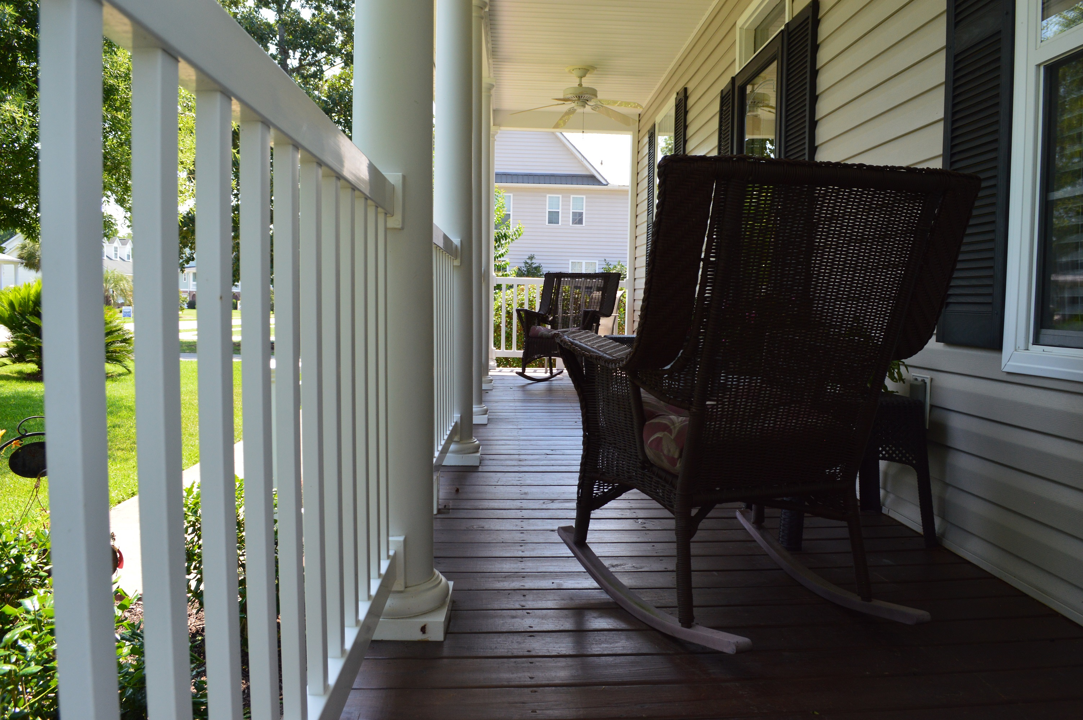
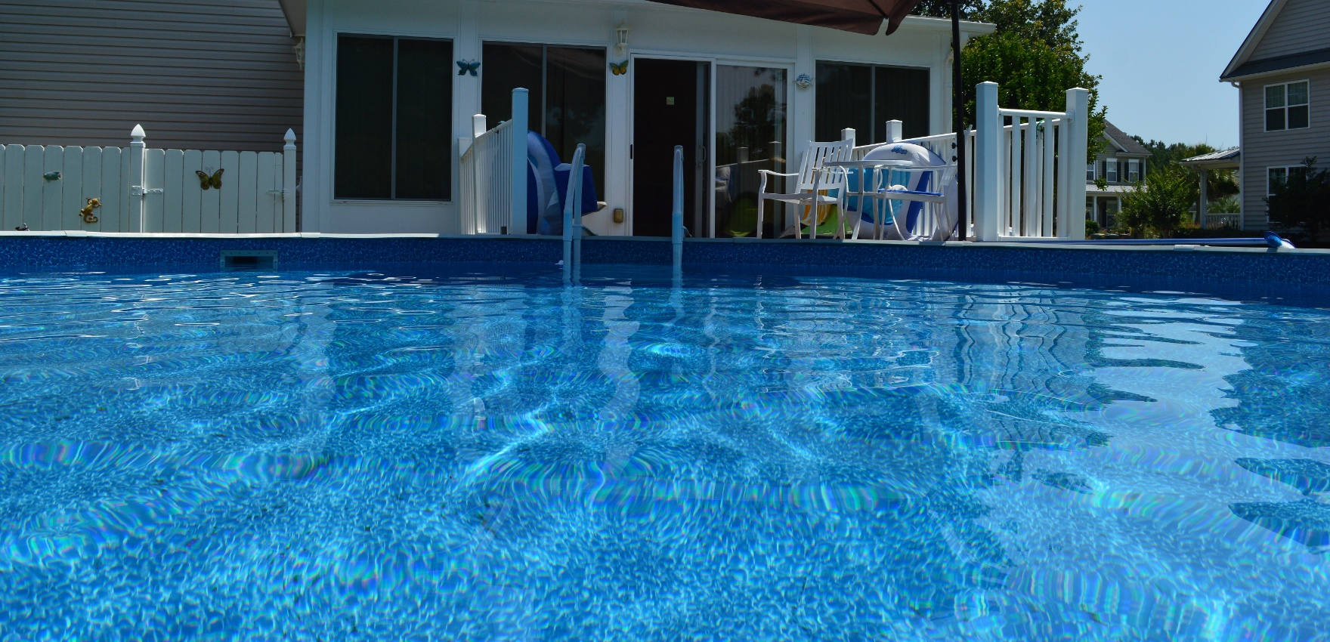


1216 Francis Marion Circle Stony Landing ~ Moncks Corner ~ MLS# 15016167 ~ $289,000
Gorgeous Home…A Must See!
All the upgrades of new construction! NO HOA! There are many homes out there that impress but only a few that will deliver the WOW factor! You will truly appreciate the attention to detail and design from the custom ceiling design in the dining room, the coordinating patterns in the upgraded kitchen, to the custom woodwork and molding adorning the living room area. This home has hardwoods on the first floor. This home also features 3 very spacious bedrooms. Upstairs, you have a very spacious frog and the two upstairs bedrooms share a jack and jill bath. The master is down and boast hardwood floors and a garden tub in the large master bath. The bright and cheery kitchen is upgraded and features a breakfast nook. The living and dining room area features custom molding and as well as a gas burning fireplace
The enclosed sunroom, added in 2009, is large and bright and features tile flooring. The hot tub area is closed off for exclusive privacy. The above ground pool was upgraded to a salt water system. The property also features an exclusive irrigation system to keep the landscaping looking it's best. The upgrades list goes on and on! This home represents true southern elegance at it's best. If you have been looking for an upgraded home that has it all then look no further than 1216 Francis Marion. The saltwater pool, hot tub, and 8x10 utility building convey with the home.
Brandon Ray
(843) 499-1928
brandon.ray@carolinaone.com
www.therightrayhome.com
Carolina One Real Estate
900 N Main St
Summerville, SC 29483

