Slide 1
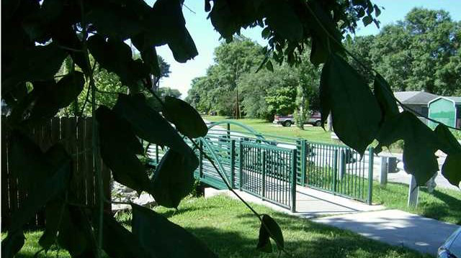
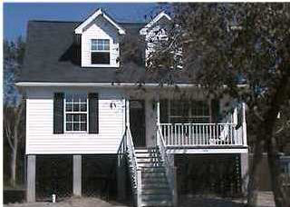
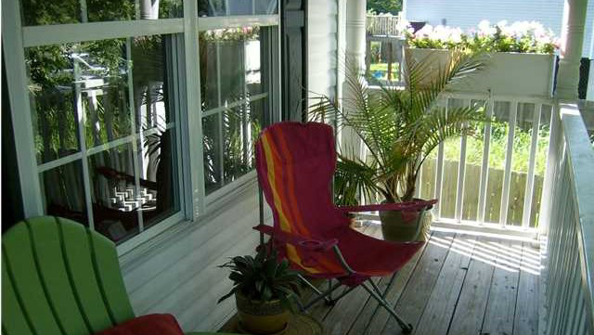
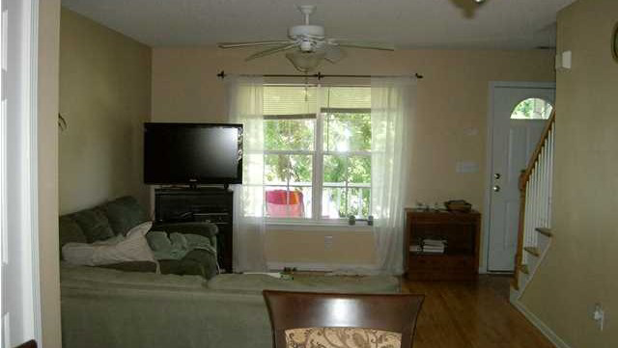
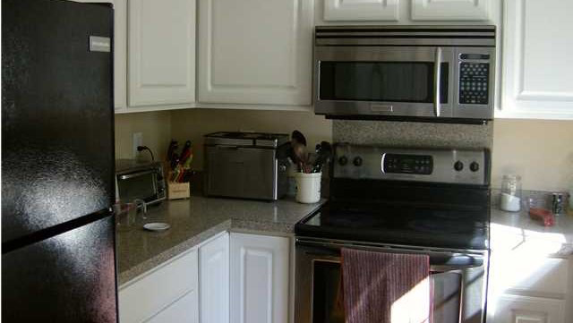
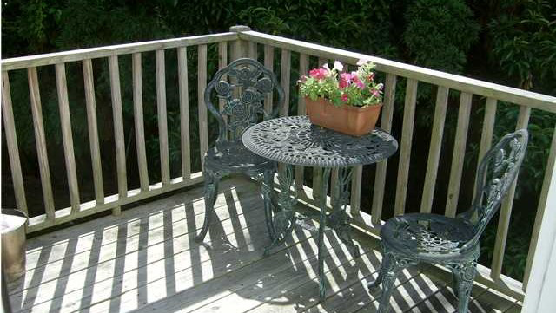
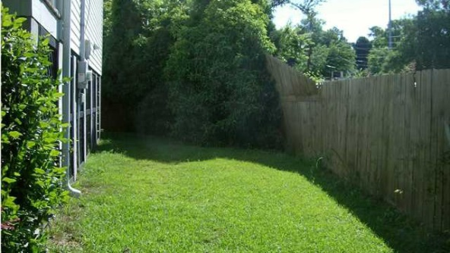
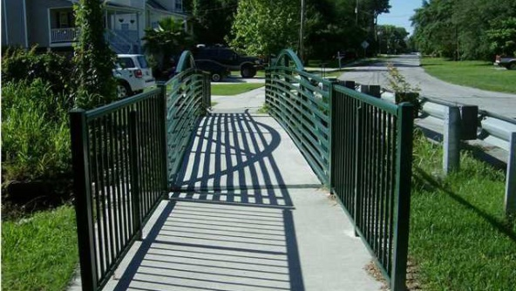


1216 Maxwell St
Park Circle
North Charleston
MLS# 14030294
Asking $177,900
3 Bed / 2 Baths
1,406 Sq Ft
Lower Price!
Motivated Seller!
Charming & Comfortable Living
Pretty and comfortable three bedroom two bath home in the much sought after subdivision of Park Circle.
There are hardwoods downstairs and tile in the bathrooms.
Outside there is a raised deck and a huge back yard.
This house is priced to sell and sold ''as is''.
Liz & Bob Simonds
843-437-9696
lizandbob@agentowned.com
AGENTOWNED REALTY CO. PREMIER GROUP, INC.
141-A N. MAIN STREET
SUMMERVILLE, SC 29483

