Slide 1
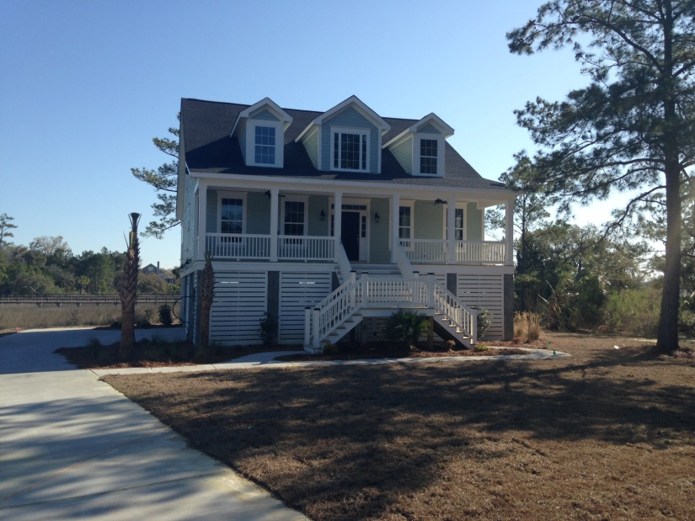
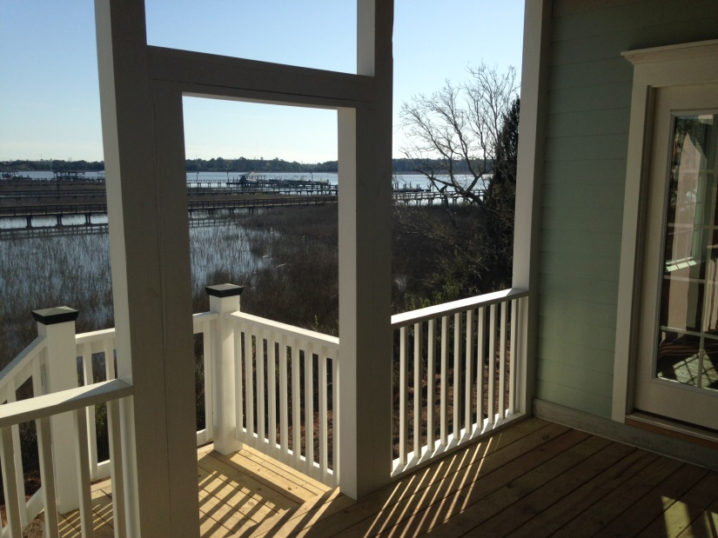
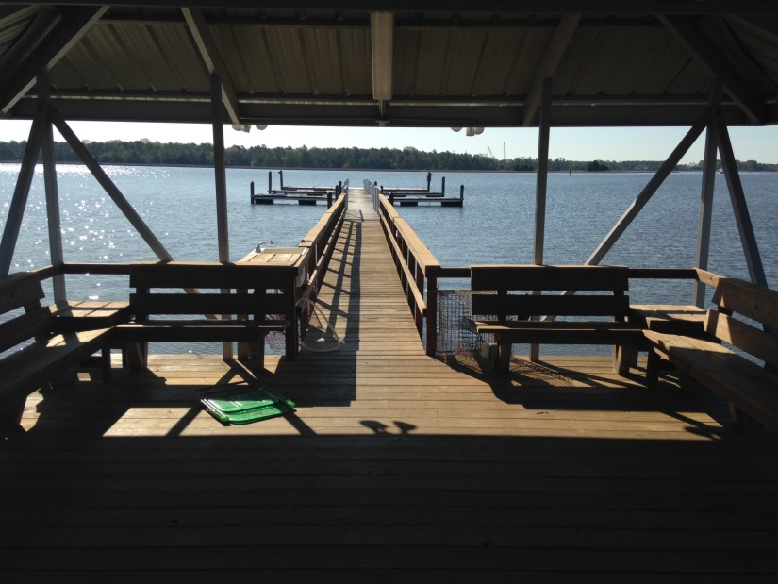
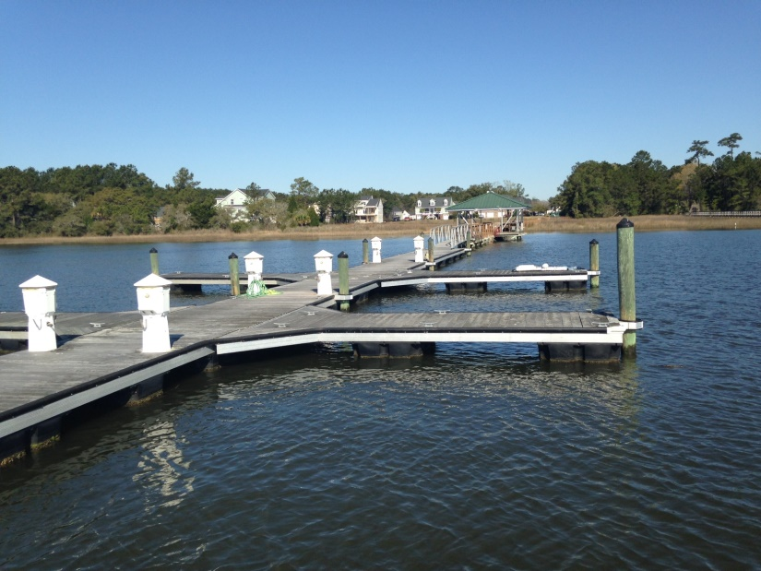

New Construction (Built by Steve Hill)
3,247 sqft with deeded (24/7) deep water boat slip with power and water
Custom Executive home on the Wando River
Move in Ready for quick close!!!
Realtor Happy Hour & Barbeque
CANCELED UNTIL FURTHER NOTICE!!
Open House
1216 Rivers Reach Drive, Charleston, SC 29492
River Reach Pointe - MLS # 1315969
Canceled
See You There!!
Bill Marx
Apex Real Estate Group, LLC
Broker-in-Charge
(843) 991-0551
Bmarx963@msn.com
RSVP by 7/28

