Slide 1
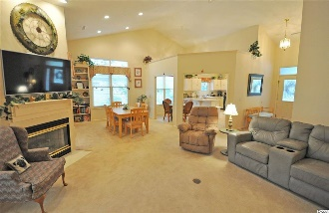
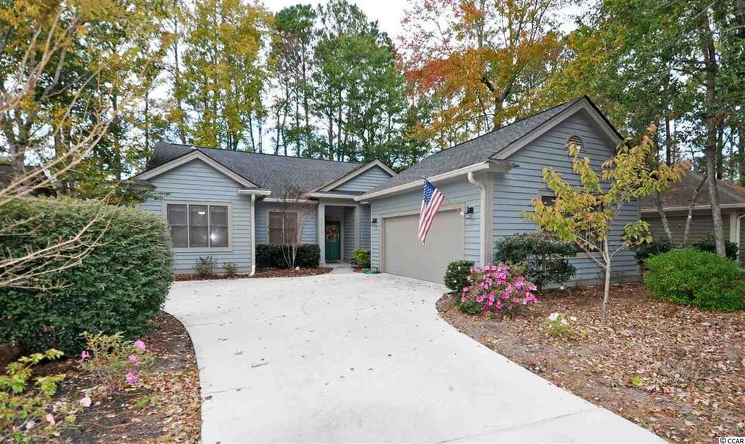
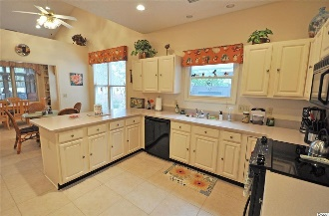
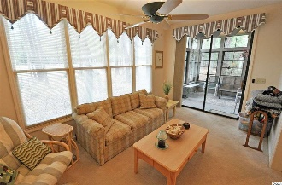
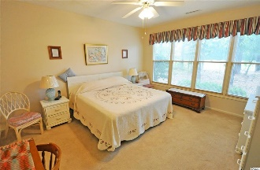
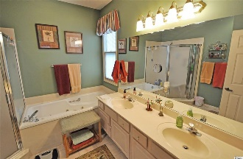
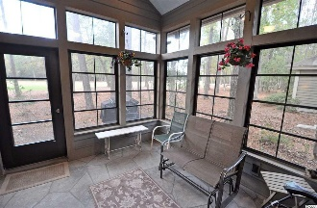
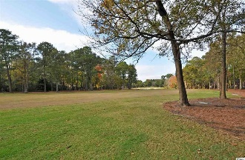
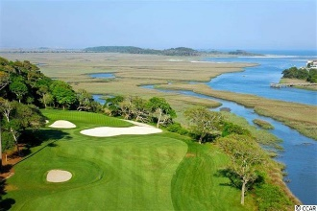
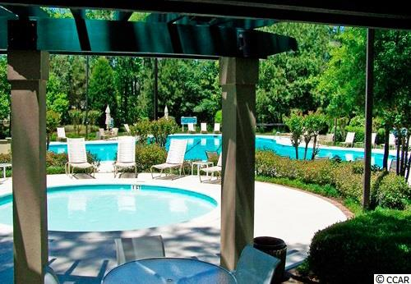
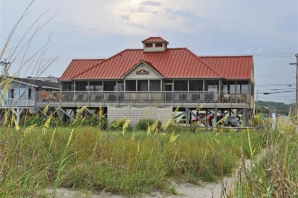


1218 Clipper Rd
Tidewater Plantation Resort ~ North Myrtle Beach
MLS# 1924864 ~ $324,900
Welcome to your forever home. This impeccably maintained 3-bedroom, 2-bath home -- all on one level -- is an answer to your desire for an affordable, easy-living lifestyle...and it has everything you need or want: on the world-class Tidewater Plantation Resort Golf Course at one of the lowest prices and with some of the richest amenities on the East Coast -- also at the lowest taxes of any such full-service city in the Carolinas! The price is indicative, too, of one of the best current East-Coast opportunities for an investment, vacation property or residence in beautiful, safe North Myrtle Beach, just named the safest city in the Carolinas and a top-ten beach town. Plus, North Myrtle Beach boasts some of the best golf in the nation! Look no further! This is IT! The best of easy, beach/golf/cottage-living, this house is a rare find! Moreover, with the proven value of Tidewater for residential and for rental-investment, this home is truly an appealing BEST BUY! Tidewater is minutes from the beach, shopping, medical services, great schools, entertainment and access to major highways. Amenities include an owners' oceanfront beach cabana on the wide, white-sand Cherry Grove Beach (11th best in the nation yet secluded and walk-able) with open/screened porches, bathrooms, showers & kitchen. Residents enjoy the use of several pools/hot tubs. Other amenities are a driving range, golf shop, clubhouse with bar/dining & event facilities, clay and hard-surface tennis courts, pickle ball court, fitness center, bocce courts & amenity center. Tidewater is manned, gated & has a gated storage yard for boats, jet skis, etc. The resort reflects the luxury and comfort of a wonderful, YET SIMPLE lifestyle. And, in Tidewater, BIG value often comes in surprising packages, such as this unforgettable cozy and desirable cottage, soon to be your forever home, at one of the lowest-priced Plantation locations in the community. Clipper Rd. is a very beautiful, secluded signature Tidewater cul-de-sac street, spanning from the Intracoastal Waterway ICW to the fairways of the golf course. The home's curb appeal is immediate, from the impeccably landscaped yard to the homey look of the welcoming low-country-designed one-level home. Upon entry, you see the heart of the home from a spacious wide foyer and hallway. There is a third bedroom in this split-bedroom lay-out off of the hallway and an entry closet. The open living area encompasses the living/dining rooms, Carolina room with wet bar and kitchen. Vaulted ceilings enhance the spaciousness, and there is a cheery gas fireplace which can be enjoyed from several rooms. The wonderful, light and airy Carolina room leads to the screened porch/3-season room on the fairway. Relax there with morning coffee or an evening glass of wine. It's the perfect place to unwind, sit back and enjoy the natural scenery and wildlife. Inside, there is also the roomy dining area and kitchen gathering space for the family and for entertaining. The kitchen is so spacious, too, and has lots of work space and cabinet storage, including pantry. The large dedicated laundry, garage entrance and a surprise office /storage room are off of the kitchen. The garage is side-load, good-sized and has a nice finished floor. On the other side of the home are the unexpectedly spacious second bedroom and master suite and baths. The master has a remarkable, private golf-course view and en suite, walk in closet, separate spa tub, walk-in shower and double-sink vanity. A linen closet is nearby. Other perks are newer major and other appliances, including a new hot water heater in 2018, roof and HVAC in 2012. The home is located across from undeveloped common area land, so it feels very open both inside & out. This traditional home shows remarkable love and attention to every detail yet is effortless to make your own. There is also much to do in Tidewater & along the North Strand. So see it all today. Live this easy, luxurious lifestyle tomorrow!
Deborah Collins
843-424-9013
dctidewater@yahoo.com
Connie Ross-Karl
702-306-2643
conniesross@aol.com
NEW WAY PROPERTIES MYRTLE BEACH

