Slide 1

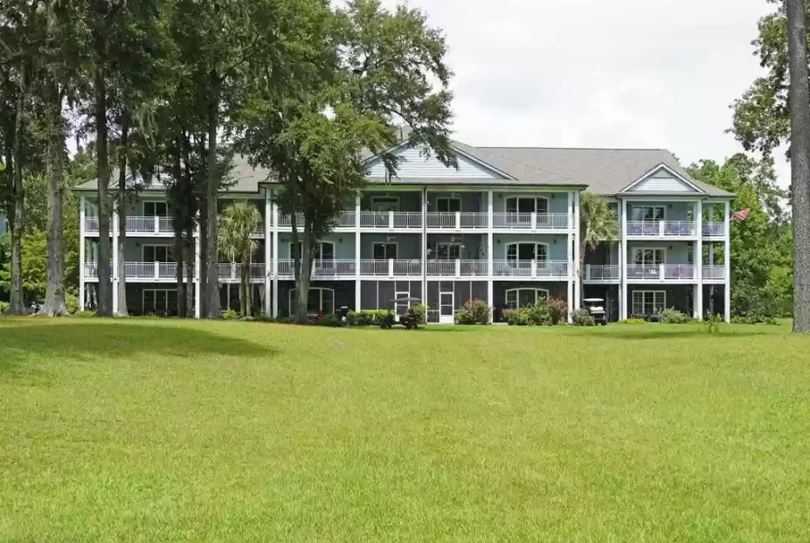
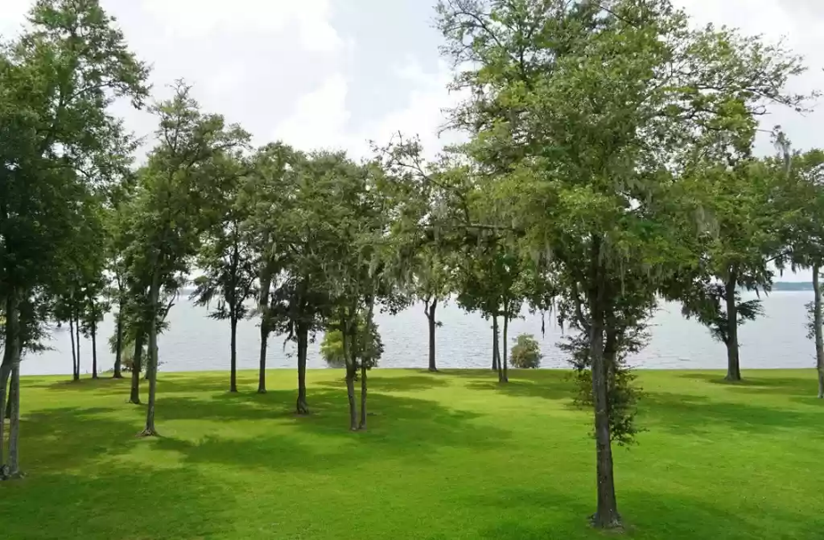
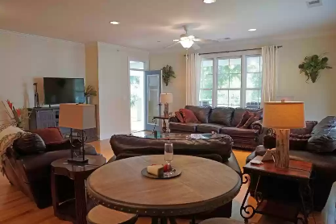
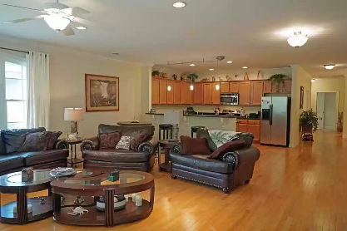
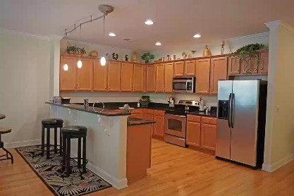
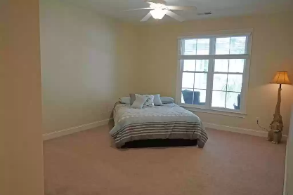

Only 4 Bedroom Condo On The Lake For Sale
1218 Bridgeview Ln #F301
Summerton, SC 29148 ~ New Price! $378,400
North Shore Condo on the Market - Only 4 bedroom currently on market - see today before it is gone! Big water views on Lake Marion. Jump on the boat from the boat slip that is included in purchase and sail to Charleston or do some sunset tours around the lake. Enjoy a dip in the pool on a SC hot day or sit by the fire on a cool evening over looking the lake. Bring the Hammock and swing your troubles away on this wrap around porch. With just over 2300 sqft you can bring the whole family to enjoy the massive condo. The grounds have a day dock with tons of green space to enjoy. Newer seawall with steps to the water. Don't forget the fishing pole. Sitting next to Pollys Landing to grab a quick bite before heading out for the day. See you at the Lake! Furnishing could convey.
Lake Homes Realty, LLC
Elloree, SC 29047
www.SCLakeLife.com
Kristie Anderson
(803) 387-9459
kristie@sclakelife.com

