Slide 1
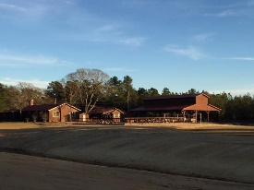
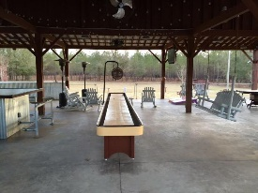
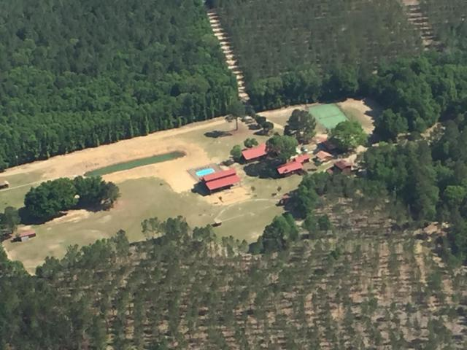
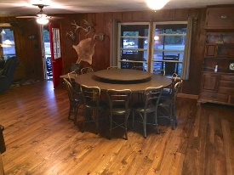
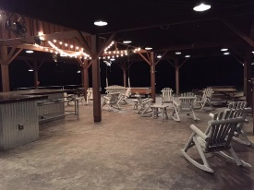
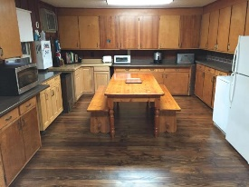
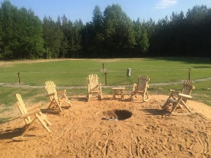
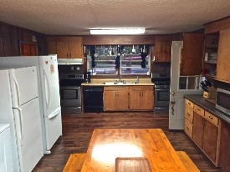
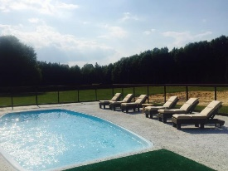
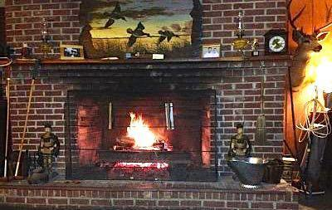
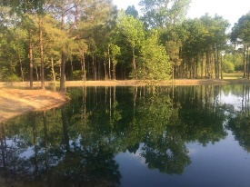


Unique, Turn-Key Sportsman Club
1219 Dingle Pond Road
Summerton, SC 29148 | MLS# 16022616 | $1,539,000
Welcome to the Clarendon Club. This 175 acre 'tradition' has been around for over 40 years. The club leaves nothing to be desired…it has it all!. Too much to possibly list but here is a brief description of the property and what it entails. * 175+/- acres complete * All buildings are fully furnished and being sold turnkey * Buildings/amenities include...Main lodge, Little lodge, Little cabin, Big cabin, Office, Laundry shed, Storage shed, 3000sf Outdoor pavilion, Salt water pool, Basketball/Tennis court, Sand volleyball, Large outdoor fire-pit, Lighted skeet range, Tractor barn, Main barn, Fuel shed, Feed shed, Dog pens, Walk in deer cooler, Commercial ice machine, Fish cleaning station, Fishing Pond, Duck Impoundment, Dove Field, Miles of trails. This property really has too much to list...every building has wall to wall furnishings. All Lodges/Cabins complete with furniture, beds, linens, fully equipped kitchens, appliances, etc. All barns/sheds fully equipped with tools, machinery, such as tractor, bush hog, tiller, club cadet mower, electric golf cart, ATV, 2 go-carts and much, much more. In addition there are 5 wells and 4 septic systems for all of the buildings. Bedrooms and bathrooms are a cumulative of all structures. Property is on VRBO and generates approximately $58,000 yearly. This is a property that can not be realized how spectacular through pictures or words. The only way to truly appreciate is to come see. It is a one of a kind and a true outdoor paradise.
Jennifer Liverett
Office - (843) 416-2000
Mobile - (843) 810-5346
jennifer.liverett@kw.com
Keller Williams Realty
496 Bramson Ct Ste 200
Mt. Pleasant, SC 29464

