Slide 1
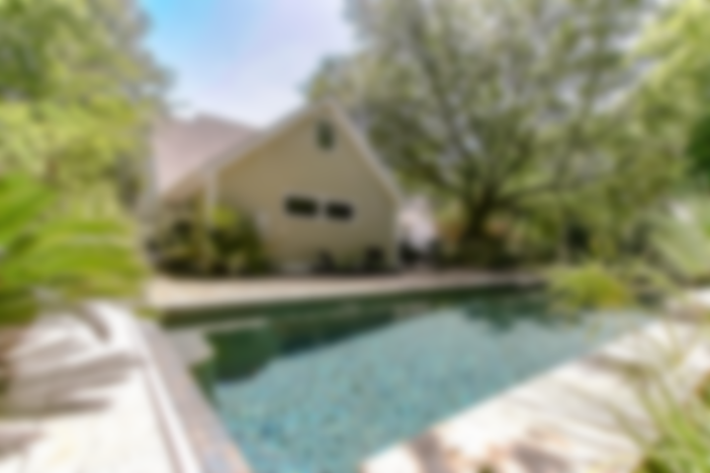
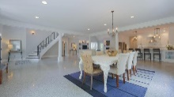
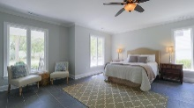
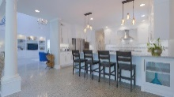
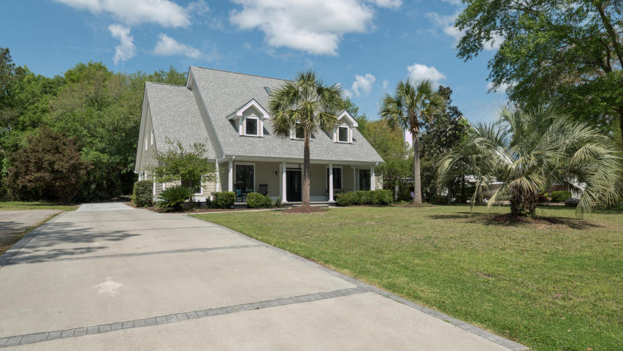
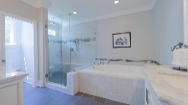
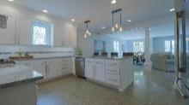
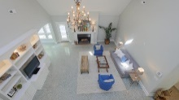
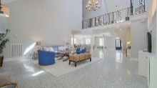
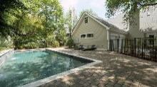
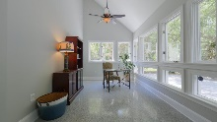
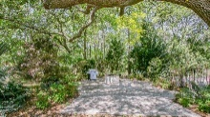
121 Berkshire Drive
St Thomas Point · Charleston, SC 29492 · MLS# 17010616 · $749,000
Bring Your Boat
Private gated boating community. Incredible renovation with no expense spared on this 5 bedroom, 3 full, 2 half bath home. Open floor plan with space for everyone. Soaring ceilings and curved open staircase greet you as you walk in. Large Great room with wood fireplace, Living room area, and Dining area large enough for the whole family. A cooks dream Kitchen comes with everything you need including, pot filler, double oven, wine fridge, tile back splash and granite countertops. Huge first floor Master Bedroom with custom walk in closet with Master bath that has a large whirlpool tub and a glass enclosed shower with multiple shower heads big enough for 2, and dual vanities. The first floor also has a room that can be used as an office or bright sunroom. Upstairs you will find 4 bedrooms, one with its own full bath, large hall bath and a sitting or reading nook. Step out side and you can swim in the Saltwater Pool with retractable cover. Or relax by the fire pit on a chilly night.
Check out the drone video here - https://youtu.be/lpaho9I5oF4
Neil Schneider · 843-200-8902 · neil@charleston.info

