Slide 1
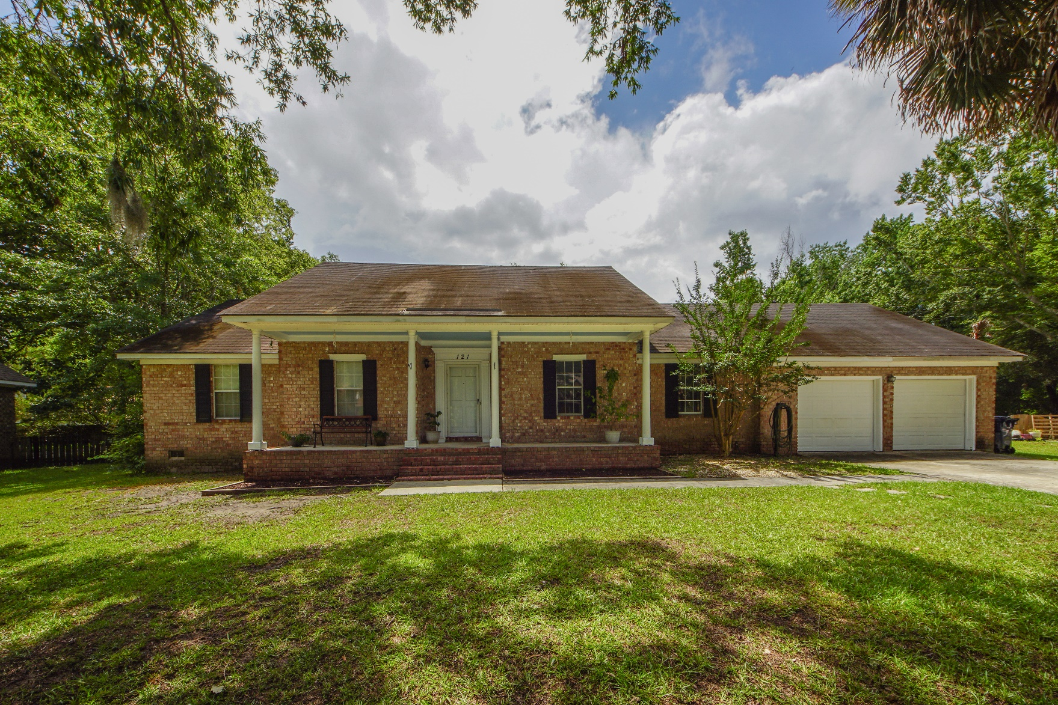
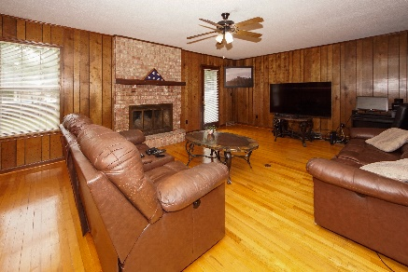
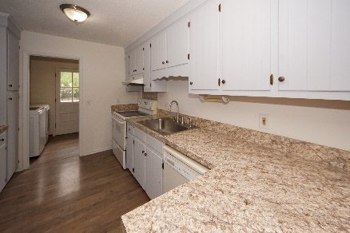
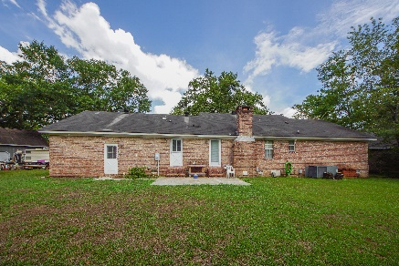


121 Bindon Circle
Archdale :: North Charleston, SC 29418
MLS# 19016861 :: $265,000
4 Bed / 2 Bath
New Listing!
Welcome Home To Archdale - Dorchester District 2
This 4 bedroom ranch is a spacious a brick home situated on a .48 acre lot in a mature neighborhood.
Wood floors, over sized family room with fire place with the fourth bedroom located over the garage.
Eat in kitchen has a spacious/mud room with access to the back yard and garage.
Back yard is fenced with a out shed and carport and this subdivision as no HOA!
Connie White, Broker
843-532-3356
connie@chrepros.com · conniewhiterealestate.com
Charleston Homes · 597 Old Mt. Holly Road · Suite 301 · Goose Creek, SC 29445

