Slide 1
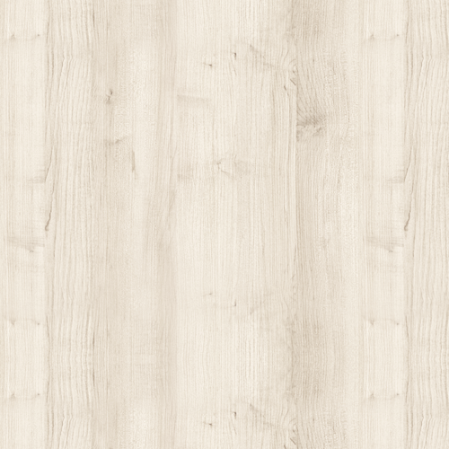
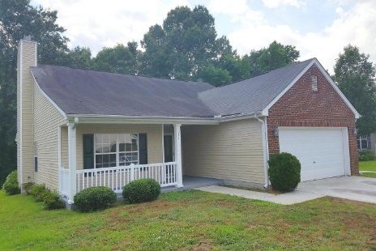
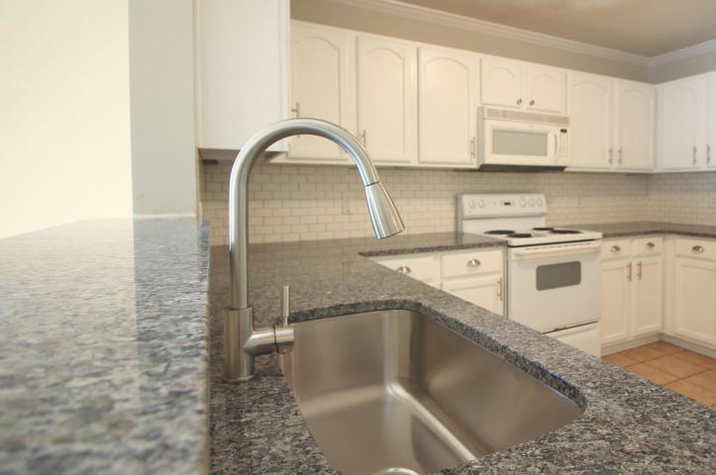
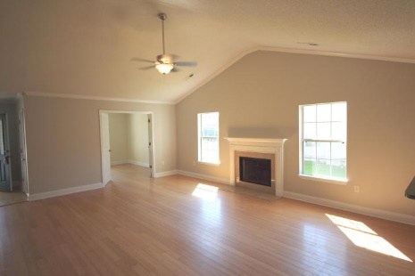
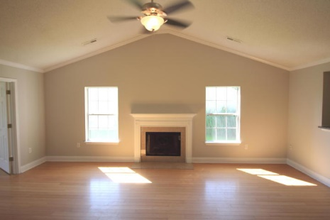
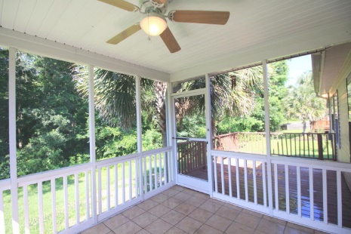


Great Buy In Liberty Hall Plantation With Buyer Agent Incentive
121 Broken Branch Drive
Goose Creek, SC 29445 ~ MLS# 16014023 ~ $187,500
Recently renovated home with a large and bright open floorplan. Tons of options with this 3 bed 2 bath plus office. New carpet and paint throughout the entire house! Granite countertops with a beautiful subway tile backsplash in the kitchen. The low-maintenance bamboo floors stretch from the entryway to the living room and office. The living room's vaulted ceilings and crown molding add to the open feel of the home. New HVAC and water heater. A wooded area behind the home adds extra privacy. Tons of storage in the 2 car garage. A must-see that is priced to sell!
Peter Stanley
M 843-300-8251 | O 843-885-6199
petermstanleyjr@gmail.com
Colony & Craft LLC
76-A Spring St
Charleston, SC 29403

