Slide 1
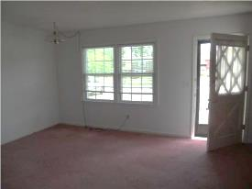
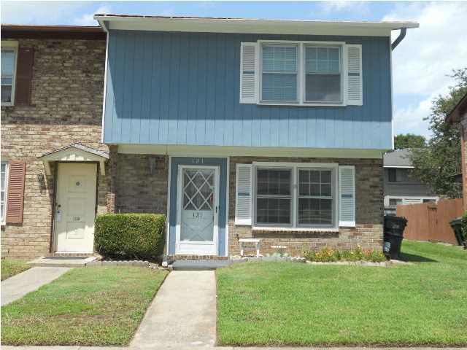
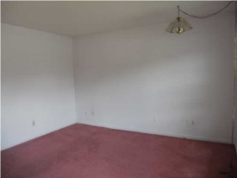
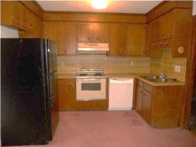
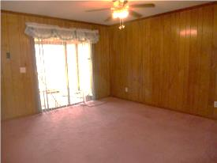
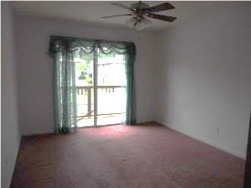
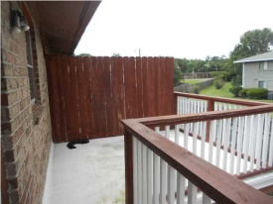

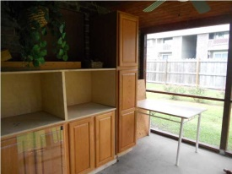

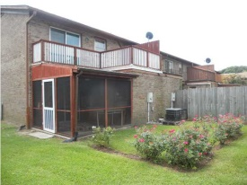
Affordable Living!
121 Brush Blvd
Foxborough Town Houses
Goose Creek, SC 29445
MLS# 1422649 | $69,900
3 Bed / 1½ Bath
Charming and well kept 3 bedroom 1.5 bath town home. Features include family room, separate dining, kitchen and laundry room down stairs along with a screened in porch. The seller replaced the wood siding with vinyl siding by Lowes in 2013 and installed 4 NEW windows in the front of the home by Lowes, NEW dishwasher and garbage disposal were replaced in 2013, Heat Pump was replaced in 2011, replaced deck in 2013 from master bedroom and updated screen porch with cabinets. This is true opportunity for an investor, first time home buyer or empty nester.
Connie White, Broker
C: 843-532-3356
conniesyouragent@gmail.com
Omni Carolina Real Estate
126 Eston Dr
Goose Creek, SC 29445

