Slide 1
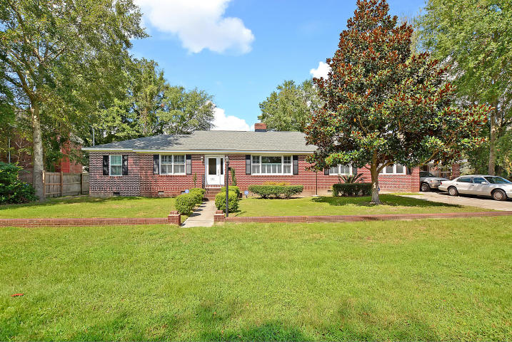
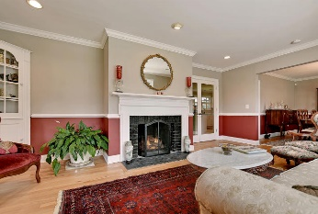
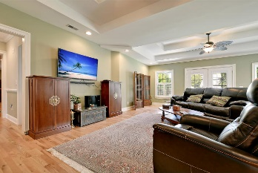
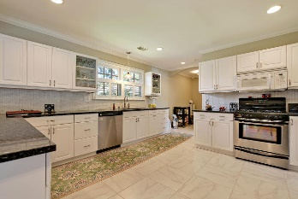
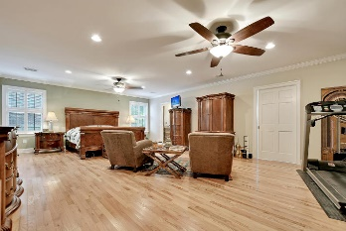
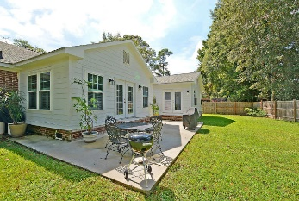


LIMITLESS EXPECTATIONS
121 Chadwick Dr
South Windermere
Charleston, SC 29407
MLS# 16025836
$675,000
Sensational fully detached ranch style brick home with approximately 2900 sq.ft. of living space is situated on a quiet tree-lined street and surrounded by a large private fenced yard in one of the most desirable locations in Charleston (South Windemere). This Remarkable home appointed with crafted chair railing, crown molding, beautiful wood and ceramic flooring, plantation shutters, stylish lighting selected plumbing fixtures, offers 3 large bedrooms including the Surprising and spacious master bedroom suite that includes an amazing walk-in closet, a private master bathroom with quality wood cabinets and ceramic flooring, large ceramic shower with multiple shower heads, a flex room adjacent to the master suite is currently an exercise room but could be a private Library/reading room a Distinctive family room and a bright sun room are appointed with stunning trey ceilings, the large country style kitchen includes Exquisite granite countertops, beautiful white cabinets, ceramic flooring, upgraded plumbing fixtures and built-in stainless appliances. The private living room and separate formal dining room is large, bright and includes charming crown molding, classic chair railing, and a two way fireplace for the cool evenings. There is a French door walk-out to the popular patio and landscaped rear yard that is perfect for outside cook-outs and entertaining. Seldom does a home in this location and with all the modern improvements become available to purchase. Don't miss this Opportunity! Age, sqft, taxes, acreage, schools are approximate buyer to verify any and all information deemed necessary.
Bill Everett, Jr
Broker
843-693-8539
Bill@TheEverettGroup.net
RE/MAX Pro Realty, 9209 University Blvd, Charleston, SC 29406

