Slide 1
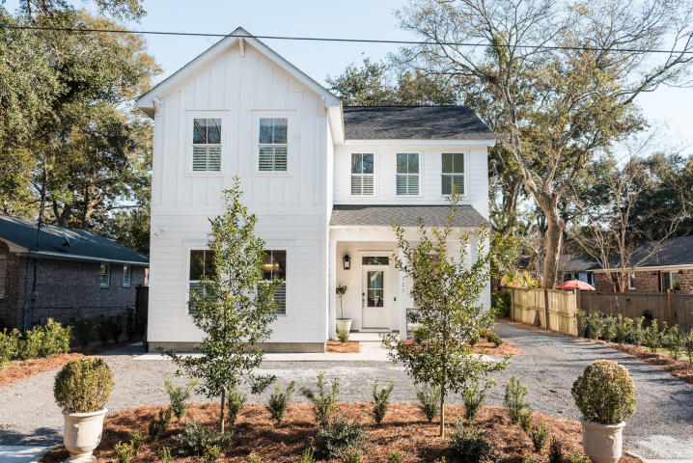
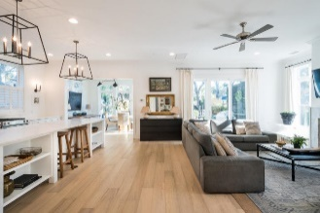
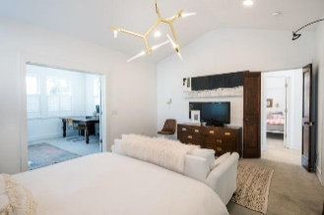
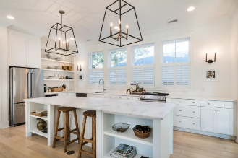
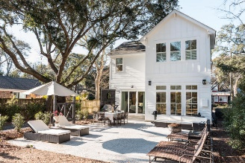
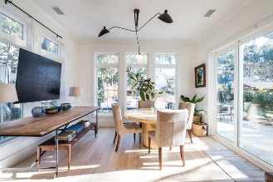
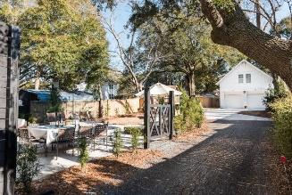
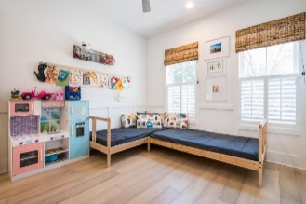
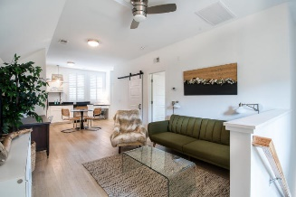


121 Freeman Street Old Mt Pleasant ~ Mount Pleasant ~ MLS# 18013145 ~ $1,395,000
Price Reduced To $1,075,000!
Plus Sellers Offering A $25,000
Allowance To Buyer
W/ Acceptable Offer!
Wine & Cheese
Drop-in Open House
Wednesday July 11th 5-7pm
ADDED BONUS!!! Above the detached two car garage is a 650 sq.ft. ADU with 1 BR, 1 BA, full kitchen, living/dining area. With separate outdoor living space and outdoor shower, it is perfect for a Mother-in-Law Suite, guest house, art studio, office or rental!. Combined sq. ft. of ADU and house is 3,100 sq.ft. The open floor plan, clean, sleek lines, natural light and textured decor' define the simplistic design of this beautiful home. The first floor flex room is currently used as a fourth bedroom, but could provide many additional options for a new owner. The kitchen is a chef's dream, equipped with KitchenAid stainless appliances, open shelving, Quartz counters and a large island with a honed marble counter top. Perfect for a large family or entertaining a crowd, the adjoining living area and dining room open to a spacious patio with a second outdoor shower...the perfect set up for grilling and lowcountry outdoor living! The backyard beyond allows room for children to play, gardening and additional parking. The master bedroom has a walk-in closet and adjoining study/sitting room. The master bath has double sinks with quartz counters, separate shower and soaker tub. Two additional bedrooms upstairs share a hall bath. Centrally located in one of the most desirable neighborhoods in Mt Pleasant, the Old Village is close to the Ravenel Bridge, Shem Creek, great restaurants, shopping, the beaches and just 25 minutes to the airport! The sense of community is evidenced from the number of golf carts you see taking children to school at Mt Pleasant Academy, joggers enjoying the views from the Old Bridge, neighbors with their pets in the dog park and tennis players on the courts just around the corner. Equipped with ''Smart House'' technology, the electrical and security systems are controlled from the panel and smart phone. The beautiful landscaping is low-maintenance. This well planned and much loved home is one you will enjoy showing. INVESTORS...PROVEN RENTAL HISTORY AND INCOME POTENTIAL FROM MAIN HOUSE AND ADU. See documents for details regarding rental history.
Mac Jenkinson
M (843) 224-0210
mac@carolinaone.com
Beth Moore
M (843) 532-4892
bmoore@carolinaone.com
www.jenkinsonandmoore.com
Jenkinson & Moore, LLC | Carolina One Real Estate | 1503 Palm Blvd | Isle of Palms, SC 29451-2280

