Slide 1
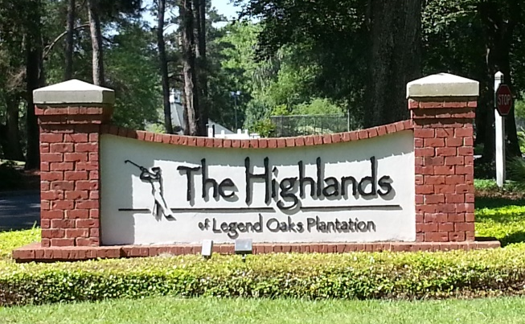

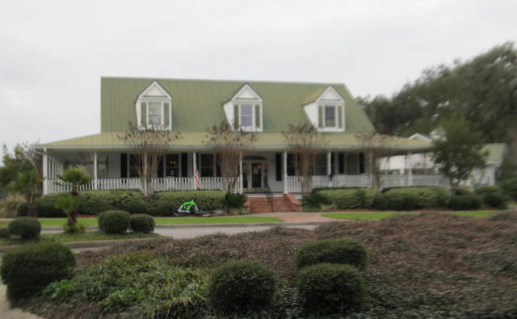
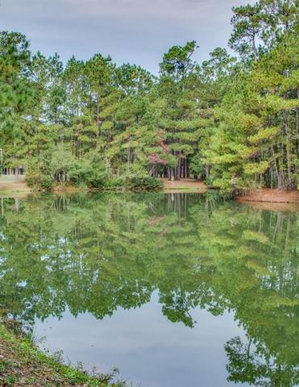
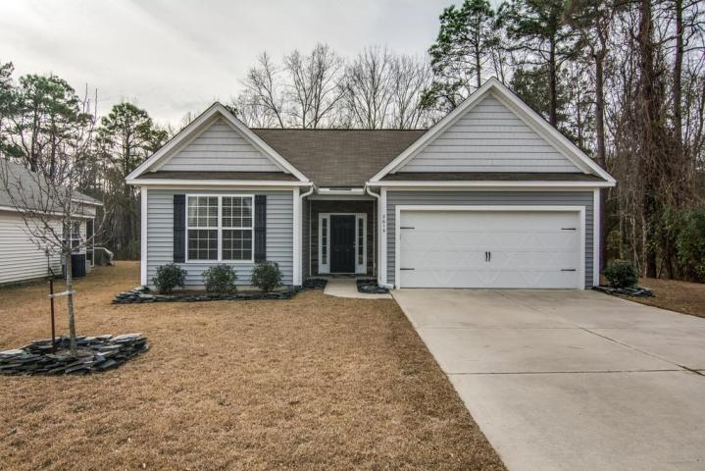
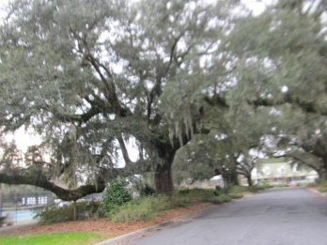
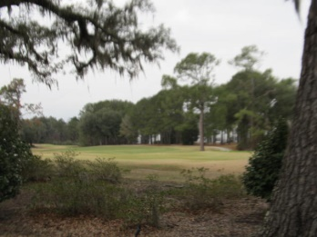
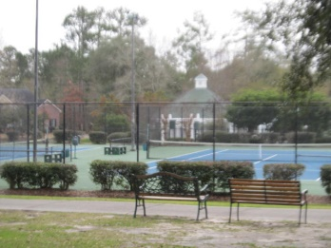
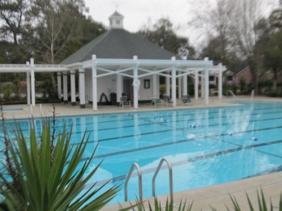
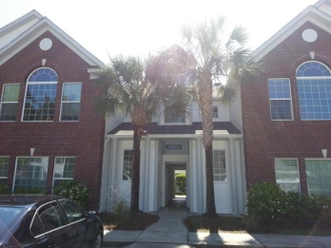
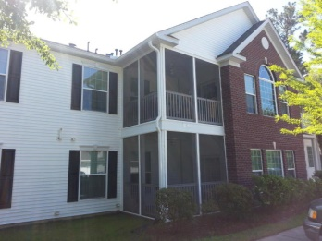
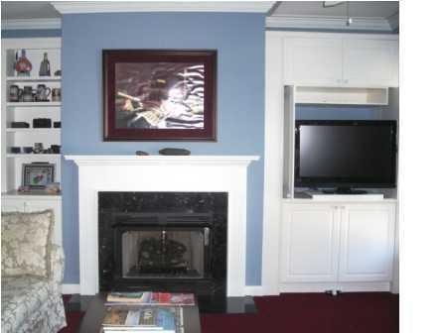
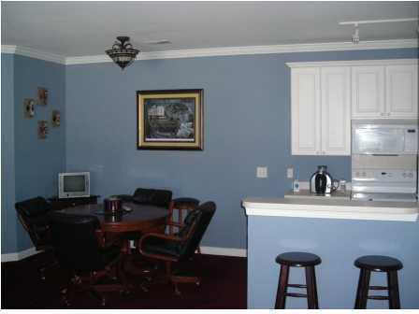


Location…
Location…
Location!
Charming &
Comfortable Living
121 Golfview Lane
· Investor's Special ·
· The Highlands of Legend Oaks Plantation · Summerville ·
· MLS# 15000329 · $137,500 ·
Spacious 2 bed, 2 bath condo in Beautiful Legend Oaks Plantation. Enjoy an active lifestyle in this condo just steps from the golf course, club house, swimming pool, tennis courts & walking trails. This second floor unit is just shy of 1700 sq ft.
The great room features vaulted ceilings, brand new thermal windows, and a cozy fireplace flanked by built-ins on both sides and adjoining the screened-in-porch.
The kitchen overlooks the living/dining areas w/breakfast nook, pantry & laundry room. The master suite has a separate sitting room/office, his and hers closets & dual sinks in the master bath, plus separate shower & garden tub. The 2nd bedroom is a nice size.
Tenant lease in place until Sept 14th, 2015. Buy as an investment or let the tenants help pay your mortgage until move-in.
Rents: $1100/mo
Julie Johnson
843-826-0088
juliemjohnson123@Gmail.com
AgentOwned Realty Premiere Group · 1800 Old Trolley Rd · Summerville, SC 29485

