Slide 1

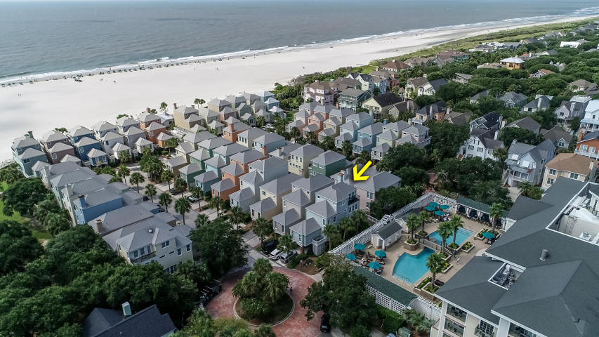
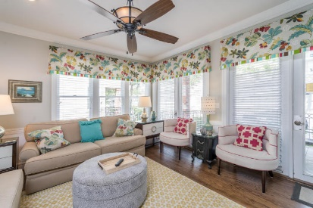
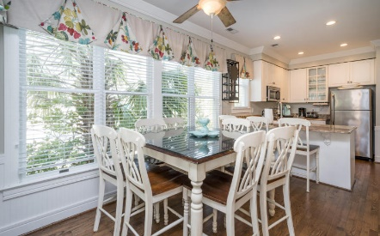
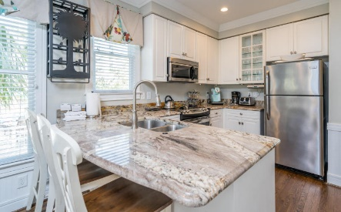
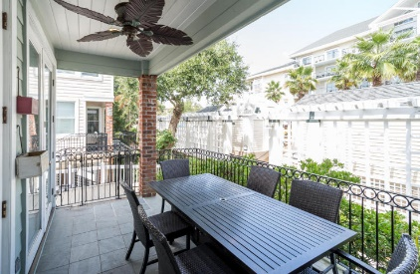
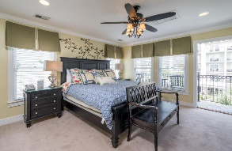
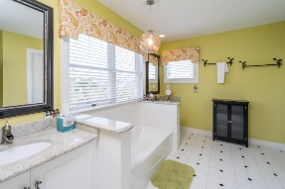
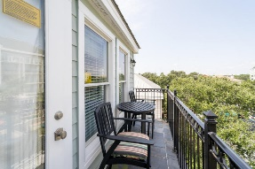
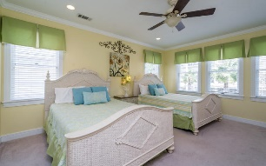
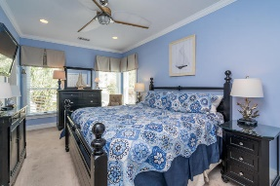
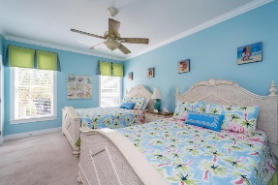
Wild Dunes Resort
Available For Showings This Week!
Ken Earnhardt
(843) 343-3872
ken.earnhardt@exprealty.com
www.kensellscharleston.com
121 Grand Pavilion Blvd | Isle of Palms | MLS# 18024069 | $1,049,000
Fabulous Grand Pavilion Resort home on the boardwalk.
Close to all resort amenities including Adult Pool, Family Pool, shops, spa, restaurants, tennis courts and the best beach area on the Isle of Palms.
Sold beautifully furnished. Home is currently on the Wild Dunes Rental Program.
22 windows replaced 2017. New stove/oven and dishwasher. Recently painted interior.
eXp Realty Charleston · 711 Fairview St · Fountain Inn, SC 29644

