Slide 1
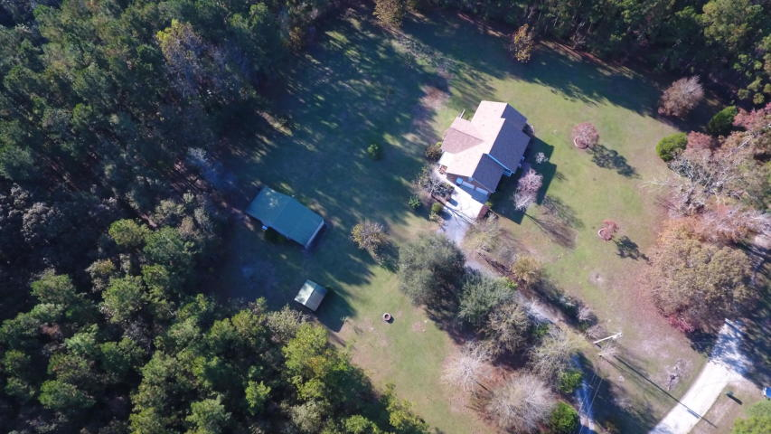
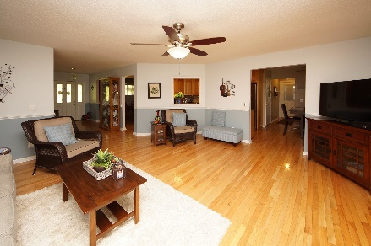
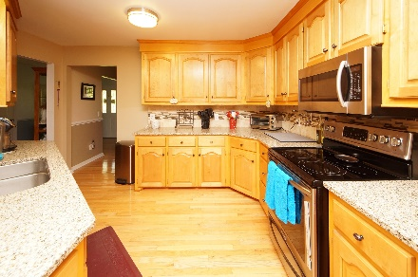
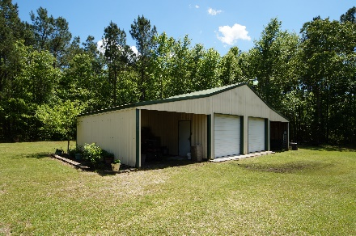


121 Orvin Street
Saint Stephen, SC 29479
MLS# 18011903 :: $358,900
3 Bed / 2 Bath
Home Sweet Home!
2.67 Acres!
Own this 3 bedroom 2 bath home and upstairs bonus room surrounded by 2.67 acres of land! New Roof Installed 2017! Seller built this home with hardwood floors, ceramic tile and a custom kitchen with birch cabinets, maple cabinet doors, granite and stainless appliances. Upstairs has attic space that is the length of the home...Potential square footage! Sun room over looks a picturesque back yard and a two car detached garage with 11ft commercial doors, loft, electrical and lean to on each side with back and side enclosed. Small shed is used as a green house. There are 2 septic tanks. One for the house and second located on left side of property with electric connection. Immaculate, Landscaped, Quiet & Well Maintained ready for a new owner. Country Living At Its' Finest!! FROG is not included in the square footage.
Connie White, Broker
843-532-3356
connie@chrepros.com · conniewhiterealestate.com
Charleston Homes · 597 Old Mt. Holly Road · Suite 301 · Goose Creek, SC 29445

