Slide 1
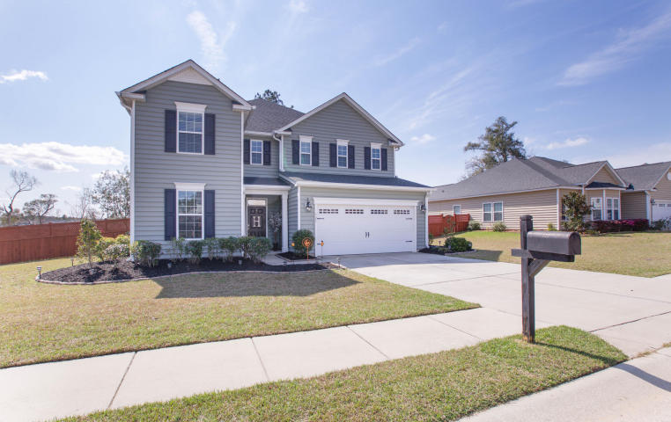
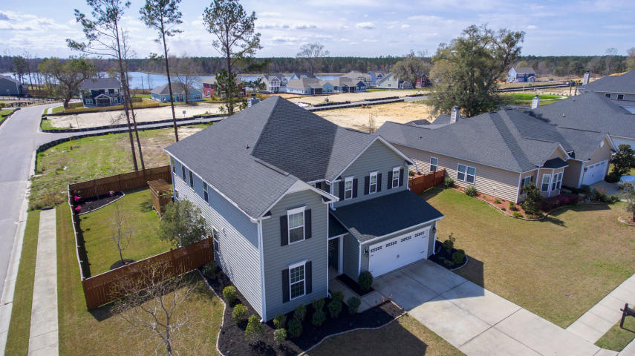
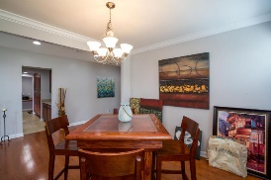
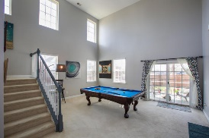
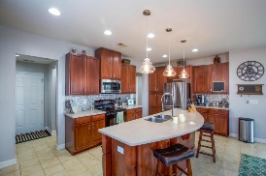
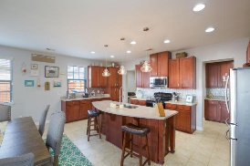
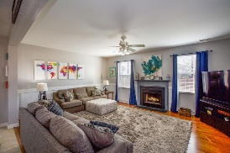
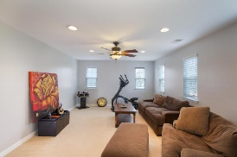
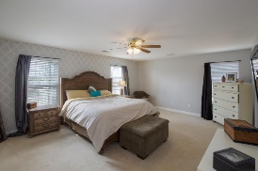
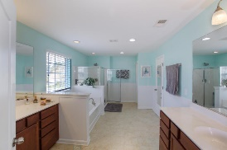
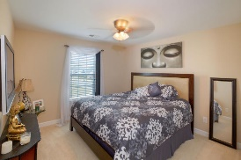
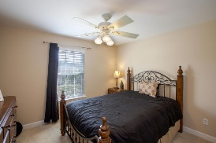
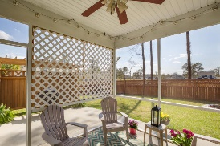
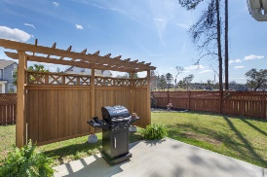
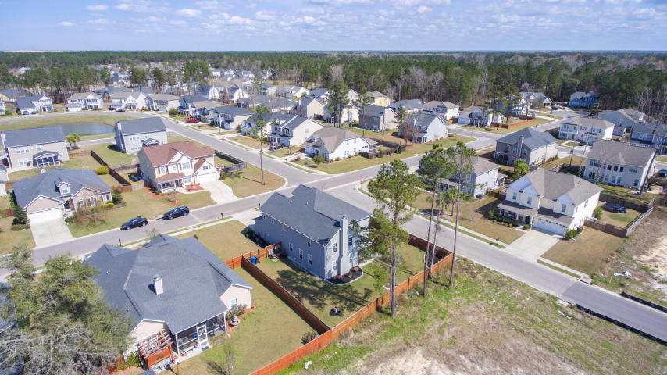

Excellent Value in Foxbank Plantation
121 Saluda Drive
Foxbank Plantation ~ Moncks Corner
MLS# 17005731 ~ $315,000
Beautiful two story home that is fully landscaped and has a privacy fence with multiple entry gates for accessing the back yard. Home has a full gutter system. Enter into this spectacular home and view the spacious foyer. The main level has a bedroom that maybe a guest/mother-in-law/older child room, has enormous kitchen with large butler's pantry and plenty of storage. Stainless steel appliances. The kitchen looks into the family room and is open and full of light. The home also has room for formal dining/living space or can be used as a game room. The upstairs has a very large Master Bedroom and Bathroom with two closets (his/hers). There are two additional bedrooms upstairs along with a large bonus room that can be used as play/media/ or additional bedroom. Plenty of room and space and can be used according to your preferences/needs. All Furniture is negotiable.
Lifestyle features of Foxbank Plantation offers a swimming pool, fitness center, 67 acre lake, 141 acres of protected wetlands as well as a state of the art elementary school (opening 2018), along with shops, churches and other business offices.
Deborah Meuli
O - (843) 491-1445
M - (843) 822-0133
dmeuli@comcast.net
LifeTree Real Estate, LLC
3094 Hwy 17 North
Mt. Pleasant, SC 29466
www.lifetreerealestate.com

