Slide 1
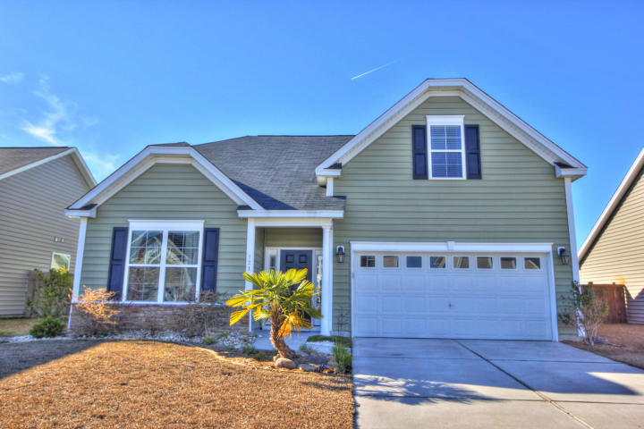
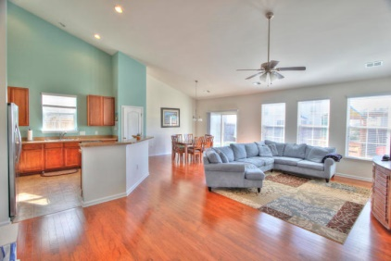

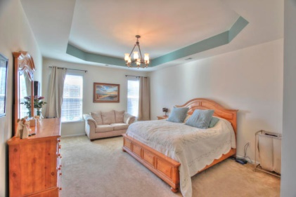
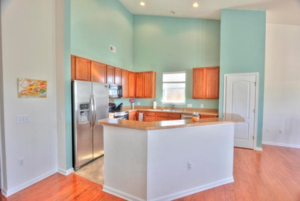
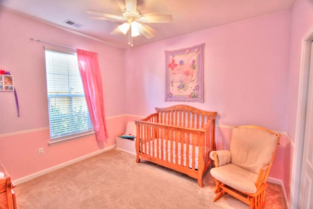
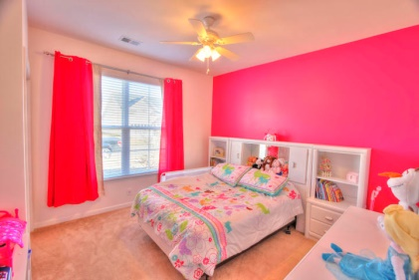
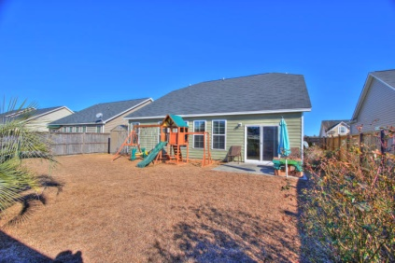



121 Satur Drive
Royal Oaks
Goose Creek
MLS# 15001520
$210,000
4 Bedrooms
3 Bathrooms
2,247 Sq Ft
Immaculate home in desirable Goose Creek location.
Just a few of the many features of this open floor plan home include:
Large family room with wood flooring and soaring cathedral ceiling;
Kitchen with bar seating, 42'' cabinets and abundance of counter and cabinet space;
Huge master suite split from other bedrooms with tray ceiling, walk-in closet, dual vanities, garden tub and separate shower;
Perfect guest suite available on 2nd floor with bedroom and private bath.
Outdoor offers large fenced yard that extends beyond fence and a 10 x 12 patio.
Ultra convenient location within minutes of:
Airport
Boeing
Interstates
Beaches
Downtown Charleston
Donald Russell
Cell - (843) 478-5015
Donald@ChuckTownHomes.com
Jeremy Wilson
Cell - (843) 478-8532
Jeremy@ChuckTownHomes.com
www.ChuckTownHomes.com
24-hour recorded property info 1-888-210-3348 ext 2997

