Slide 1

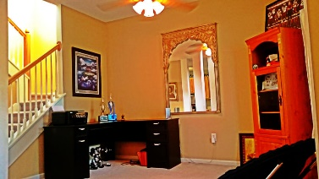
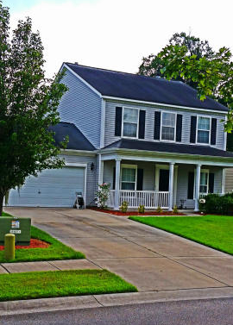
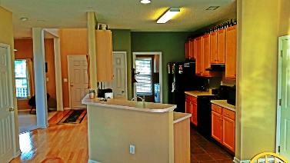
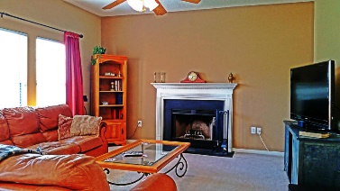
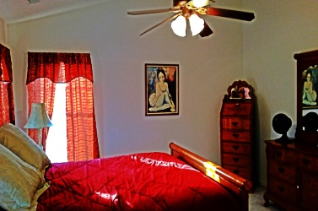
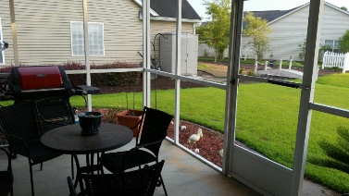
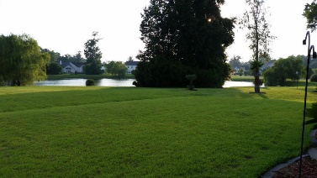



Where convenience and lifestyle collide
121 Walnut Creek Rd
Grand Oaks Plantation
Charleston, SC 29414
MLS# 15016417
$240,000
1,656 SF
3 Bedrooms :: 2½ Bath
Harrington Place in Grand Oaks Plantation. This open floor plan is sure to WOW!!! Big kitchen, oversized breakfast nook, formal dining room (currently being used as an office space)and large living area all flow together effortlessly. The master and secondary bedrooms are located upstairs. The master suite has a large bathroom with double vanity. The walk in closet is HUGE!!! The secondary bedrooms are both big and bright. Oh yeah, and this lot backs up to the pond and has a great screened in porch. I bet you can almost see yourself sitting out on the porch enjoying your coffee and the nice views... don't worry if its too hot you can enjoy the same views from the kitchen and living room, too! You really should come see this one today.
Lizzie H Ray
(843) 452-9298
lizzieray1122@gmail.com
Eric Draper
(843) 442-7118
eric.draper@gmail.com
www.charlestonrealestategroup.com
Charleston Real Estate Partners. LLC | 792 Folly Rd. C1 | Charleston, SC 29412

