Slide 1
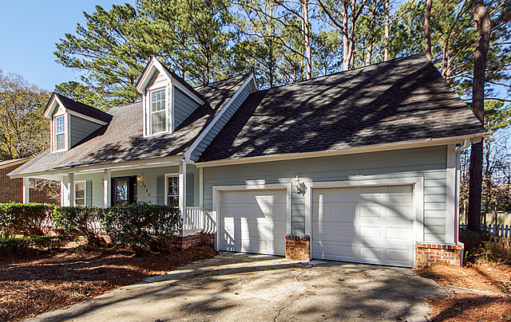
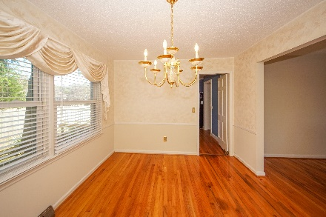
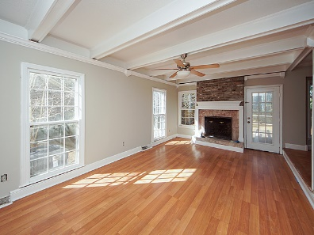
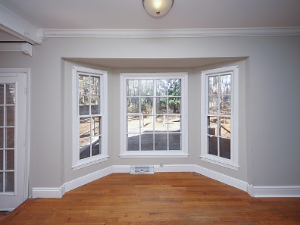
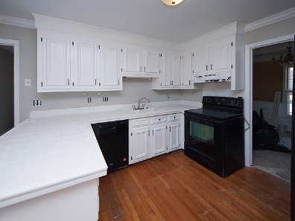
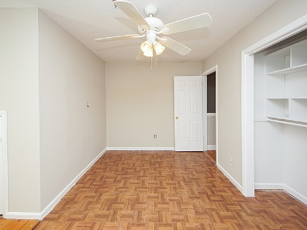
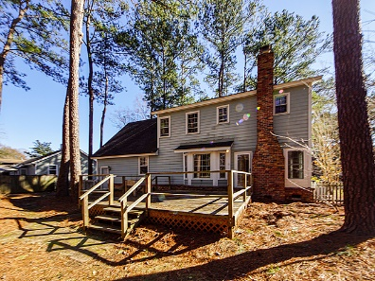


121 Cherry Hill Avenue
Crowfield Plantation | Goose Creek, SC 29445
MLS# 22020691 | $2,200
Otranto Beauty
$318,000
Open House Sunday 12:30-3:30
Rental Property
Move In Ready!
Great opportunity to live/rent a home in Crowfield Plantation! Features include 3 bedrooms, 2.5 bath, living room, eat in kitchen, and separate dining perfect for office space. Enjoy evenings on your front porch or privacy on the back deck with a large fenced in back yard. Cherry Hill Subdivision has a pool and this community is close to the play park and walking trails, shopping restaurants, I26 and I526.
Come take a virtual tour: https://charlestonvirtualhomes.com/2220012
Connie White, Broker
843-532-3356
connie@conniewhiteteam.com · conniewhiterealestate.com
Connie White Real Estate Brokers By EXP · 102 Six Point Court · Goose Creek SC 29445

