Slide 1
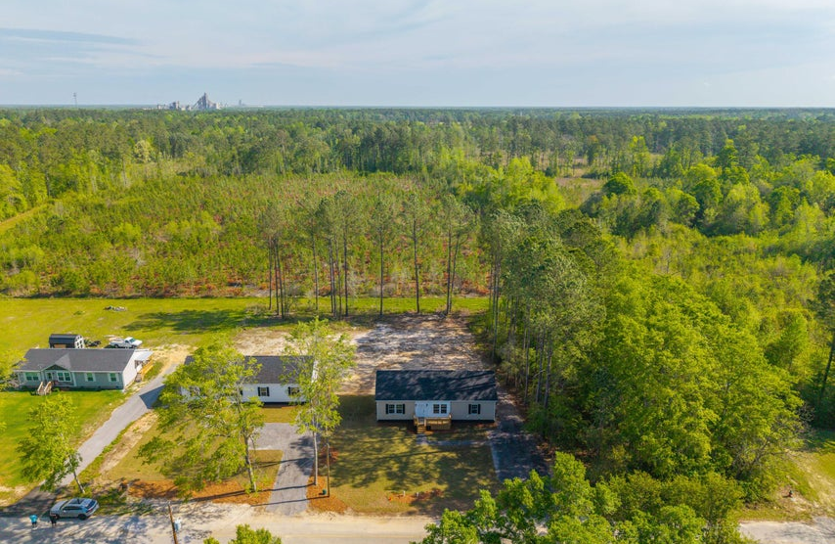




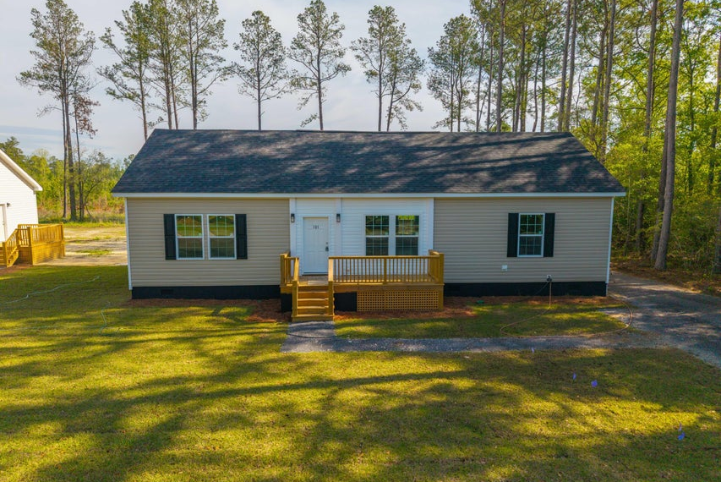
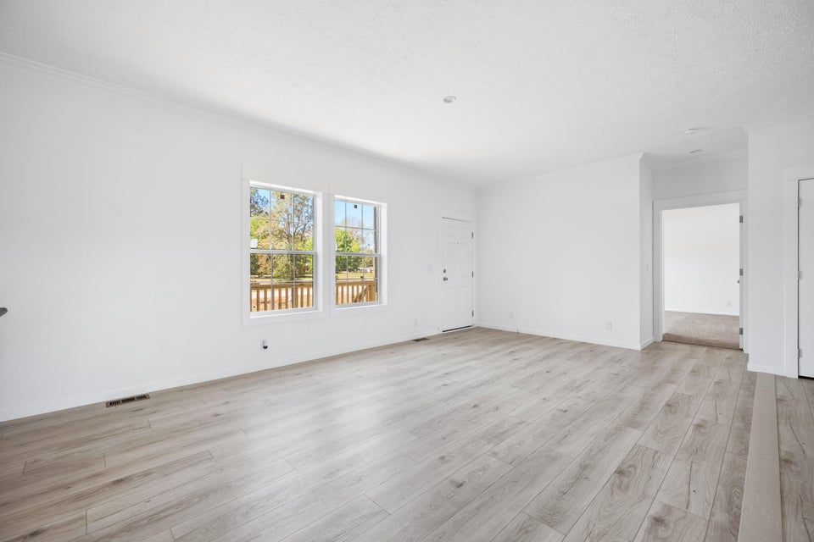
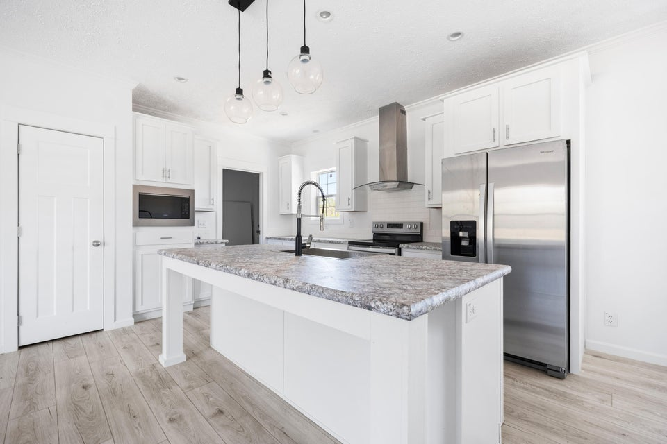
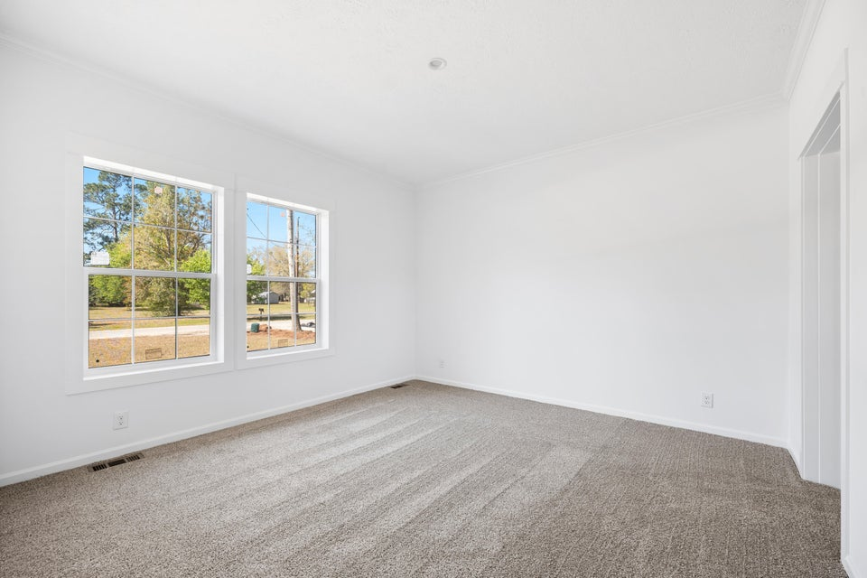

NEW CONSTRUCTION
121 Dotson Street
Harleyville, SC 29448 | MLS# 25009308 | $309,900
NEW CONSTRUCTION located in the town limits of Harleyville. Sitting on a half acre lot with no HOA! 2 miles off I-26 & easy commute to I-95, Summerville, St George, Holly Hill, Walmart Distribution Center and Volvo. This home is a modern 3 bedroom 2 bath open kitchen and living area floor plan with a welcoming front porch. The large kitchen has stainless steel Energy Star appliances, and a centrally located island. An adjacent dining area and living room coupled with the 9' ceilings. Bedrooms are carpeted and LVP flooring throughout.
Telecia Bilton
843-412-3586
tmbilton@rogcoastal.com
Amber Cammer
843-972-9450
acammer24@gmail.com
Realty ONE Group Coastal | 1510 Trolley Rd | Summerville, SC 29485

