Slide 1
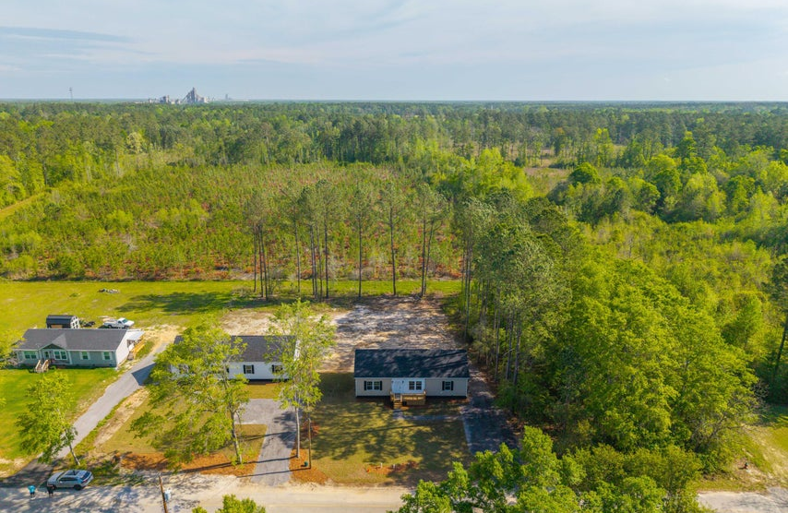



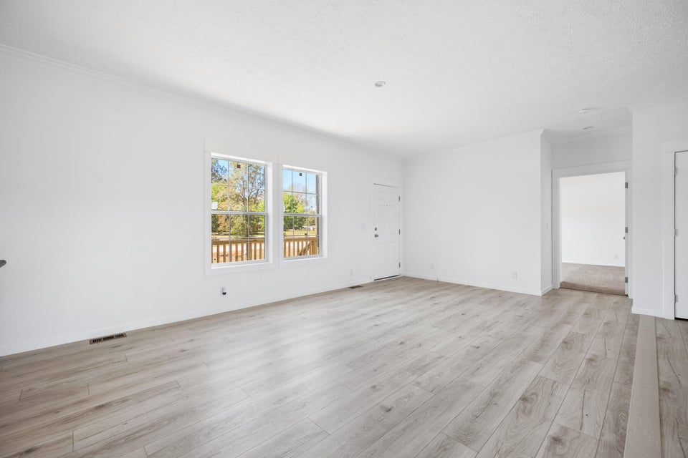
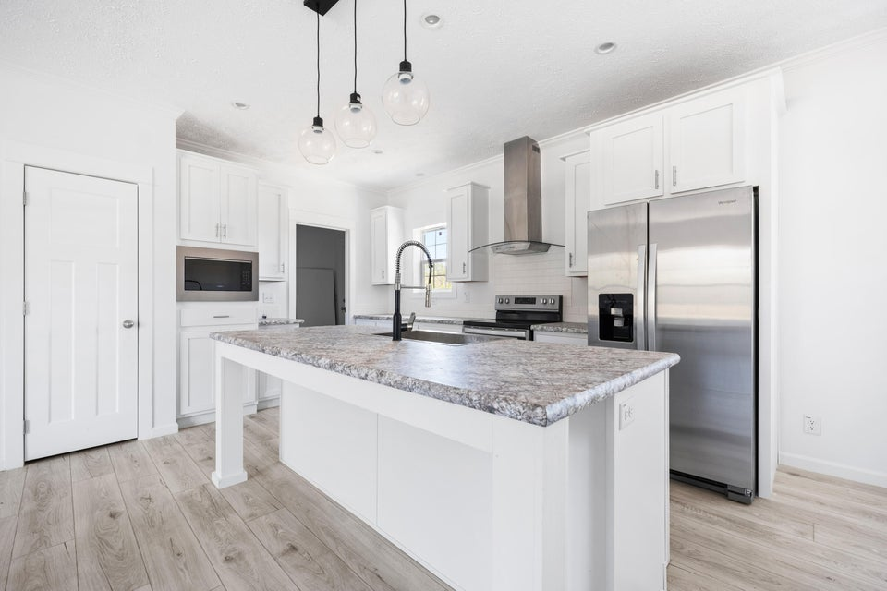
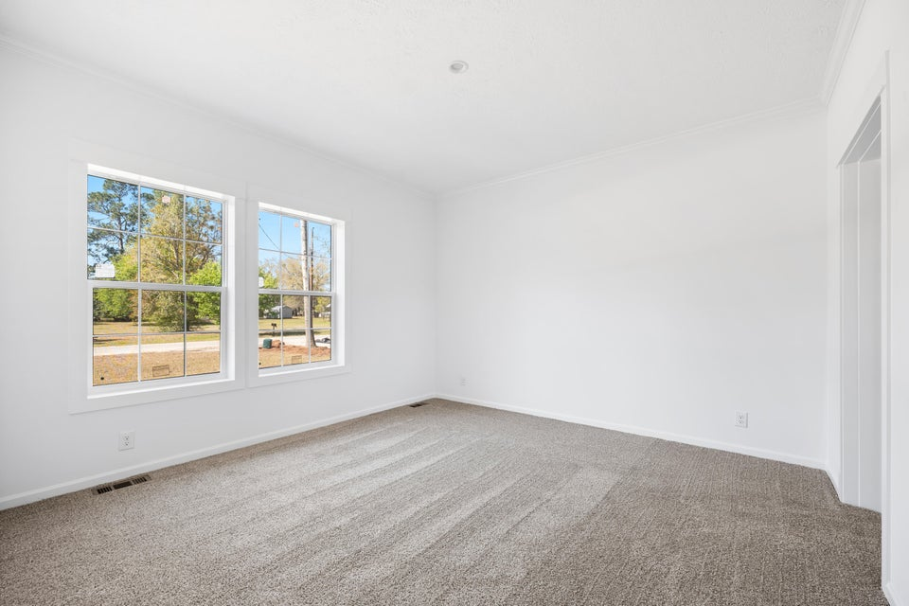
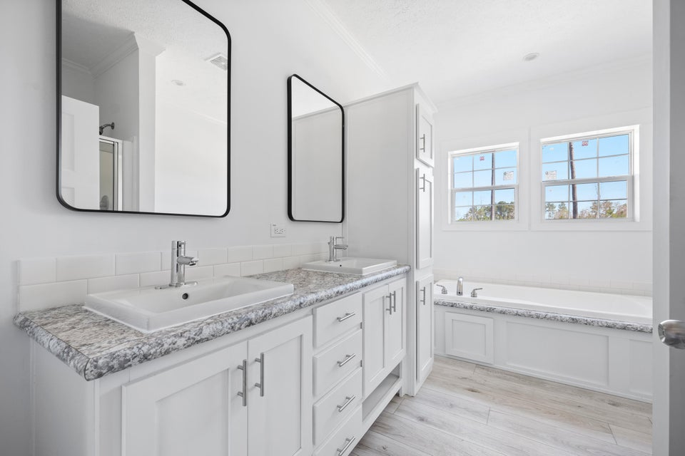


NEW CONSTRUCTION
121 Dotson Street
Harleyville, SC 29448 | MLS# 25009308 | $299,900
Brand-New Construction in Harleyville - No HOA & Prime Location! Welcome to your brand-new home, located within the town limits of Harleyville and perfectly positioned on a spacious half-acre lot with no HOA—offering both privacy and freedom. Just 2 miles from I-26 and within easy reach of I-95, Summerville, St. George, Holly Hill, the Walmart Distribution Center, and Volvo, this home is ideal for commuters looking for comfort and convenience. Inside, you'll find a modern 3-bedroom, 2-bath layout featuring an open-concept kitchen, dining, and living area—perfect for everyday living and entertaining. The heart of the home is the stylish kitchen, complete with stainless steel Energy Star appliances, a center island, and a seamless flow into the dining area and spacious living room, all enhanced by 9-foot ceilings for an airy, open feel. Enjoy luxury vinyl plank flooring throughout the main living spaces, while cozy carpet adds comfort in the bedrooms. A welcoming front porch completes the charm of this thoughtfully designed home. Don't miss your chance to own a brand-new home with room to breathe and no HOA restrictions...schedule your showing today!
VIDEO TOUR
Telecia Bilton
843-412-3586
tmbilton@rogcoastal.com
Amber Cammer
843-972-9450
acammer24@gmail.com
Realty ONE Group Coastal | 1510 Trolley Rd | Summerville, SC 29485

