Slide 1
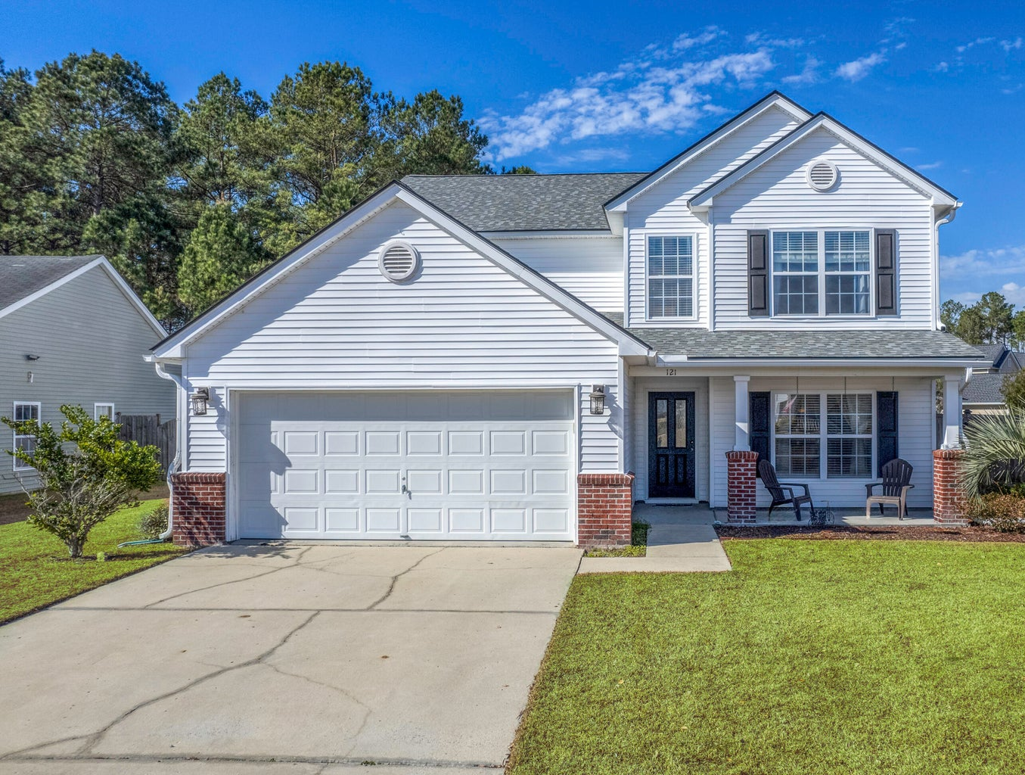
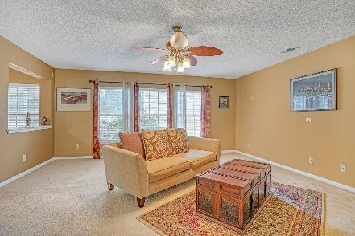
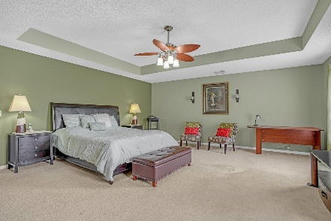
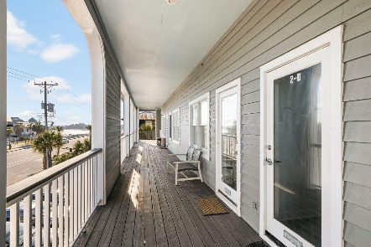
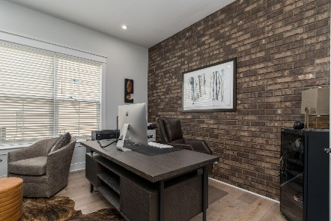
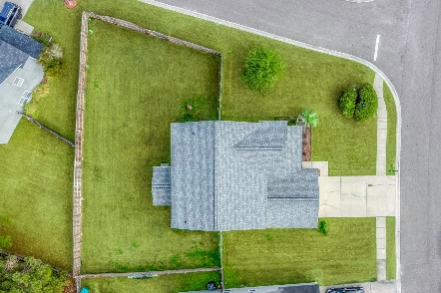
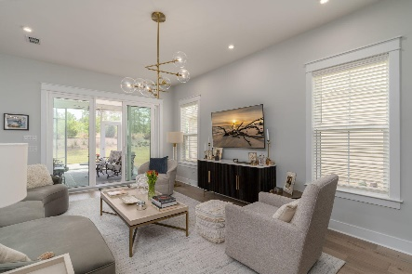
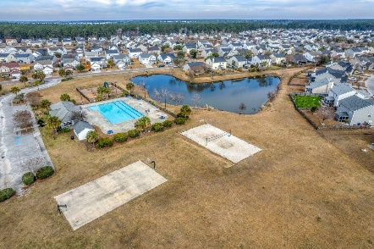

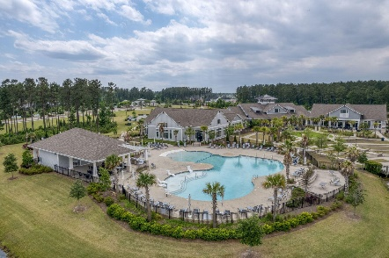
121 Waylon Drive
Weatherstone | Summerville, SC 29483 | MLS# 24004072 | $465,000
Darrell Creek Elevated Home With Elevator & Salt Pool
Just Listed & Open House in Weatherstone
Stop By Saturday 2/24 from 1-4 PM
Co-sponsored by
Offering $3000
Lender Credit
Welcome home to 121 Waylon Drive! This expansive 5-Bedroom, 3-Bathroom home is a rare find in the beautiful Weatherstone Community in Summerville, SC. Boasting 2722 SF of living space on almost a quarter acre, fully fenced lot, this residence stands as one of the largest homes with one of the largest lots in the area. Sip your mornng coffee on your front porch across from the tranquil pond and take in the views! Upon entering, downstairs greets you with a grand layout, including a spacious Family and Dining Room, a Formal Living Room, and a Large Eat-In Kitchen with New Stainless Steel Appliances! Around the corner is a Bedroom, which could also serve as a Den or Study, Full Bath, and Laundry Room. The screened back porch offers a perfect retreat for unwinding or entertaining.
Upstairs you will find 3 more generously sized Bedrooms and another Full Bath. One of the highlights of the home is the Luxurious Master Suite! It will take your breath away, with tray ceilings, a sitting area, en suite bath, and His and Her Walk-In Closet.
Residents of Weatherstone can enjoy a variety of Amenities, including a sparkling pool for cooling off on hot days, a basketball court, a sand volleyball court, and an awesome playground where the kids can make memories! The Bus Stop itself, is right in front of the home. Within 5 minutes you can be Dining and Shopping at Azalea Square or Nexton Square, as well as I-26 for easy commuting! You are within 10 minutes to downtown Summerville and less than 30 minutes to Downtown Charleston. From relaxation to convenience, this Neighborhood offers it all!
The home also has a New Roof, HVAC, and Appliances. This unique home will not last, call for your showing TODAY! Lender is also offering up to $2500 in Closing Cost or Rate Buydown.
House Tour
Elissa Campbell
843-853-1433 | elissa.campbell@agentownedrealty.com
AgentOwned Realty Preferred Group | 824 Johnnie Dodds Blvd | Mt Pleasant, SC 29464

