Slide 1
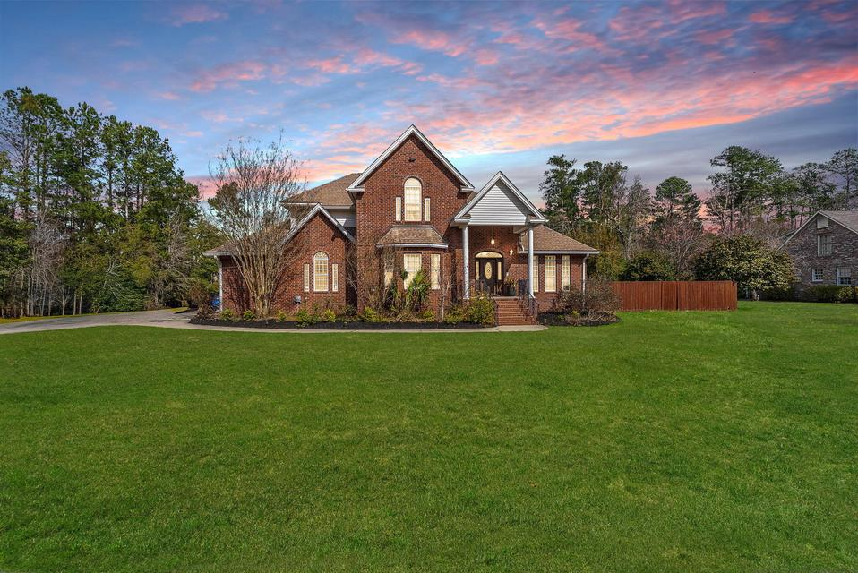
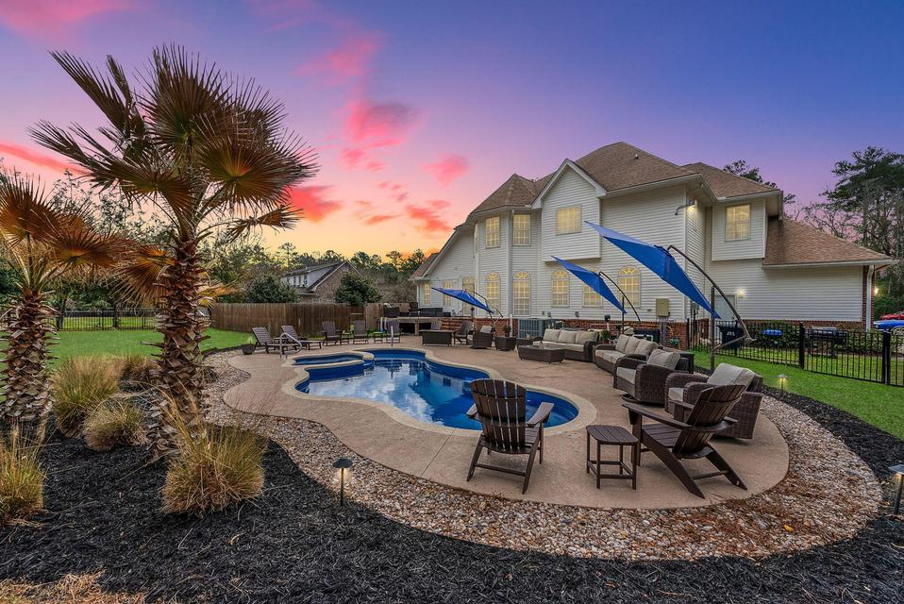
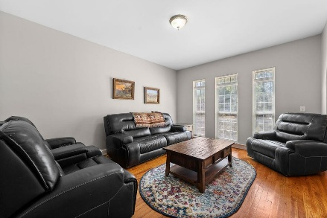
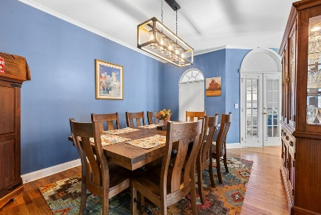
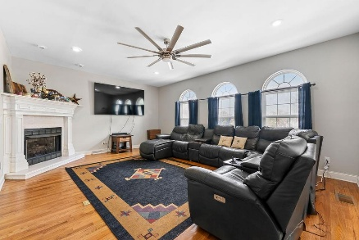
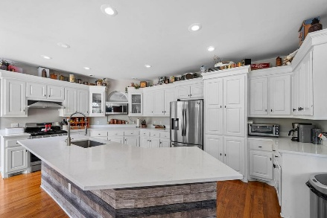
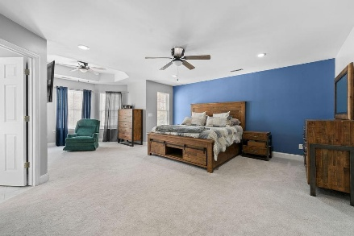
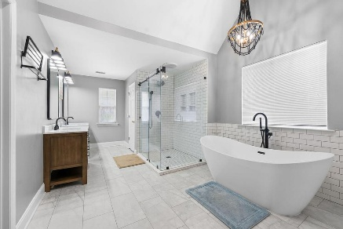
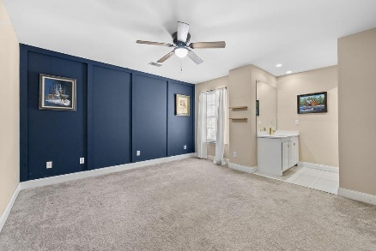
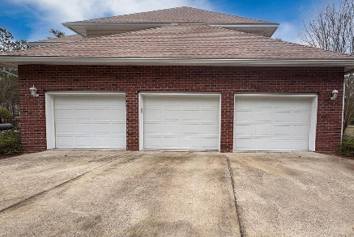


121 Wintergreen Road
Beautiful Home With Pool In Walterboro On Over An Acre
Silverhill | Walterboro, SC 29488
MLS# 26005652 | $749,000
Welcome to a home designed for both everyday comfort and unforgettable gatherings. From the inviting curb appeal to the spacious interior, this impressive over 4500 square foot home offers the perfect blend of warmth and functionality. At the heart of the home is a chef's dream kitchen featuring abundant cabinetry, generous counter space and wonderful appliances. Every bedroom enjoys access to a bathroom, providing comfort and privacy for family members and guests alike. The primary suite is a true retreat, offering space to unwind and recharge. The stunning primary bath feels spa-inspired with dual vanities, a soaking tub, and an oversized tiled shower that elevates daily living. The huge walk around closet is everyone's dream! The spacious great room offers a warm and inviting atmosphere, perfectly positioned just off the kitchen for everyday living and entertaining. Beautiful hardwood floors flow adding great character.
The beautifully framed gas fire place is a classic focal point that anchors the room and provides cozy ambiance during the cooler months. Flexible spaces throughout the home offer endless possibilities -- create a home gym, office, playroom, or additional living area to fit your needs. A spacious three-car garage adds practicality with room for vehicles, storage, or hobbies. Step outside to your fully fenced private backyard oasis that is over an acre that features lovely landscaping, a beautiful in ground pool with hot tub, and patio area, which is perfect for summer gatherings and quiet evenings at home. Most of the pool furniture will convey. Come see this home in person to appreciate all it has to offer. Priced below recent appraisal.
TAKE A VIDEO TOUR
Kelly Rozier
(843) 209-3129
kellywrozier@gmail.com
Brand Name Real Estate
4 Carriage Lane Suite 106
Charleston, SC 29407

