Slide 1
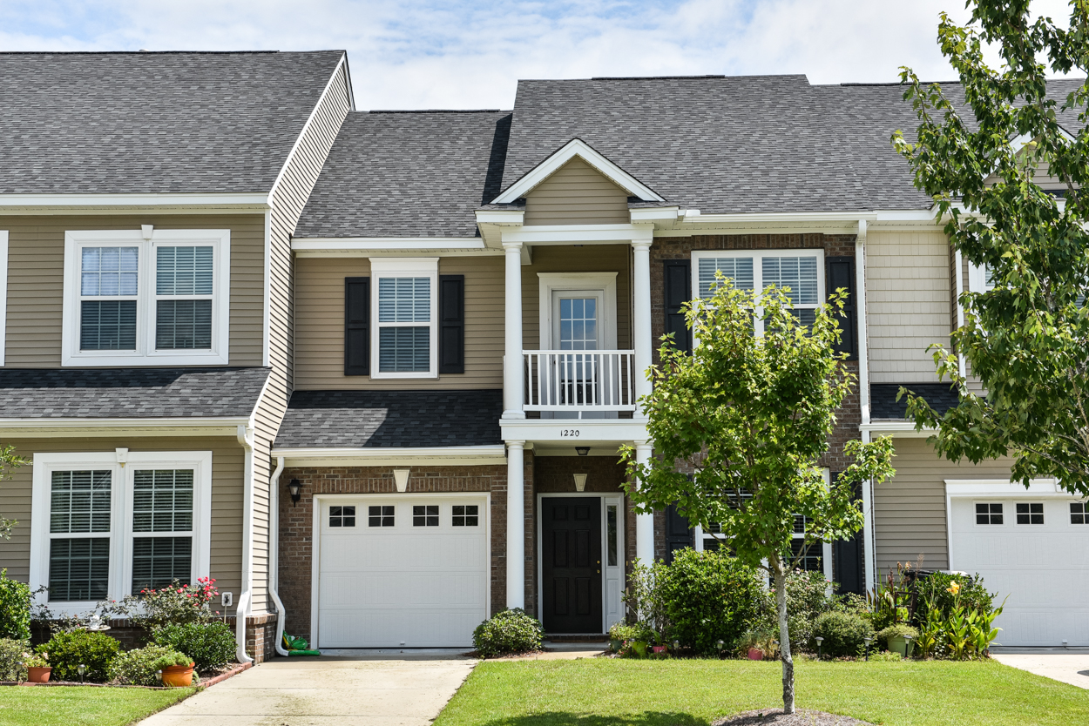
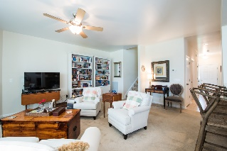
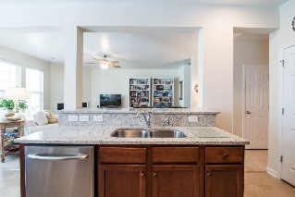
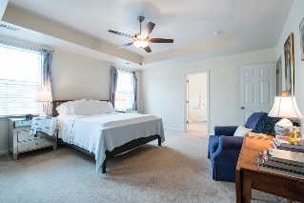
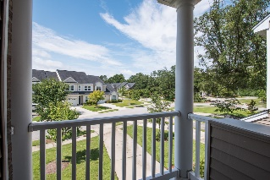
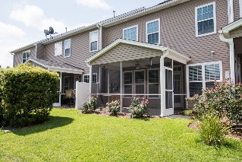


1220 Circle Oaks Drive Cain Crossing - Charleston - MLS# 16021832 - $250,000
Luxury Townhome! Just Listed!
Welcome home to Cain Crossing! A great townhome community nestled among beautiful oak trees and with community pool. This townhome is the largest floorplan with a third floor that can be used as fourth bedroom, office or media area. Spacious living on the first floor with an open floor plan with updated kitchen granite countertops and new dishwasher, stove, and microwave and eat in breakfast area. The great room has a wall of windows to enjoy the natural light, a gas fireplace and a screened porch off that breakfast nook to enjoy outdoor space. The kitchen has 42'' Maple cabinets, lots of counter space and island with a double sink, and eat in bar area. The master bedroom is on the second floor with large walk in closet, tray ceilings with ceiling fan and access to master bath. Dual vanity with large mirrors, separate water closet, garden tub, glassed in shower. There are two other bedrooms and another full bath on the second floor as well as the laundry room. There is an outdoor balcony off the second bedroom. The third floor can be a 4th bedroom, media room or a great office. Beautiful sky lights allow natural light and great storage as well. Additionally, there is a one car garage with good storage.
Charla McDonald Office - (843) 884-1622
Cell - (843) 343-1456
Fax - (843) 746-4845
cmcdonald@carolinaone.com
charlamcdonaldproperties.com
Carolina One Real Estate
628 Long Point Rd
Mt Pleasant, SC 29464

