Slide 1
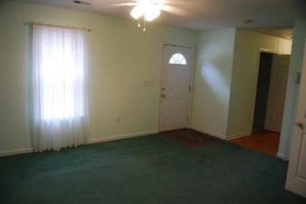
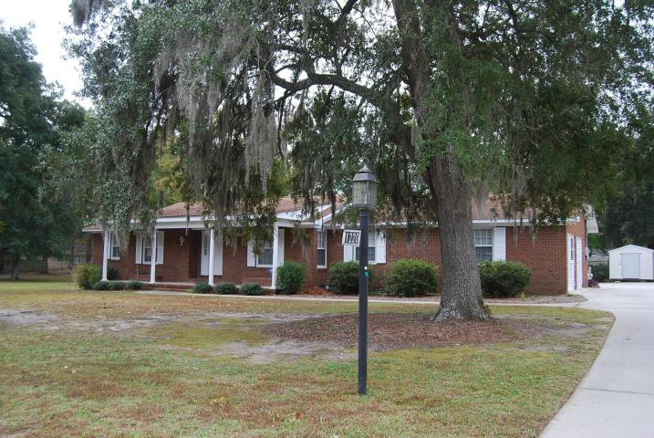
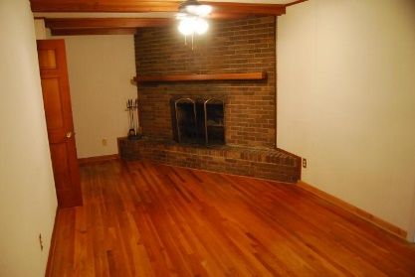
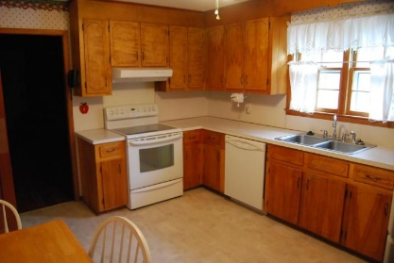
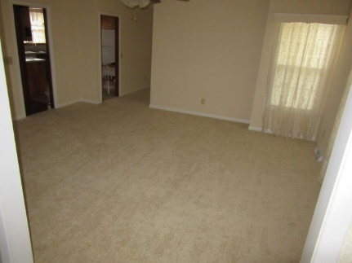
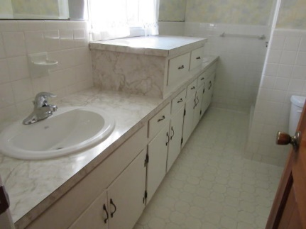
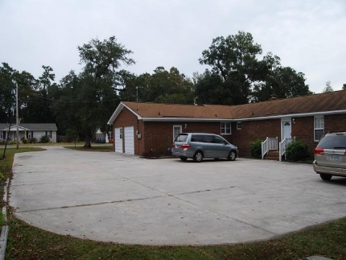
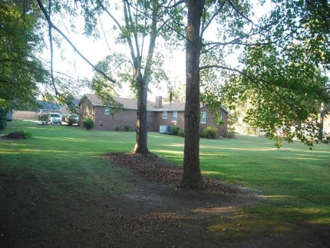


1220 Old Fort Road
Fairlawn Barony ~ Moncks Corner ~ MLS# 14028547 ~ $249,995
$1,000 Agent Bonus with accepted offer by Sept 21, 2015
Welcome Home!!! Come enjoy the grounds. Old Oaks and Magnolias give a touch of the Old South to this immaculate ranch style all brick home in the heart of Moncks Corner. This home in Fair Lawn Barony offers all the space you will ever need and a Mother-in-law suite to boot. The main house has been freshly painted through out most of the house and has 4/3 spacious bedrooms and 3 full baths. Formal living room and Dining rooms great for entertaining. Kitchen has eat in area and plenty of cabinet space. Great room offers an all brick wood burning fireplace for those chilly evenings. Hardwood floors in bedrooms (except mother in law bedroom), hallway and great room. o Ceramic tile in 3 of the 4 baths. Mother in law suite has a private entrance, own laundry, full bath and kitchen.
Rhonda Tudor
Pager - (843) 728-2346
Mobile - (843) 709-8800
rhonda_tudor@yahoo.com
Coldwell Banker United, Realtors
205 St James Ave # 5
Goose Creek, SC 29445-2938
www.rhondatudor.net

