Slide 1
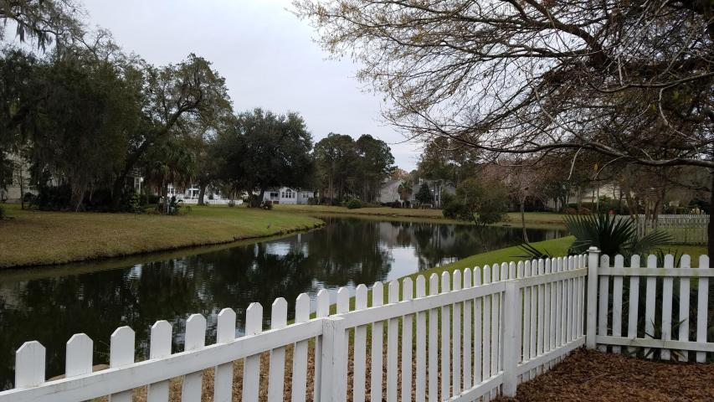
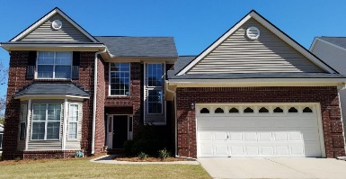
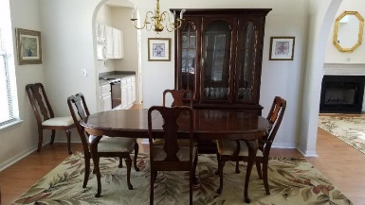
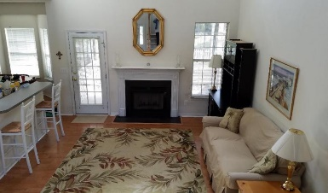
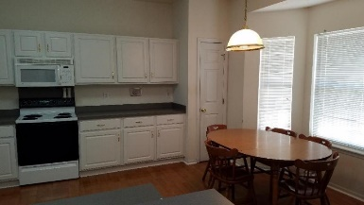
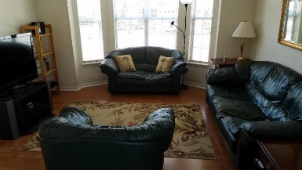
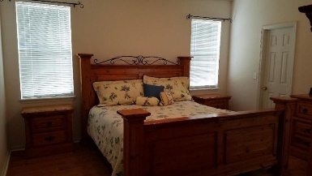
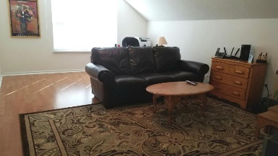
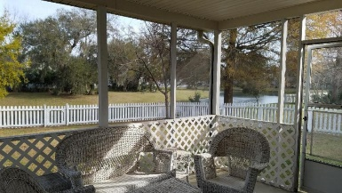
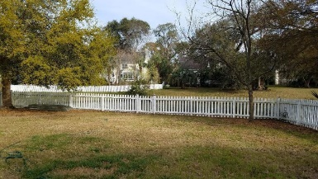
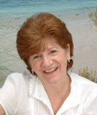

1220 Wild Olive Drive
Seaside Farms ~ Mt Pleasant, SC 29464
MLS# 18007670 ~ $2,950
Do you need a rental ASAP?
This home is waiting for you
Do you need a rental ASAP - this home is waiting for you
Large 4 bedroom home in Highly sought after Seaside Farms & on a beautiful, serene pond lot! Enjoy the convenience of walking to the shops, restaurants, walking trails, fishing ponds etc. that make up this beautiful community close enough to the beach to bike. Enjoy your morning coffee or tea on the large screen porch while being entertained by the sights & sounds of nature. Master Bedroom downstairs with 2 generously sized bedrooms upstairs along with the extra large FROG that makes the 4th bedroom. Formal living room & dining room. Bright cheery kitchen open to the family room and overlooks the private back yard.
Maggie Curtis
REALTOR, EPRO, LMC, ABR
(843) 693-8207
maggiecurtis@comcast.net
Coldwell Banker Residential Brokerage
1127 Queensborough Blvd. 103
Mt Pleasant, SC 29464

