Slide 1
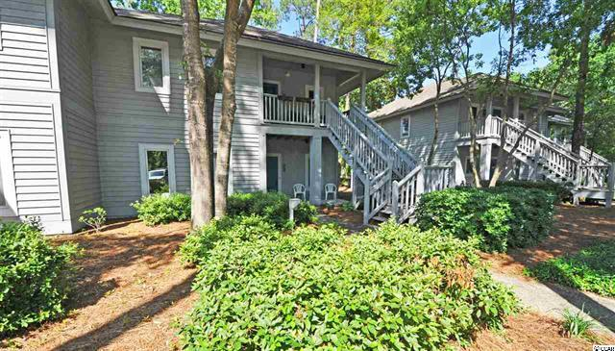
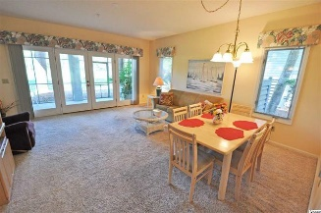
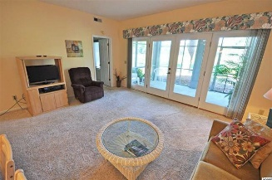
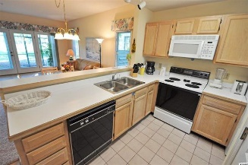
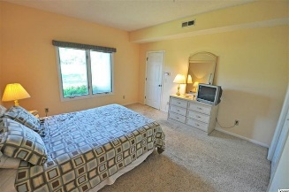
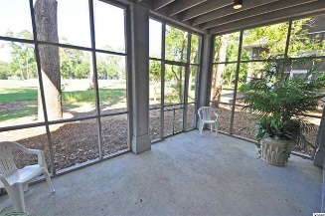
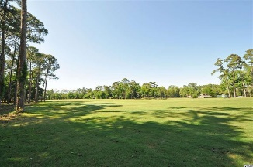
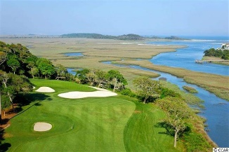
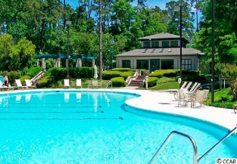
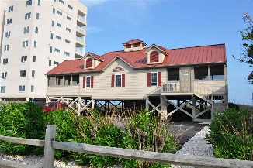


1221 Tidewater Drive
Teal Lake Village @ Tidewater Plantation Resort
North Myrtle Beach ~ MLS# 1609930 ~ $119,000
So sought after! Finally a first-floor end unit in popular Teal Lake Village of Tidewater Plantation Resort. Overlooking the driving range and peaking at the golf course, the view is sweeping and ever-changing, yet quiet and relaxing, particularity when enjoying the spacious screened-in back porch. But there is much more. Not only is there ease of main-level access but convenient adjoining parking as well, along with an open floor plan that allows the same unlimited view from the entry, kitchen, dining/living rooms and master bedroom. Golfers, families, pet owners and more, this condo is just simply comfortable and meets the anticipation of stroll-in and out from both the front and rear entrances, the rear being off of the porch. Teal Lake, itself, is very comfortable as well, with its own community pool, walking path, cottage-like atmosphere and natural wooded environment. Plus everything conveys in this refreshed 2 BD/2BA well-designed condo, featuring good storage space and even a comprehensive home warranty. Looking for main floor, looking for end unit, look no farther! And it's Tidewater...Prestigious Tidewater Plantation -- one of the top rated golf courses on the Grand Strand -- features 24-hour gated/manned security. Tidewater amenities include an oceanfront beach cabana for owners' use with open/screened porches, bathrooms, showers and kitchen. Teal Lake owners also enjoy the use of a private pool surrounded by wooded, circular walking path around pool - perfect for dog-walking or a leisurely stroll. Other amenities include 2 additional pools/hot tubs, driving range, golf shop, clubhouse with bar and dining facilities overlooking the 18th hole, clay and hard surface tennis courts, pickle ball court, and amenity center for public/private events. Group activities include outdoor summer concert series, work out classes including water aerobics, weekly art classes, Happy Hours, dinner clubs, book clubs, bridge club, dart group, mahjong, holiday events and more! In addition, Tidewater boasts a gated, security monitored storage area for boats, jet skis, motorcycles, kayaks and trailers. Tidewater Plantation and its full range of amenities truly reflects a "way of life" where friendly neighbors will welcome you to your new home!
Deborah Collins
843-424-9013
dctidewater@yahoo.com
Connie Ross-Karl
702-306-2643
conniesross@aol.com
NEW WAY PROPERTIES MYRTLE BEACH

