Slide 1
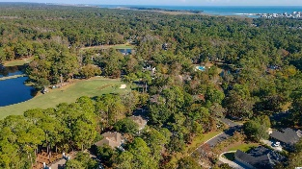
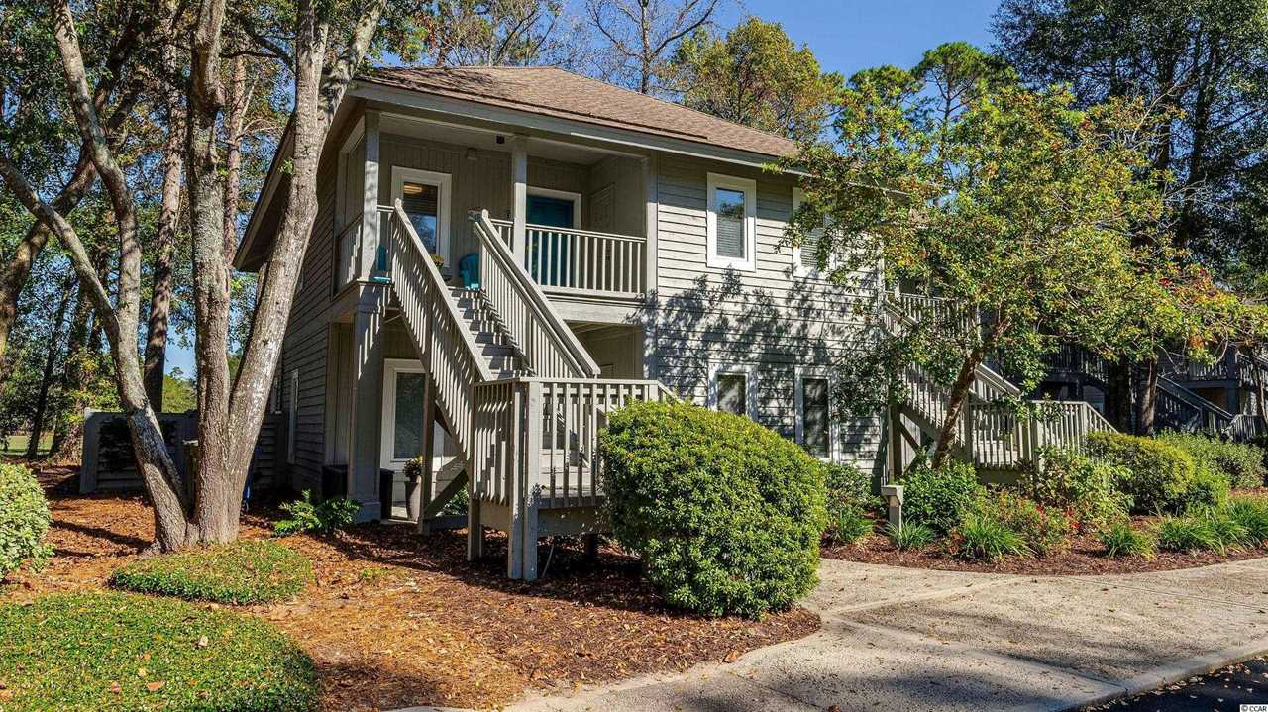
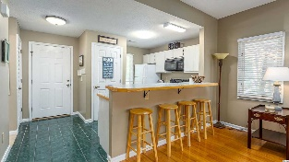
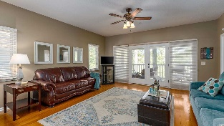
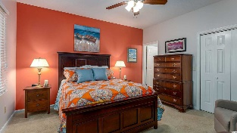
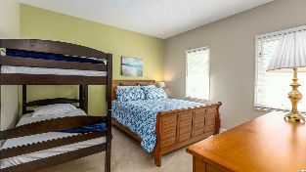
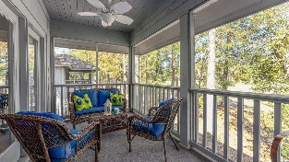
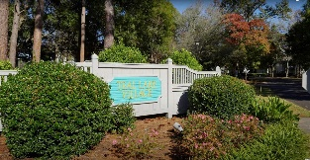
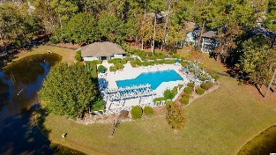
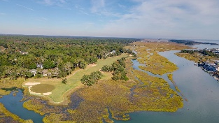
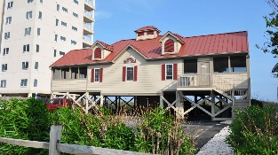



Teal Lake Oozes Charm With Its Low-rise Cottage Appeal, Meandering Lakes And Walk-ability.
1221 Tidewater Dr. #1023
Teal Lake Village | North Myrtle Beach, SC 29582 | MLS# 2224339 | $264,900
Highly desirable Teal Lake Village of singular Tidewater Plantation Resort, located in safe, affordable and popular North Myrtle Beach, is still one of the top condo complexes for its extraordinary value on the North Strand. Plus, Teal Lake oozes charm with its low-rise cottage appeal, meandering lakes and walk-ability. A gentle walking path surrounds the community, and its cozy pool, exclusive to Teal Lake residents, is easily accessible as well. But that is certainly not all! Owners have two other magnificent pools and a private oceanfront beach cabana on the wide, white-sand Cherry Grove Beach, just named one of the nation's top beaches. Amenity-rich Tidewater is on a tree-lined road to oceanfront Anne Tilghman Boyce Coastal Reserve, a nature conservancy, including Waties Island, with access for managed recreational use. Tidewater itself is on an elevated peninsula of live oaks and southern pines between the ICW and the Cherry Grove Inlet to the Atlantic Ocean. The Plantation also preserves the look of its own historic origins. It is minutes from the beach, shopping, medical services, entertainment, memorable parks and access to major highways. Amenities include that oceanfront beach cabana for owners' use with open/screened porches with plenty of parking, bathrooms, showers, and kitchen. Residents have the use of several pools/hot tubs. Other amenities include a driving range, golf shop, clubhouse with bar/dining and event facilities, clay- and hard-surface tennis courts, pickle ball court, fitness center overlooking a guests' pool, and amenity center for public/private events. Tidewater has a gated storage yard for boats, jet skis, motorcycles, and kayaks. Manned, gated Tidewater Resort reflects a classic beach lifestyle, well enjoyed by those lucky residents of Teal Lake Village. Teal Lake boasts a relaxed, very secluded atmosphere of first- and second-story, larger one- and two-bedroom units. This is one of the most appealing SECOND-floor, lake view, single-level 2 bedrooms/2 baths in more than 1,000 sq. ft., complete with an outdoor storage closet for beach paraphernalia and so much more. There is a fully equipped, pretty white kitchen with breakfast counter, big great-room with beautiful flooring, featuring a nice living /dining combination, master en suite with views, plus a wonderful screened porch overlooking the driving range and lake, gorgeous panorama.The guest bath is large and can be locked off as a second en suite. There is a utility closet with washer/dryer and that fabulous, fun kitchen. Parking is close & easy, plentiful and ADA accessible. Owners are welcome to have pets, and this condo is pet-friendly. Teal Lake Village has it all... and, at this established-value price, do not let this unique, homey Tidewater immaculately maintained beauty being sold furnished slip away! This condo has both long- and short-term rental opportunities and sleeps 8 comfortably. This is a top-floor end unit, perfect for privacy, nice natural light and did we say SERENITY? The front porch is likewise inviting; plus, it is being sold furnished with a does-not-convey list; it is move-in ready. Perfect condo in a picture perfect location. See it today and move in soon! A Best of the Beach!
Video Tour: https://youtu.be/Y4BJ9JF_vXo
Connie Ross-Karl
702-306-2643
conniesross@aol.com
Ronnie Nichols
Realtor / BIC
ronnienichols8@aol.com
NEW WAY PROPERTIES MYRTLE BEACH

