Slide 1
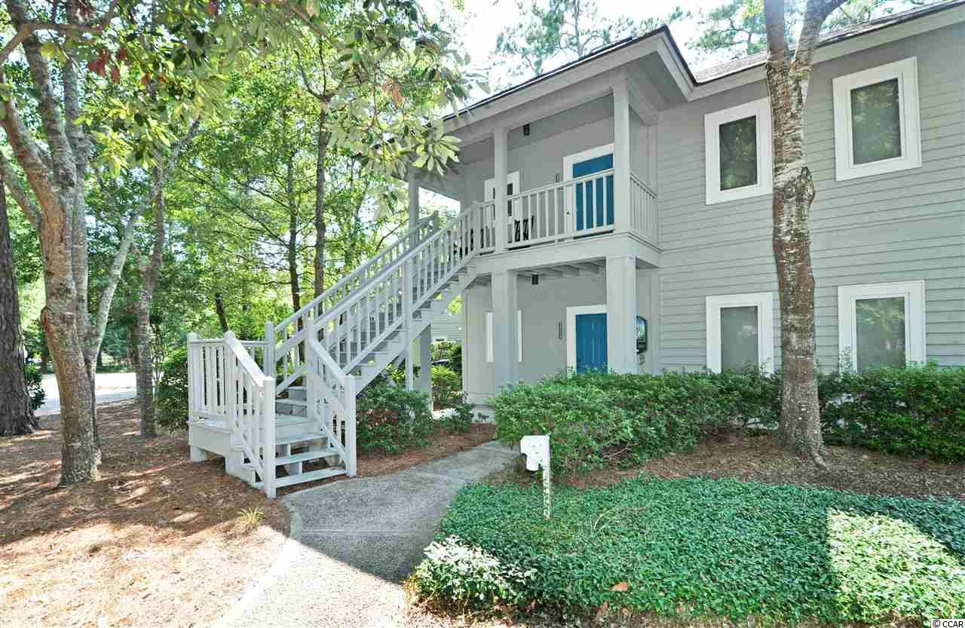
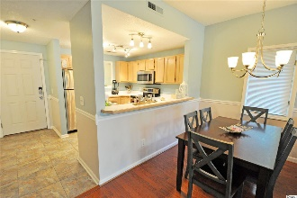
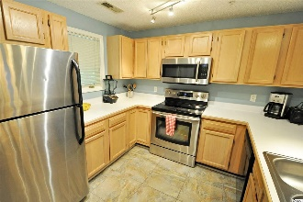
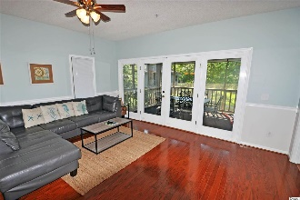
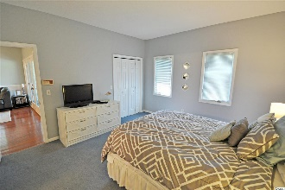
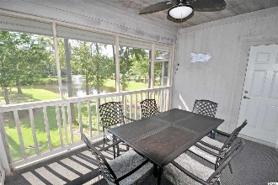
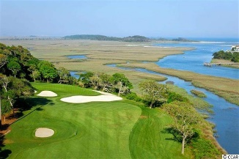
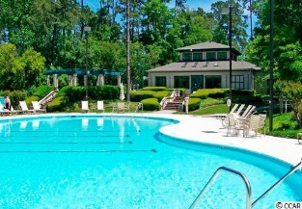
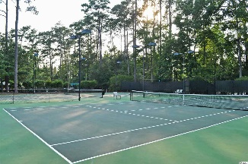
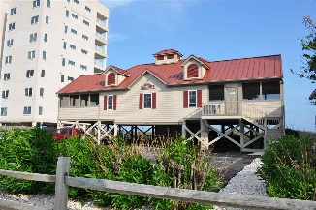


1221 Tidewater Drive #2224
Teal Lake Village @ Tidewater Plantation Resort
North Myrtle Beach ~ MLS# 1917989 ~ $149,900
Teal Lake Village of singular Tidewater Plantation Resort, located in safe and popular North Myrtle Beach, is still one of the top condo complexes for its extraordinary value on the North Strand. Plus, Teal Lake oozes charm with its low-rise cottage appeal, meandering lakes and walk-ability. A gentle walking path surrounds the community, and its cozy pool is easily accessible as well. But that is certainly not all! Owners have two other magnificent pools and a private oceanfront beach cabana on the wide, white-sand Cherry Grove Beach, just named one of the nation's top beaches. Amenity-rich Tidewater is on a tree-lined road to oceanfront Anne Tilghman Boyce Coastal Reserve, a nature conservancy, including Waties Island, with access for managed recreational use. Tidewater itself is on an elevated peninsula of live oaks and southern pines between the ICW and the Cherry Grove Inlet to the Atlantic Ocean. The Plantation also preserves the look of its own historic origins. It is minutes from the beach, shopping, medical services, entertainment and access to major highways. Amenities include that oceanfront beach cabana for owners' use with open/screened porches, bathrooms, showers, and kitchen. Residents have the use of several pools/hot tubs. Other amenities include a driving range, golf shop, clubhouse with bar/dining and event facilities, clay and hard surface tennis courts, pickle ball court, fitness center overlooking a pool, bocce courts and amenity center for public/private events. Tidewater has a gated storage yard for boats, jet skis, motorcycles, golf carts and kayaks, etc. Manned, gated Tidewater Resort reflects a golf/ beach lifestyle, well enjoyed by those lucky residents of Teal Lake Village. Teal Lake boasts a relaxed, secluded atmosphere of low-rise first- and second-story, large one- and two-bedroom units. This signature classic condo floor plan is one of the most appealing – second floor (top), corner, end unit, side window in great/living area for much light and airiness, and single-level 2 bedrooms/2 baths in more than 1,000-plus sq. ft. of enjoyable, easy living. It is complete with front porch and hall entry, fully equipped workable kitchen, big great-room featuring a nice living/dining combination, master with big window and relaxing views of the lake and surroundings and with larger en suite offering double-sink vanity, and a beautiful over-sized screened porch overlooking the lake/turtle pond & green space featuring much wildlife. Linger there for a while... It is also a short walk to pool. Upscale beach-themed, cottage-inspired furnishings and decor are included. It is a very clean, pretty unit , well-loved and meticulously maintained as a second-vacation home. Plus, the floors are fabulous! The functional kitchen has a breakfast bar and adjoining gathering-sized dining, perfect for a family or foursome, and convenient for entertaining. The big split-bedroom second bedroom and the washer/dryer also adjoin the kitchen. The convenient second bath can be an en suite as well as opened to the hallway for guests. Stainless steel appliances and many other upgrades are included. Parking is close, plentiful and ADA-accessible. Owners are welcome to have pets, and Teal Lake is pet-friendly. Teal lake units are known for lots of storage, too, and wonderful spaciousness throughout! This unit also features one of the few models offering a rare, inside-hallway owners' storage closet. Teal Lake Village really does have it all... and, at this established-value price, do not let this unique, modern yet homey Tidewater beauty being sold turnkey-furnished slip away! In summary, here are the features and upgrades: -New Ceramic Tile in Kitchen/Entry -Newer Hot Water Heater -New, Upscale HVAC -Stainless Steel Appliances -Modern, Updated Beach-Themed Cottage Decor & Furniture -Newer Paint Throughout Moreover, all of this luxury is in North Myrtle Beach, just named a Top 10 Beach Town in the U.S.!
Deborah Collins
843-424-9013
dctidewater@yahoo.com
Connie Ross-Karl
702-306-2643
conniesross@aol.com
NEW WAY PROPERTIES MYRTLE BEACH

