Slide 1
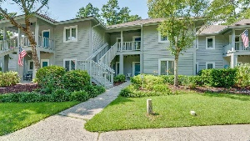
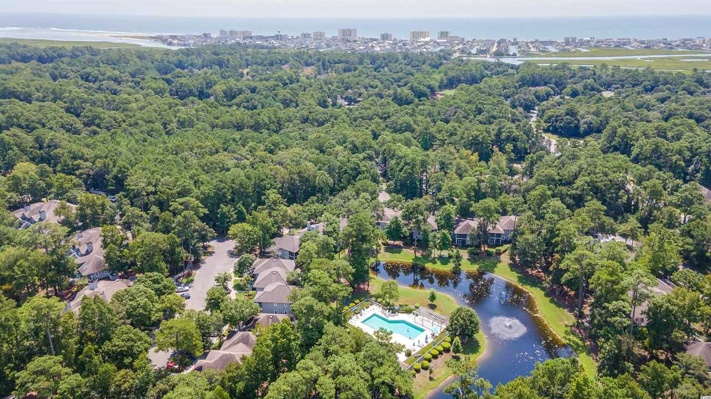
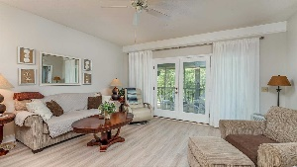
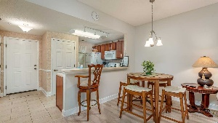
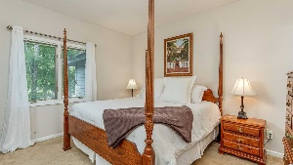
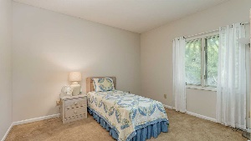
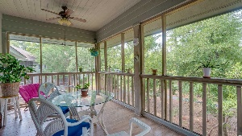
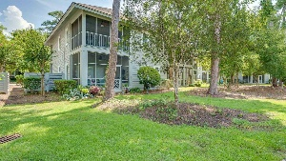
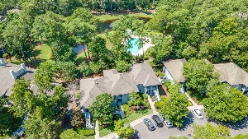
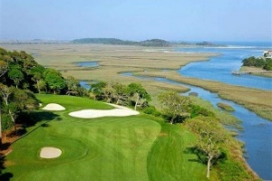
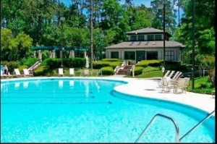
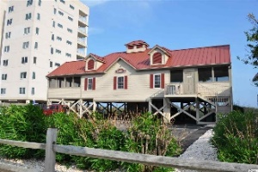


SOLD TURNKEY ~ BEAUTIFULLY FURNISHED!
1221 Tidewater Dr. #2322
North Myrtle Beach, SC 29582
MLS# 2118966 ~ $239,000
Teal Lake Village of singular Tidewater Plantation Resort, located in safe and popular North Myrtle Beach, is still one of the top condo complexes for its extraordinary value on the North Strand. Plus, Teal Lake oozes charm with its cottage appeal, meandering lakes and walk-ability. A gentle walking path surrounds the community, and its cozy pool is easily accessible. Owners have two other magnificent pools and a private oceanfront beach cabana on the wide, white-sand Cherry Grove Beach, recently named one of the nation's top beaches. Amenity-rich Tidewater is on a tree-lined road to oceanfront Anne Tilghman Boyce Coastal Reserve, a nature conservancy, including Waties Island. Tidewater itself is on an elevated peninsula of live oaks and southern pines between the ICW and the Cherry Grove Inlet to the Atlantic Ocean. It is minutes from the beach, shopping, medical services, schools, parks, dining and entertainment and access to major highways. Amenities include that oceanfront beach cabana for owners' use with open/screened porches, bathrooms, showers, and kitchen. The Teal Lake pool is exclusive to Teal Lake residents; all residents have the use of several pools/hot tubs. Other amenities include a putting green/driving range, golf shop, clubhouse with bar/dining and event facilities, clay and hard surface tennis courts, pickle ball court, fitness center, bocce courts and amenity center for public/private events. Tidewater has a gated storage yard for boats, jet skis, motorcycles, golf carts and kayaks, etc. Manned, gated Tidewater Resort reflects a golf/ beach lifestyle, well enjoyed by those lucky residents of highly sought-after Teal Lake Village. Teal Lake boasts a relaxed atmosphere of low-rise first- and second-story, large one- and two-bedroom units. This signature classic condo floor plan is one of the largest and most appealing second floor (top), private, secluded front porch; big open area for entertaining and easy family living, the heart of the house; and single-level 2bds/2bas in more than 1,000-plus sq. ft. There is much green space in between buildings for privacy and personal enjoyment, too. This condo comes complete with that wonderful front porch and a wide, welcoming entry; fully equipped workable kitchen; the great-room featuring handsome high-tech flooring everybody wants and that roomy living/dining combination; and master with windows and views of the lake & pool and surroundings and with larger en suite offering master vanity and tub/shower. The master bedroom has a new and inviting Posture Pedic mattress and a closet has a nice built-in dresser tower for extra drawer space and organization.The over-sized rear screened porch overlooks the lake/turtle pond, pool & green space, too, presenting much wildlife. Look quickly, you may even catch site of the resident otter! Linger there for a while; heron may appear! However, you may never want to leave. The back porch is magnificent, has a porcelain tile floor, two ceiling fans, and lots of relaxing privacy and seclusion. The appealing beach-themed, cottage-inspired furnishings and decor are all included. Everything is newer; it is a very clean, stunning unit, well-loved and meticulously maintained as a second-vacation home. The kitchen includes a cheery window, breakfast bar and a dedicated space for a full-sized, upscale newer LG washer/dryer! The roomy split-bedroom second bedroom and the convenient second bath can be an en suite as well as opened to the hallway for guests. There's even a linen closet. Parking is close and plentiful. Owners are welcome to have pets, and Teal Lake is pet-friendly. Teal Lake units are known for good storage and wonderful spaciousness throughout! This unit also features a closet on the front porch area, convenient to store beach paraphernalia. Teal Lake Village really does have it all! So do not let this luxurious yet comfortable Tidewater beauty being sold fully furnished get away.
Take a Virtual Tour: https://my.matterport.com/show/?m=Z2ZAHAymYRs
Deborah Collins
843-424-9013
dctidewater@yahoo.com
Connie Ross-Karl
702-306-2643
conniesross@aol.com
NEW WAY PROPERTIES MYRTLE BEACH

