Slide 1
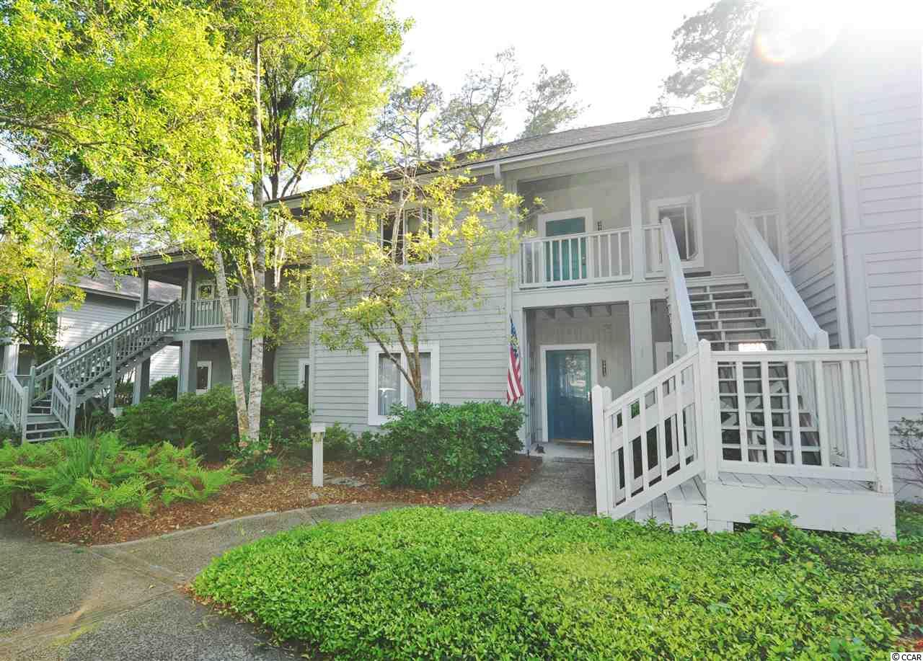
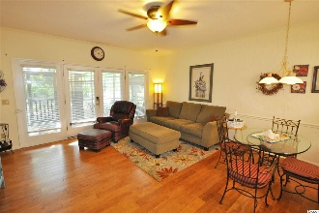
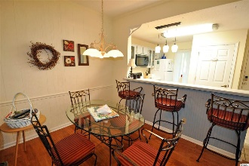
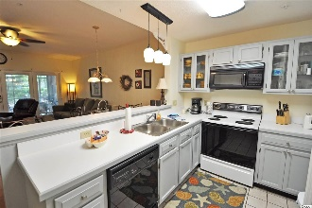
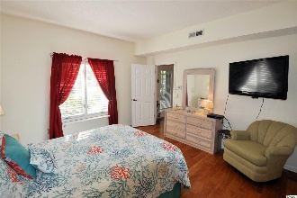
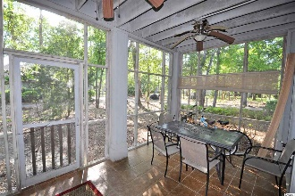
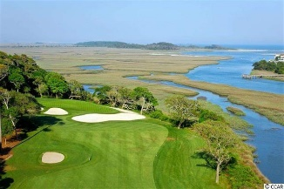
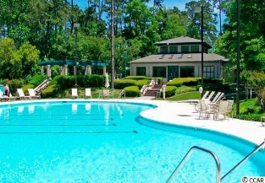
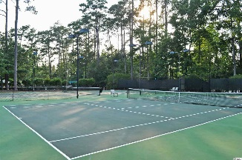
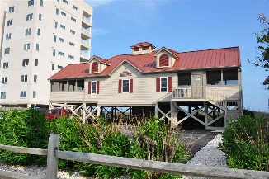


1221 Tidewater Drive #2412
Teal Lake Village @ Tidewater Plantation Resort
North Myrtle Beach ~ MLS# 1910008 ~ $149,000
Teal Lake Village of singular Tidewater Plantation Resort, located in safe and popular North Myrtle Beach, is still one of the top condo complexes for its extraordinary value on the North Strand. Plus, Teal Lake oozes charm with its low-rise cottage appeal, meandering lakes and walk-ability. A gentle walking path surrounds the community, and its cozy pool is easily accessible as well. But that is certainly not all! Owners have two other magnificent pools and a private oceanfront beach cabana on the wide, white-sand Cherry Grove Beach, just named one of the nation's top beaches. Amenity-rich Tidewater is on a tree-lined road to oceanfront Anne Tilghman Boyce Coastal Reserve, a nature conservancy, including Waties Island, with access for managed recreational use. Tidewater itself is on an elevated peninsula of live oaks and southern pines between the ICW and the Cherry Grove Inlet to the Atlantic Ocean. The Plantation also preserves the look of its own historic origins. It is minutes from the beach, shopping, medical services, entertainment and access to major highways. Amenities include that oceanfront beach cabana for owners' use with open/screened porches, bathrooms, showers, and kitchen. Residents have the use of several pools/hot tubs. Other amenities include a driving range, golf shop, clubhouse with bar/dining and event facilities, clay and hard surface tennis courts, pickle ball court, fitness center overlooking a pool, bocce courts and amenity center for public/private events. Tidewater has a gated storage yard for boats, jet skis, motorcycles, and kayaks. Manned, gated Tidewater Resort reflects a classic beach lifestyle, well enjoyed by those lucky residents of Teal Lake Village. Teal Lake boosts a relaxed, secluded atmosphere of first- and second-story, larger one- and two-bedroom units. This is one of the most appealing – first floor, single-level 2 bedrooms/2 baths in more than 1,000 sq. ft., complete with fully equipped kitchen, big great-room featuring a nice living/dining combination, master with en suite and views and a wonderful screened porch with storage closet overlooking the lake/pond & green space and close to the pool. Furnishings and decor are lovely, especially the inspired-hardwood flooring, the ship-lap paneling and Southern country-cottage look and feel. It is a very pretty unit and well-loved as a second-vacation home and investment property. The functional kitchen has a breakfast bar and adjoining gathering-sized dining, perfect for a family or foursome, and spacious for entertaining. The split-bedroom second bedroom and the washer/dryer also adjoin the kitchen. The convenient second bath can be an en suite as well as opened to the hallway for guests. Major appliances including HVAC, washer/dryer & hot water heater are newer. Even so, a top-of-the-line Old Republic Ultimate Home Warranty is included. Parking is close & easy, plentiful and ADA accessible. Owners are welcome to have pets, and this condo is pet-friendly, with rear access to green space from the rear porch. There is also a covered front porch with owners closet and foyer entry. Teal Lake Village has it all... and, at this established-value price, do not let this unique, homey Tidewater beauty being sold turnkey-furnished slip away!
Deborah Collins
843-424-9013
dctidewater@yahoo.com
Connie Ross-Karl
702-306-2643
conniesross@aol.com
NEW WAY PROPERTIES MYRTLE BEACH

