Slide 1
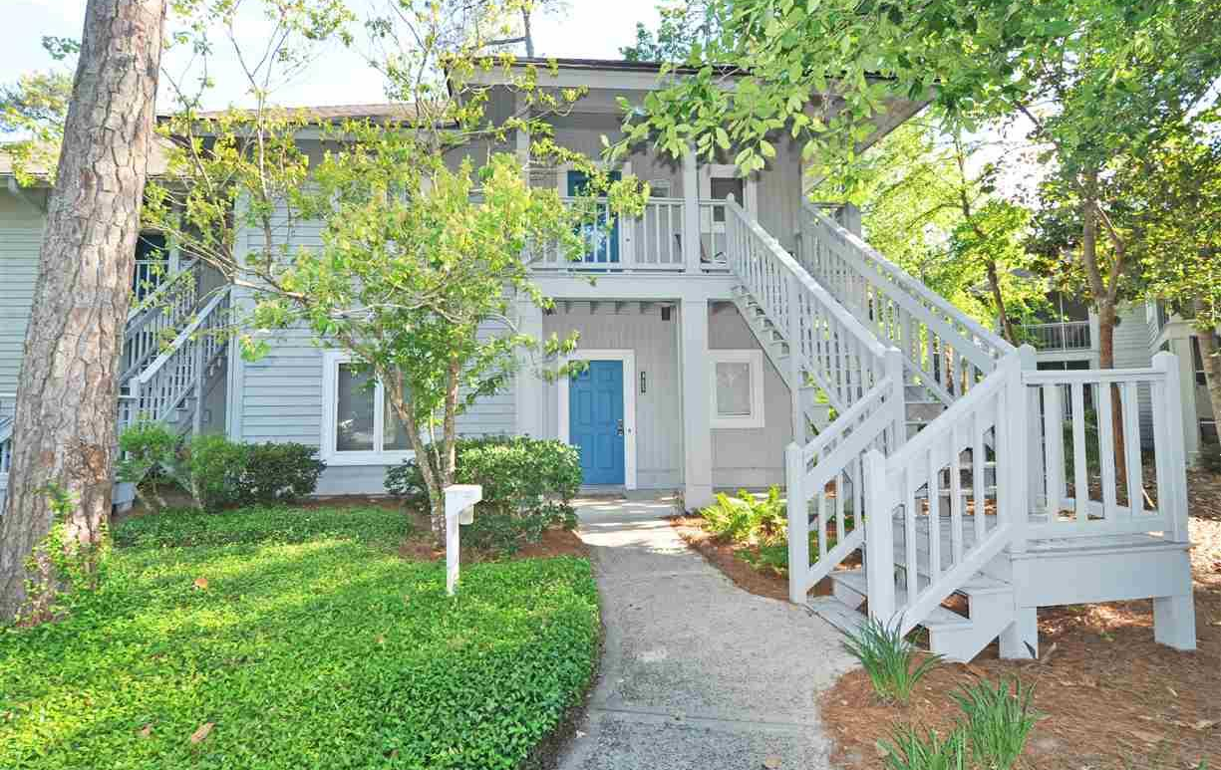
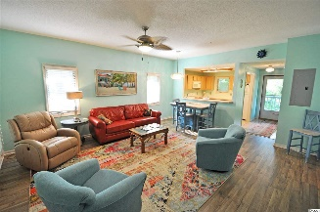
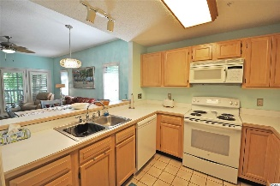
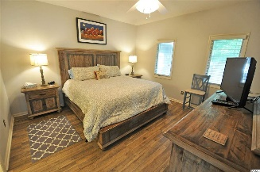
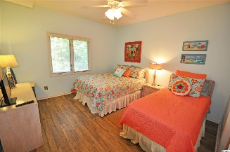
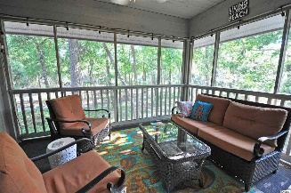
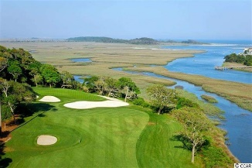
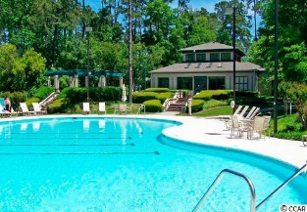
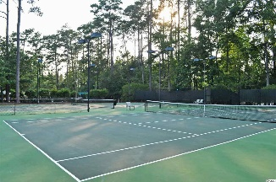
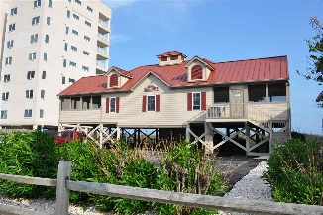


1221 Tidewater Drive #321
Teal Lake Village @ Tidewater Plantation Resort
North Myrtle Beach ~ MLS# 1711050 ~ $125,900
Everything here is expertly maintained and has an impressive list of upgrades. So wait no longer to buy; see this charming top-floor end unit in mid-rise cottage-inspired, serene Teal Lake Village in amenity-rich Tidewater Plantation Resort in popular North Myrtle Beach today...as it may not be available tomorrow! This perfect wooded, lake-view location is, however, only a part of its perfection. It is the largest and most sought-after, roomier floor plan of its type, featuring a nice entry foyer, additional generous interior owners' closet along with exterior closet storage as well off the fully-screened over-sized screen porch, excellent natural light throughout, double-sink vanity in master en-suite bath, and the privacy and sunlight afforded by its nice lot placement and end unit -- just wonderful, peaceful and appealing. Parking is adjacent, and there is a welcoming front porch up a short flight of stairs for convenient entry. The kitchen off the entry hall is cheery and boasts new appliances. The stars of the spacious design of 2 big bedrooms, 2 baths and highly functional living and dining areas are the unique and appreciably lovely high-tech laminate floor and some of the most beautiful furnishings ever in any comparable condo. Everything is planned with attention to detail and a sumptuous blend of warm color, quality and comfort. It's the beach but so much better! Then there's the screened porch, so inviting and enjoyable overlooking the lush Tidewater wooded enclave, lake and nature habitat that you may just want to linger there all day and into the lull of evening. One of the best things about Teal Lake is that you can do it all -- swim in your own community pool, stroll on the walking-path around the complex, work out in the fitness room, play tennis or golf, ride your bike or bask on the deck of your owners' oceanfront beach cabana only minutes away on one of the most uncrowded white sand beaches in the Cherry Grove section of North Myrtle Beach -- or nothing at all...on the porch...perfection! Moreover, Tidewater is a a top-rated golf resort and ICW community, offering that owners' oceanfront beach cabana with parking, open/screened porches, bathrooms, showers and kitchen. And North Myrtle Beach is one of the most well-managed cities in the Carolinas and has the lowest tax millage of any full-service city of its size in South Carolina. The resort has 24-hour gated, manned security. Other amenities include a driving range, golf shop, clubhouse with bar and dining facilities overlooking the 18th hole, clay and hard surface tennis courts, pickle ball court, fitness center overlooking a pool, bocce courts and amenity center for public/private events. Other group activities include an outdoor summer concert series, workout classes including water aerobics, weekly art classes, Happy Hours, dinner clubs, book clubs, bridge club, mahjong and holiday events. In addition, Tidewater's secure, gated storage yard is for owners boats, jet skis, motorcycles, kayaks and more. Tidewater Plantation and its full range of things to do and to enjoy truly reflects a "way of life."
Deborah Collins
843-424-9013
dctidewater@yahoo.com
Connie Ross-Karl
702-306-2643
conniesross@aol.com
NEW WAY PROPERTIES MYRTLE BEACH

