Slide 1
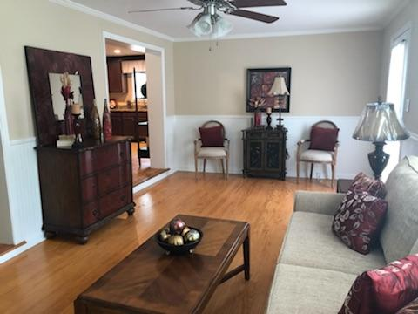
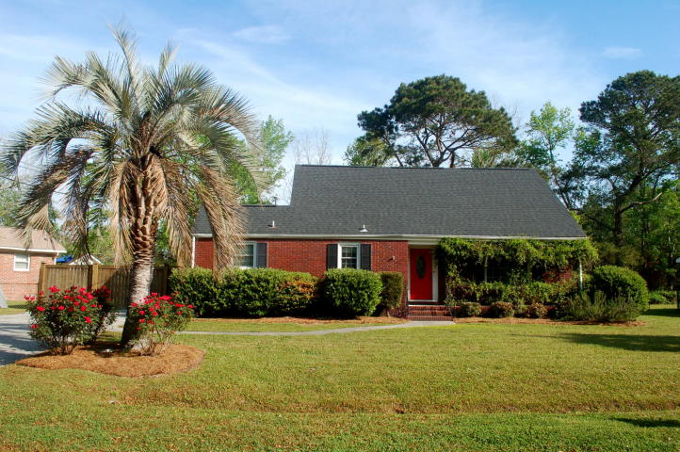
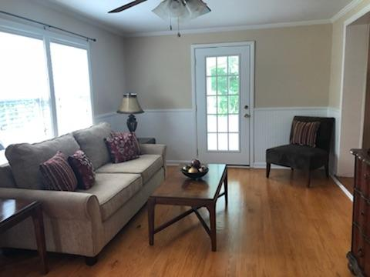
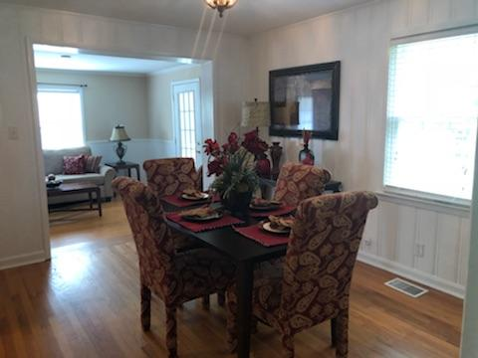
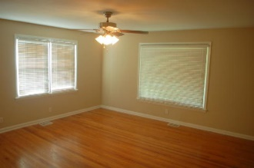
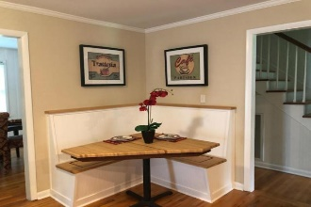
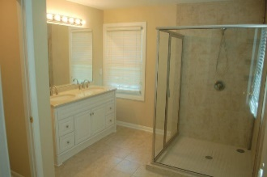
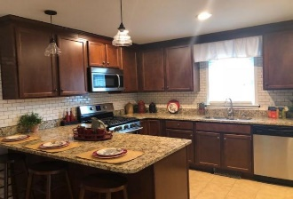
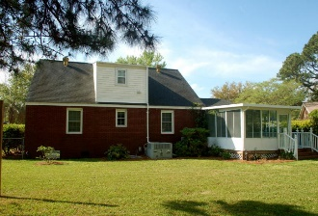
Just Reduced! Walk to Avondale or the new Whole Foods!
1222 Byron Road
Charleston ~ MLS# 18006185
Reduced to $395,000
Lovely renovated 2 story home with a large master downstairs near the popular Avondale area. This home is the perfect mix of updates and 60's charm. The large, eat in kitchen with granite counter-tops and subway tile backspalsh will wow you! . Wood and tile floors throughout, you will love this layout. Downstairs we have a family room and a dining room with a cool bar. The master bath has a large shower & dual sinks. Upstairs are 2 bedrooms and a full bath, a nice set up for kids or guests. The fenced backyard is big and includes a shed. Come see this home, you won't be disappointed.
Mike Goldston, Realtor
mikesellscharleston@gmail.com | 843-343-7026 | www.cometocharlestonsc.com
Brand Name Real Estate | 4 Carriage Lane, Suite 106 | Charleston, SC 29407

