Slide 1
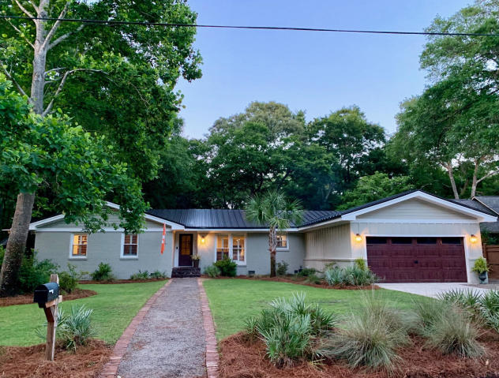
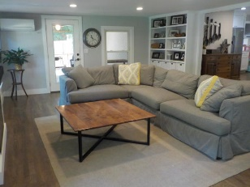
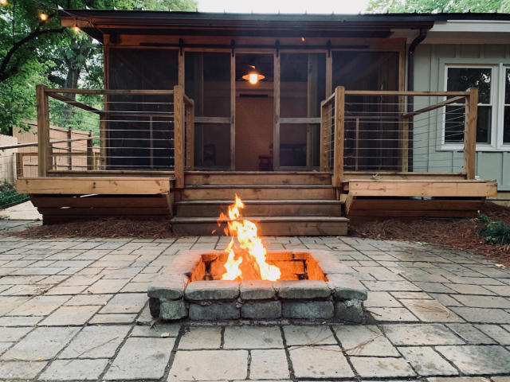
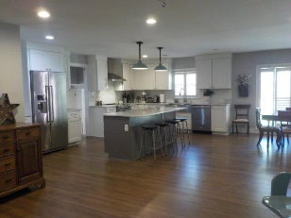
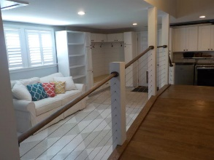
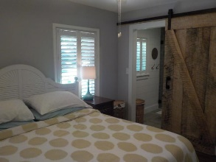
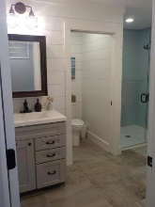
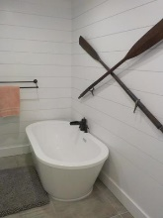
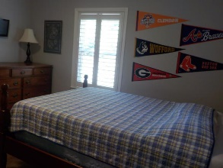
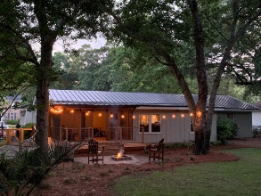
Renovated Lowcountry Charmer
1222 Calais Drive
Heritage ~ Mount Pleasant, SC 29464 ~ MLS# 19014714 ~ $619,000
Beautiful completely renovated painted brick home with classic Mount Pleasant charm! Combined with meticulously designed upgrades via a 2016 redesign, this home is move-in ready. The kitchen features all new cabinets, countertops, appliances, plumbing and electrical. Cabinets feature roll out drawers, soft-close doors, corner lazy Susan. Countertops are honed marble with subway tile backsplash. Full suite of Kitchen Aid appliances new in 2016. Previous existing bathrooms were completely demolished and each enlarged for a spacious feel. The ship lap walls of the bathroom surround the floor level walk in showers with floor to ceiling glass doors, tile and multiple faucets. Exterior includes new metal roof, manicured landscape and an additional driveway for boat or vehicle storage. HVAC duct, plumbing and electrical all newly updated. Stepping through the sliding screen barn doors off of the screen porch leads you to the large back yard complete with a fire pit, custom play house and newly completed shed. The shed is equipped with running electricity and water making it ideal for a pool house renovation should a pool be in your vision for the spacious backyard. The ideal location places the home minutes from Highway 17, Coleman Blvd, Rifle Range and Interstate 526. Whether you are headed to the beaches or into downtown Charleston, you are minutes away.
Kenneth Nix
kenneth@landsouthofcharleston.com
M (843) 222-2582 | O (843) 577-5263
Land South of Charleston, LLC | 180 E Bay St Ste 300 | Charleston, SC 29401

