Slide 1
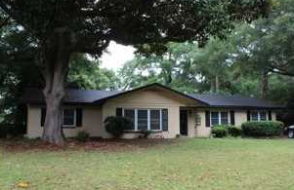
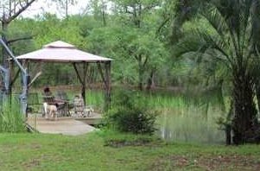
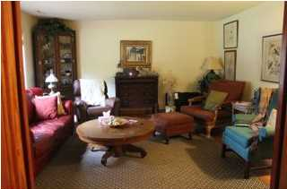
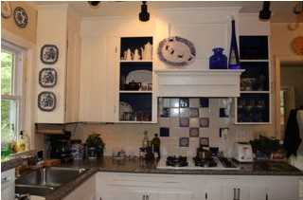
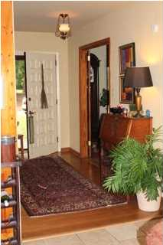
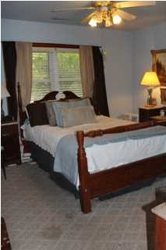
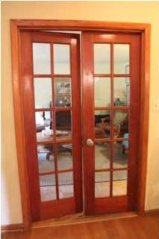
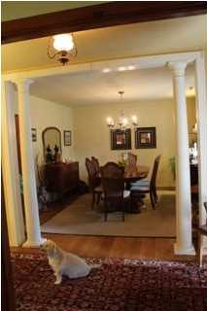
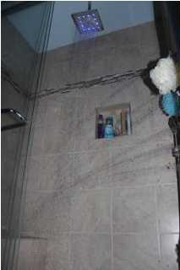
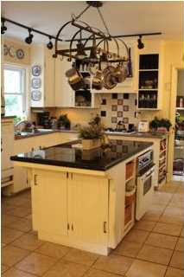
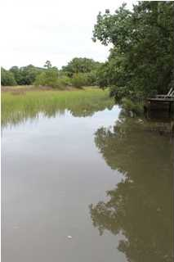


Boat Dock & Ramp In Place!
1222 Taliaferro Ave
Riverview – Charleston
MLS# 1418220 - $325,000
This is the chance you have been waiting on - living life on the water! This beautifully updated home has kept her character while lovingly updated. The cottage style kitchen and sunroom look out onto the large backyard. The master shower is a retreat within itself with heated lamp and 5 shower head shower!
Robin Crump
(843) 813-5688
Robincrumprealestate@gmail.com
Brand Name Real Estate | 207 East Bay Street Ste 311 | Charleston, SC 29401

