Slide 1

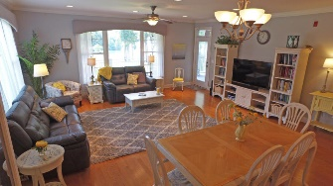
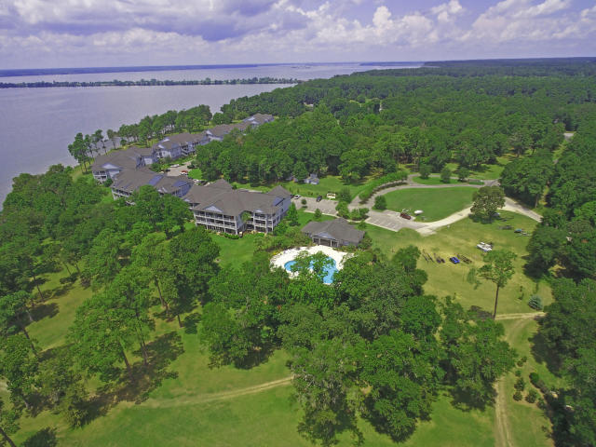
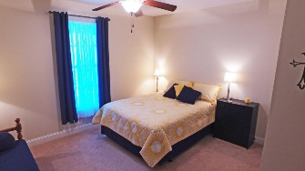
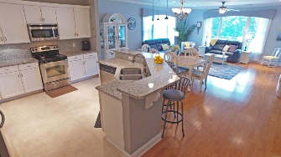
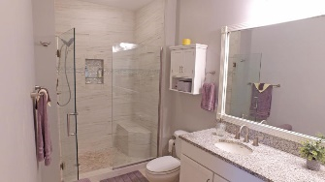
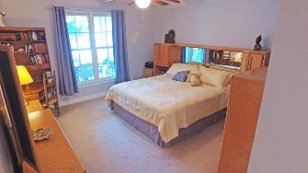
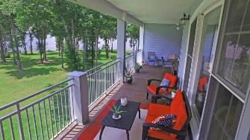
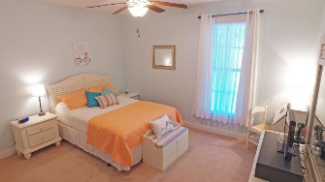
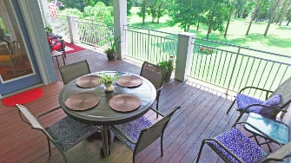
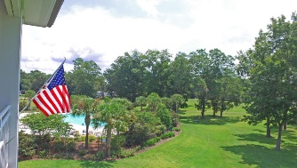
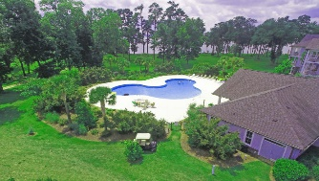
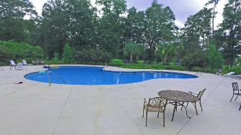


Live on the Lake
1222 Bridgeview Lane F303
Summerton, SC 29148 | MLS# 18022509 | $274,000
Updated Condo on Lake Marion TOP FLOOR unit with elevators. Don't miss out on this wonderful unit! This condo offers the best of Lake Marion with lake views, lake access, marina, pool, clubhouse, work out room, garden area, dry storage, storage shed, AMAZING VIEWS and much more. This unit comes with BOAT SLIP that will convey** and storage shed. The master bath tub has been tiled and walk-in shower added. Drinking your coffee at sunrise on your large deck over looking the lake will never taste better! See this one today!
Lake Homes Realty, LLC
Elloree, SC 29047
www.SCLakeLife.com
Kristie Anderson
(803) 387-9459
kristie@sclakelife.com

