Slide 1
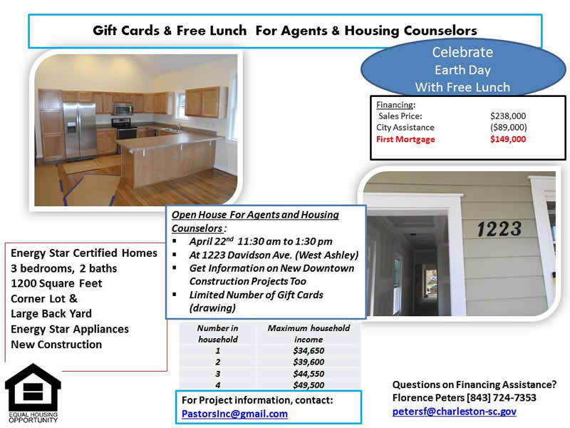


Corwyn J Melette, ABR Mobile - (843) 364-3095 corwyn@corwynmelette.com www.corwynmeletteandassocs.com
Exit Realty Lowcountry Group

