Slide 1
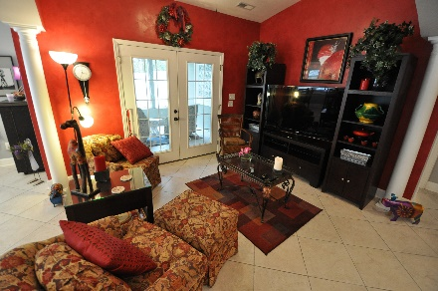
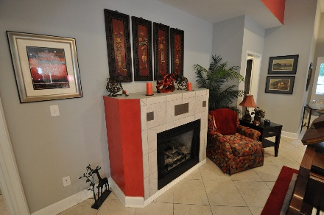
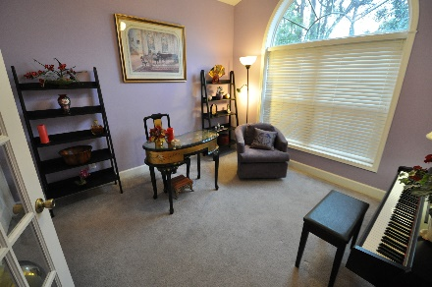
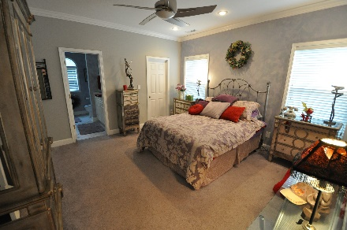


Estate Sale of Entire Contents of Vacation Home in The Courtyard Section of Tidewater Plantation
1223 Trisail Lane
Tidewater Plantation ~ North Myrtle Beach, SC 29582
Liquidation of lightly used content of second home in prestigious Tidewater Plantation Resort in North Myrtle Beach includes lovely living, dining, bedroom, kitchen and study furniture and collectibles. Festive decor, oriental accessories, artwork, pictures, contents of kitchen and more. Dishes, linens, outdoor art, garage paraphernalia and floral arrangements. Several signature furniture pieces and some electronics.
Nothing more than $500! Comfortable, stylish furniture sets, coordinating tables, chairs, lamps and rugs. Buy a single piece or assemble a room full of matching pieces -- to the smallest detail! Easy to walk through or to linger a while to take in the full scope of this unique, well-priced, fun shopping opportunity.
Some surprises...books, antiques, fine art and recreational items...
Gated community: Check in at Guard Gate in the left lane for community association pass and directions to sale
2 Days only: Friday and Saturday, March 3 & 4, 2017, 10 a.m. - 4 p.m.
Terms and Conditions:
Cash preferred, credit/debit cards accepted, NO checks
Items sold as is, where is.
All sales final.
Rain or shine.
No public restroom.
No food or drink allowed in the house.
Inspect items to your satisfaction before purchase.
Bring help to load large items.
You (or your child) break it, you buy it.
Use caution while on the property: we are not responsible for accidents or injuries.
We reserve the right to open the sale before the posted start time.
First come, first served – the waiting line must monitor itself.
There are no "holds" or pre-sales on items pictured for sale.
No animals please (we love them, but this is a private residence).
Items purchased and left onsite at the conclusion of a sale will be considered abandoned and removed as needed.
Though rare, due to circumstances beyond our control, an item(s) pictured for sale may be removed by our client prior to the doors opening.
By attending, guests understand and agree to allow the recording of their image for security
Or marketing purposes.
If the sale is being conducted in a covenant restricted community, such covenants
Must be followed by all participants.
Deborah Collins
843-424-9013
dctidewater@yahoo.com
Connie Ross-Karl
702-306-2643
conniesross@aol.com
NEW WAY PROPERTIES MYRTLE BEACH

