Slide 1
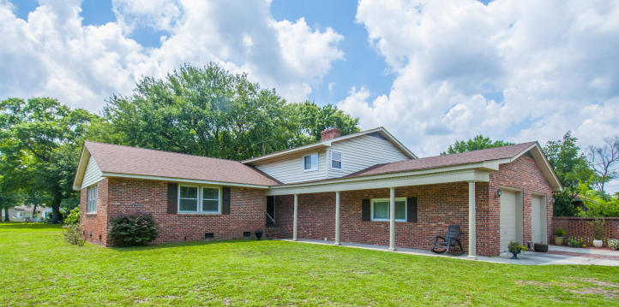
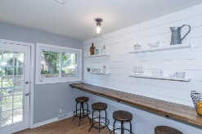
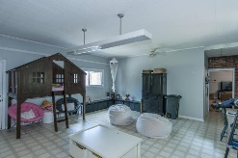
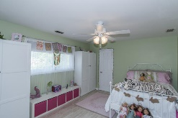
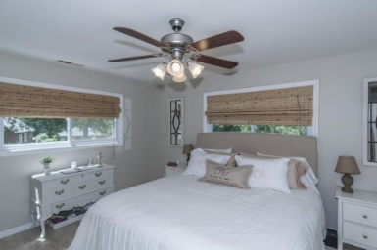
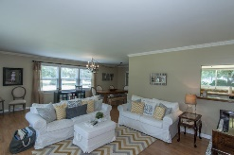
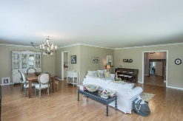
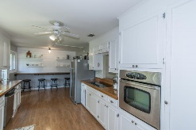


Motivated Seller Price Reduced $25k
1224 N Park Place
Park Circle North Charleston
MLS# 16017401
Now Asking $469,900
Rare opportunity... Over 3,700 sqft in highly desirable Park Circle! Brick home has been renovated with open floor plan and full of upgrades. Hardwood floors and smooth ceilings throughout this 3 bedroom, 3.5 bath. Situated on almost half acre corner lot. Kitchen offers stainless appliances, back splash, wood countertops, full bar area with floating cabinets. Separate dining area. Formal living, family room with fireplace AND large play room or game room. All 3 bedrooms are located upstairs and each has private bath. Master bath offers dual vanity with custom tile shower. Additional room off garage has closet and could easily be used as 4th bedroom if desired. Oversize 2 car garage and brick shed in back yard for additional storage.
Jennifer Frampton Pait
843-568-9509
jenniferfp@carolinaone.com

