Slide 1
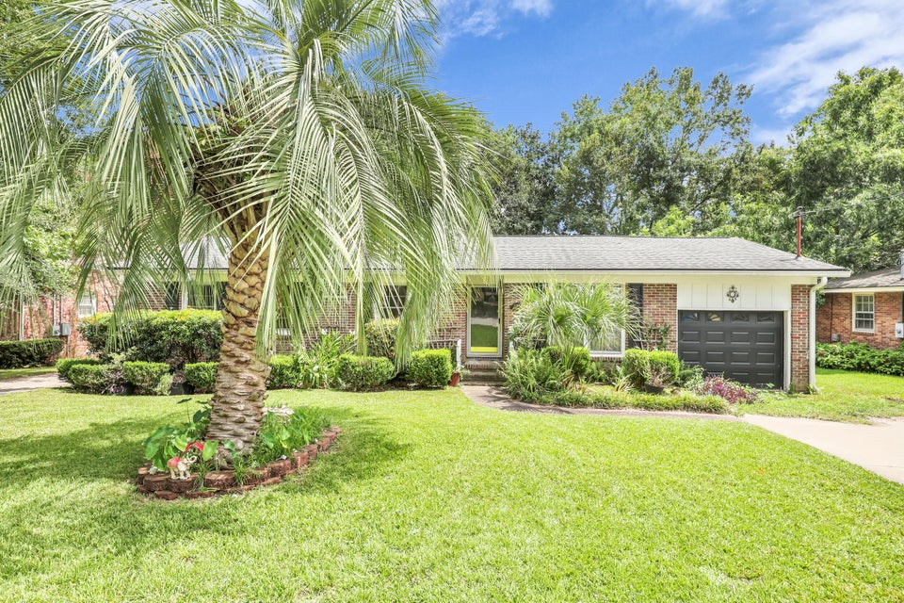
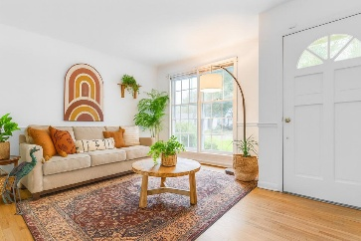
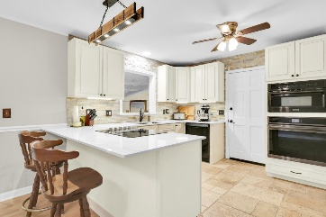
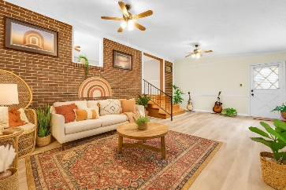
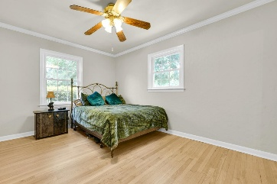
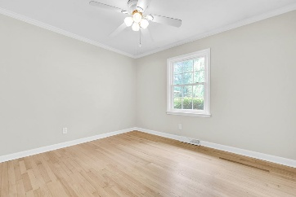
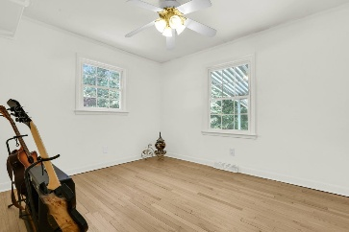
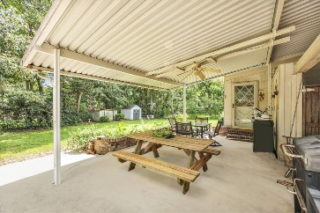
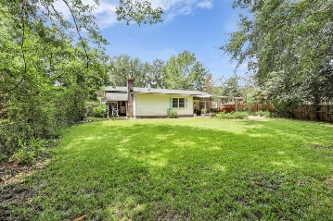



Revamped Brick Ranch in Hanahan, SC!
1225 Hillside Drive
Berkeley Hills
Hanahan, SC 29410
MLS # 25022002
$439,000
4 Beds | 2 Bath | 1,591 SF
Welcome to 1225 Hillside Drive, a charming and thoughtfully updated home in the heart of Hanahan. Step inside and you'll be greeted by a spacious, light-filled layout that seamlessly blends comfort with style. The beautifully renovated kitchen serves as the heart of the home, featuring sleek cabinetry, modern fixtures, and underglow ambient lighting that creates the perfect atmosphere for both casual mornings and evening entertaining. The hardwood floors have just been completely refinished throughout the home, adding warmth and character to every room, while a fresh coat of paint and updated baseboards give the entire space a crisp, polished feel.
This home offers a smart and functional floor plan with a generous living room that flows into the breakfast nook and kitchen, a separate living and den perfect for gatherings, and four comfortable bedrooms, including a primary suite with its own bath. Each bathroom is well-appointed, and the additional bedrooms provide flexibility for a home office, guest space, or hobbies. The attached garage offers convenience and extra storage, while the fenced-in backyard is ideal for pets, play, and outdoor living. A covered back porch area adds another inviting space to relax or entertain. Located in a quiet, established neighborhood, 1225 Hillside is just minutes from all Hanahan elementary, middle, and high schools, local parks, and the convenience of nearby grocery stores, restaurants, and shops. Quick access to the interstate makes commuting to Summerville, downtown Charleston, or the surrounding areas a breeze. With its blend of recent updates, comfortable living spaces, and excellent location, this home is ready to be enjoyed from the moment you move in.
VIRTUAL TOUR
Nick Mazzilli
843-640-5575
nick@themazzilliteam.com
sellmyhousecharlestonsc.com
The Mazzilli Team
3427 W Montague Ave
Suite 6
North Charleston, SC 29418

