Slide 1
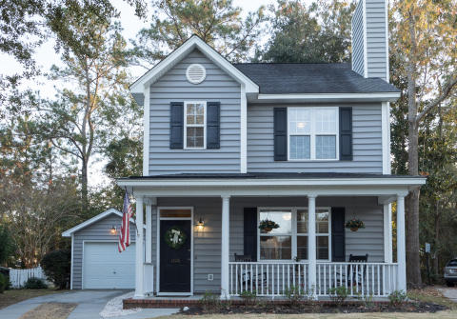
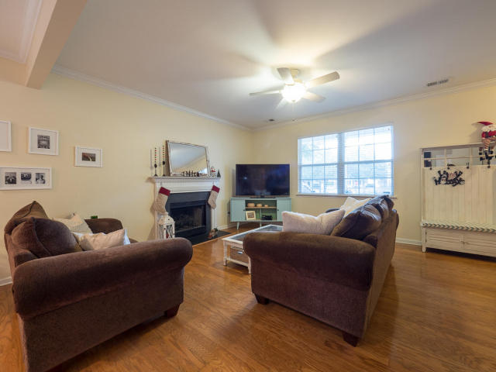
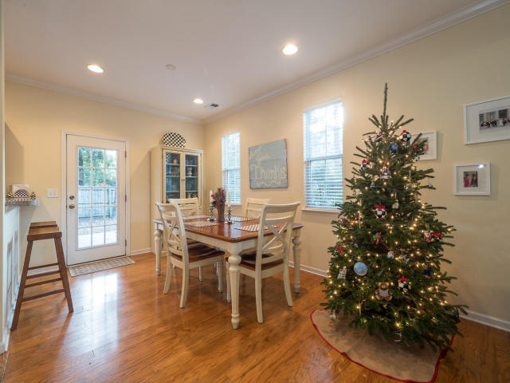
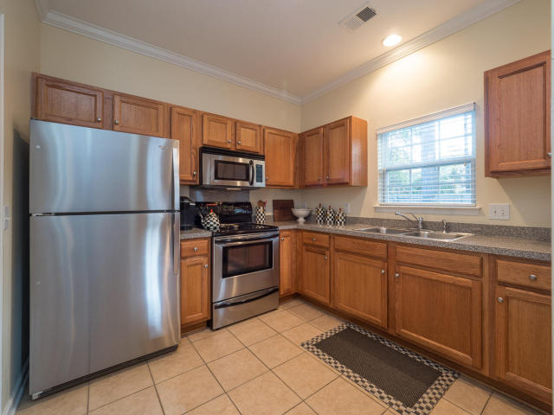
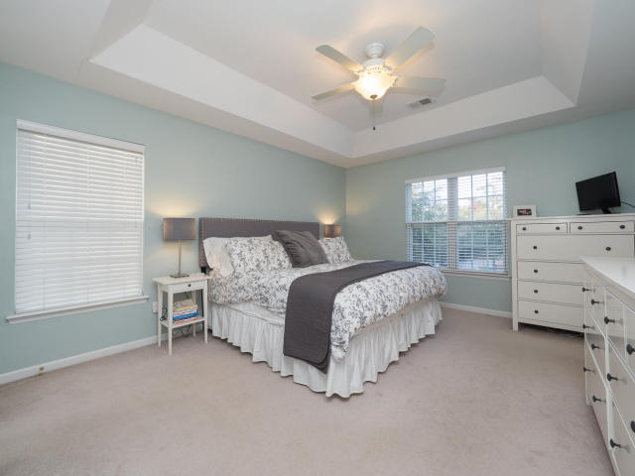
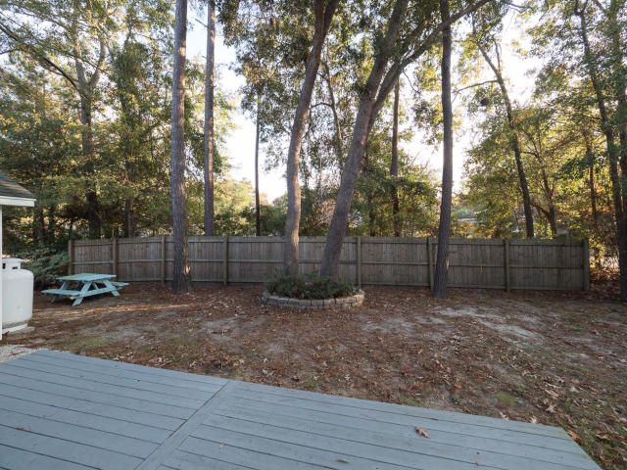
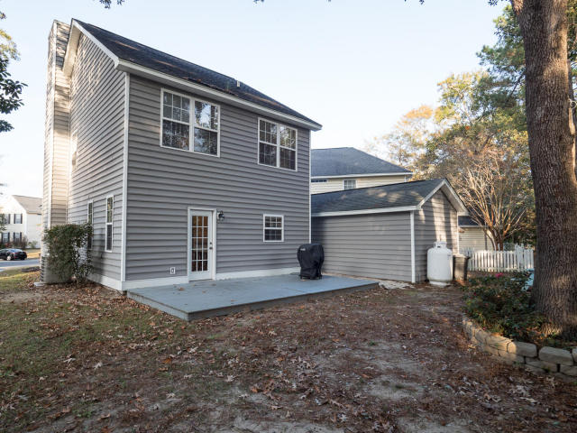


1226 Spotted Owl Drive
Mount Pleasant ~ MLS# 17032046 ~ $342,000
Great Value in Laurel Grove
3 Bed / 2½ Bath
1,426 Sq Ft
Great Location
Open Floorplan
Hardwood Floors
Detached Garage
Great Backyard
Charming well kept single family home in a PRIME LOCATION!!! As you enter the home you will find an open and spacious living room that leads to the dining room with real hardwood floors. Relax in your living room with a gas fireplace and a mantel perfect for your large TV. The kitchen is spacious with ceramic tile, a breakfast bar, pantry and modern stainless appliances. Walk out back to an oversized wood deck perfect for grilling and entertaining. All three bedrooms are upstairs and are a nice size with ample closet space. The master is spacious and receives plenty of natural light. The master bath has dual vanities and a garden tub.
LOCATION, LOCATION, LOCATION...WALK TO RESTAURANTS AND SHOPPING. MAKE YOUR APPOINTMENT TODAY AS THIS HOME WILL NOT LAST!!
Leah M. Rust
843-709-9211 Mobile
843-856-8800 Office
leahmrust@gmail.com
Coldwell Banker RESIDENTIAL BROKERAGE

