Slide 1
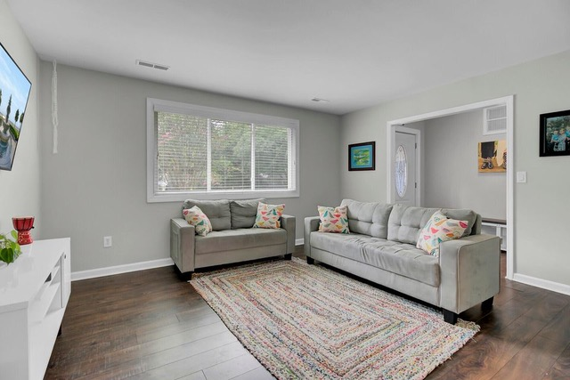
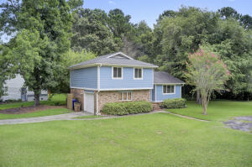
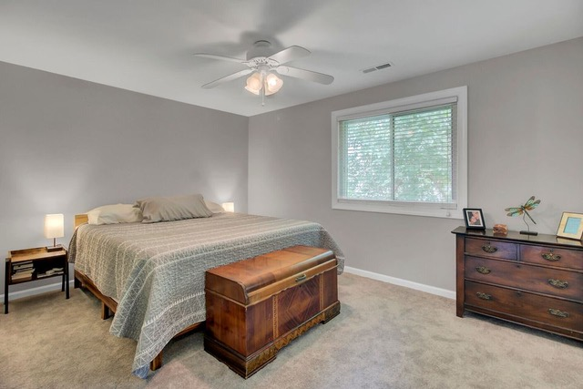
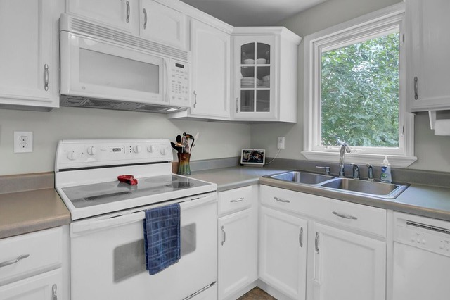
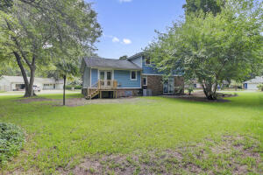
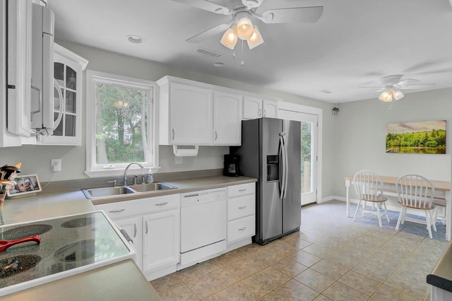
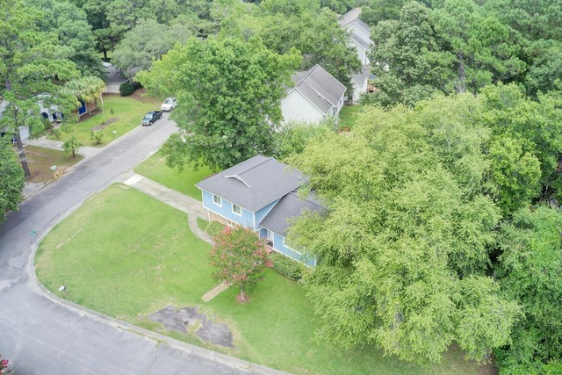


Price Reduced & Buyer Incentive
1226 Chuka Court
Quail Run
Charleston, SC 29412
MLS# 22019148 | $435,000
The owners of this move in ready 3 bedroom home in Quail Run are offering the buyer $4,000 whether to apply toward closing costs, buy down the interest rate on their loan, or take as an additional price reduction if a cash buyer! Newly reduced price makes this a STEAL!
This 3 bedroom 2 bath charmer is freshly painted throughout, with new carpet and NO MORE popcorn ceilings. Sitting on a large corner lot in a neighborhood with NO HOA! Park your boat or RV on your lot. 10 minutes to Folly Beach and 15 minutes to Downtown Charleston!
Virtual Tour
Ellen O'Neil
Broker/Owner, ABR, e-PRO, CNE
Charleston Realtor of Distinction
(843) 300-8530
www.EllenONeilProperties.com

