Slide 1

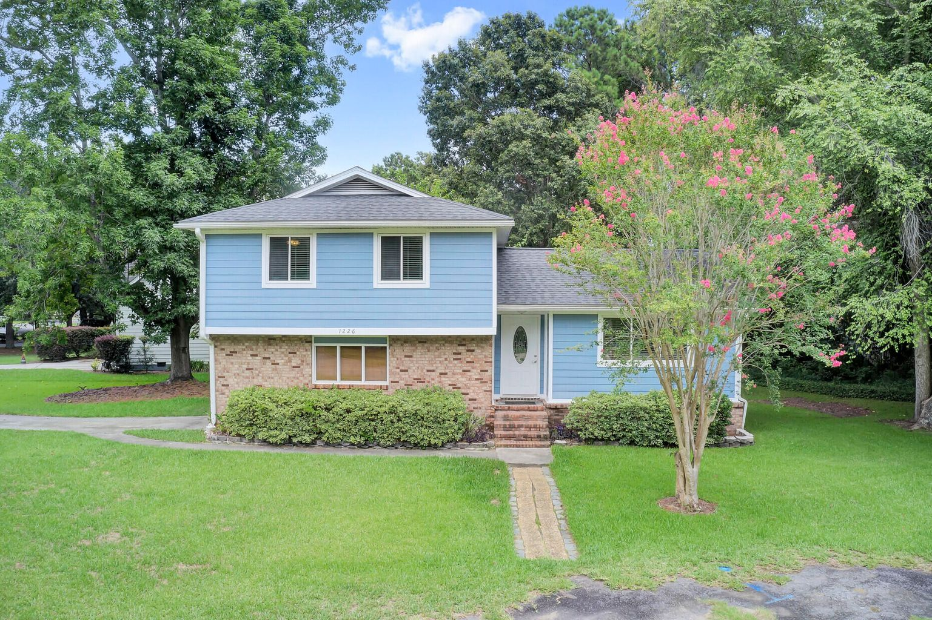

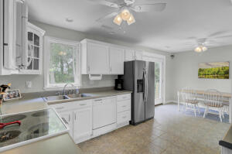
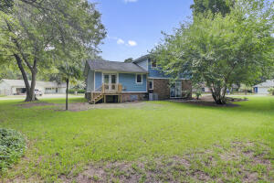
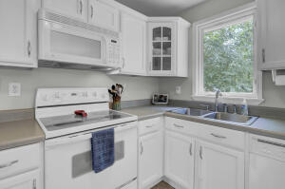
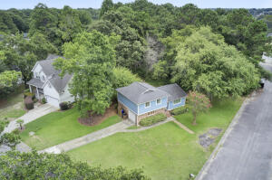


New Listing on James Island and Open House Open House Saturday 12-3
1226 Chuka Court
Quail Run
Charleston, SC 29412
MLS# 22019148 | $440,000
This is a GEM of a home in the HEART of James Island! Just 10 min. to Folly and 15 min. to Historic Downtown Charleston the location can’t be beat! This 3 Bedroom 2 Bath home is ideal for someone who wants to live in a community with mature trees, a large yard, and NO HOA!
Recent upgrades include fresh paint throughout the entire interior, the removal of all popcorn ceilings, new carpet in the bedrooms and a kitchen refresh- cabinets were painted bright white. Move in ready and oozing with cozy comfort, this home is a great find at a great price!
3D Matterport Tour | Video Tour
Ellen O'Neil
Broker/Owner, ABR, e-PRO, CNE
Charleston Realtor of Distinction
(843) 300-8530
www.EllenONeilProperties.com

