Slide 1
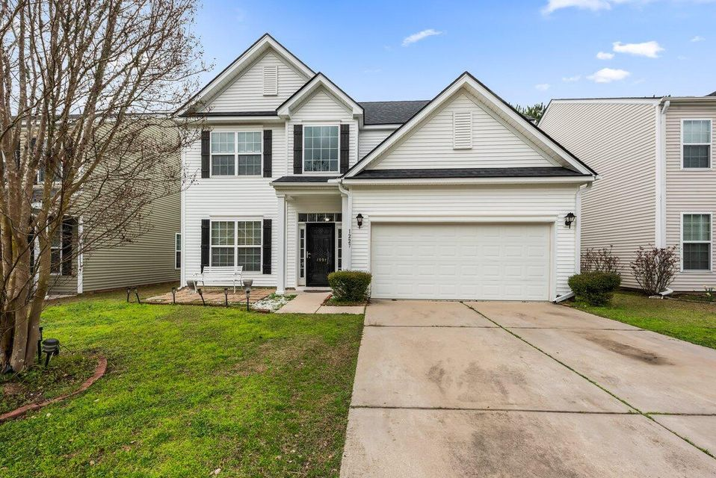
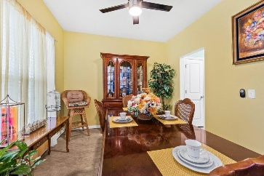
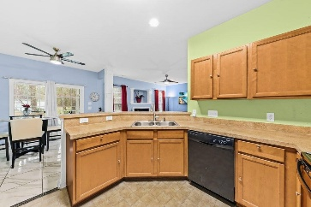
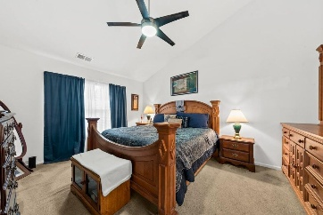
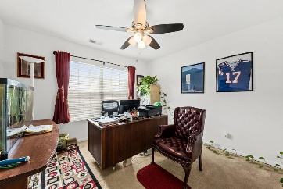

Price Reduced - Seller is Motivated!!
1227 Cosmos Road
Myers Mill · Summerville, SC 29483 · MLS# 25004568 · $388,000
Welcome to this exquisite home located in the highly sought-after Myers Mill neighborhood, which is located in the highly sought after Dorchester 2 School District. This 5-bedroom home is located on a quiet cul-de-sac. The open concept living space features a cozy fireplace in the spacious living room, ideal for gatherings. The bedroom downstairs can be used as a flex space for an office, workout room, home school, etc. The kitchen has an eat in area, plenty of storage, maple cabinetry, and pantry. The formal dining room opens to the foyer and kitchen. The large master suite has vaulted ceiling and a large master bath on the second floor along with 3 other bedrooms. There is a two-car garage with opener. The home has a neighborhood pool, making it easy to enjoy the community's amenities.
Cornelius Shepherd
843-530-6798
cornelius@ergroupofsc.com
The Elite Realty Group of SC, LLC
8310-A Rivers Ave
North Charleston, SC 29406

